Slide 1
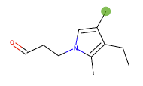
Bidisha Samanta, Abir De, Gourhari Jana, Pratim Kumar Chattaraj, Niloy Ganguly, Manuel Gomez-Rodriguez
^{IIT Kharagpur, MPI-SWS}
^{AAAI’19}
Designing Random Graph Models using Variational Autoencoders…
…with Applications to
Molecule Design

Slide 2
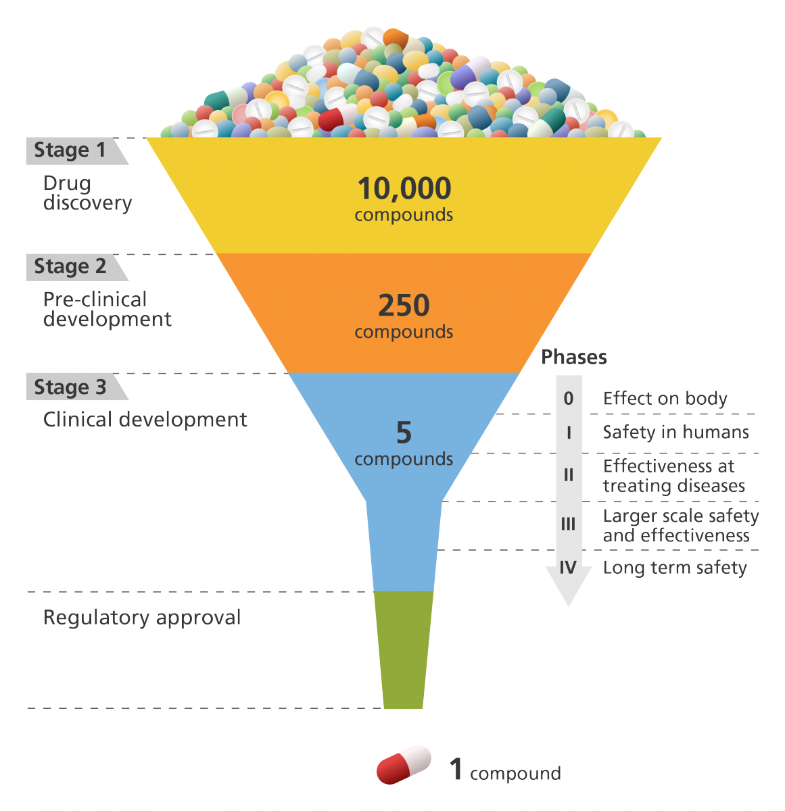
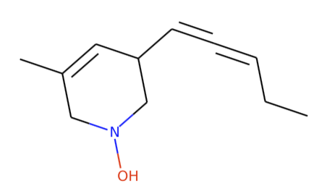
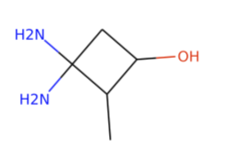
Discovering new, plausible drug-like molecules
Need to discover sizeable numbers
of candidate drug-like molecules
Low rate of new
therapeutic discovery
Image credit: Genome Research Limited

Slide 3
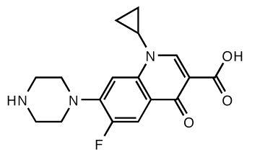
Generative models for molecule design
In recent years, flurry of work on deep generative models for automatic molecule design.
Text-based approaches [Dai et al. ‘18; Kusner et al., ‘17; Gomez-Bombarelli et al., ‘16]
Represent molecules using SMILES strings and then use deep generative models for text
SMILES string
Graph-based approaches [Simonovsky & Komodakis, ‘18; Jin et al. ’18; Liu et al., ‘18]
Represent molecules using molecular graphs and then need to develop deep generative models for molecular graphs
Molecular graph

Slide 4
Limitations of current models
Text-based approaches [Dai et al. ‘18; Kusner et al., ‘17; Gomez-Bombarelli et al., ‘16]
SMILES strings do not capture structural
similarity between molecules
Lack of diversity and validity on the
generated molecules
A single molecule can have multiple
SMILES representations
Graph-based approaches [Simonovsky & Komodakis, ‘18; Jin et al. ’18; Liu et al., ‘18]
Can only generate (and be trained on) molecules with the same number of atoms
Lack of diversity on the
generated molecules
Not invariant to permutation of node labels
Generate molecular graphs by combining a small set of graphlets

Slide 5
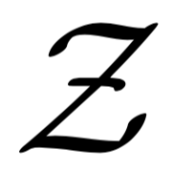



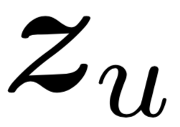
NeVAE: A variational autoencoder for graphs
Probabilistic encoder
Probabilistic decoder
Latent embedding
Key innovations:
Encoder: Aggregator functions from representation learning learned using variational inference
Permutation invariant
Variable size graphs
Decoder: It guarantees structural & functional properties using masking
High validity

Slide 6
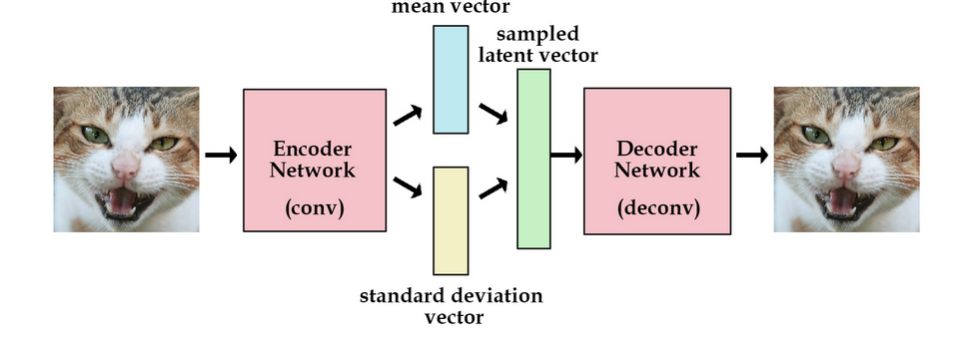
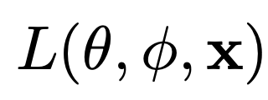
Background on Variational Autoencoder
Approximate posterior
Prior
Generation distribution

Slide 7

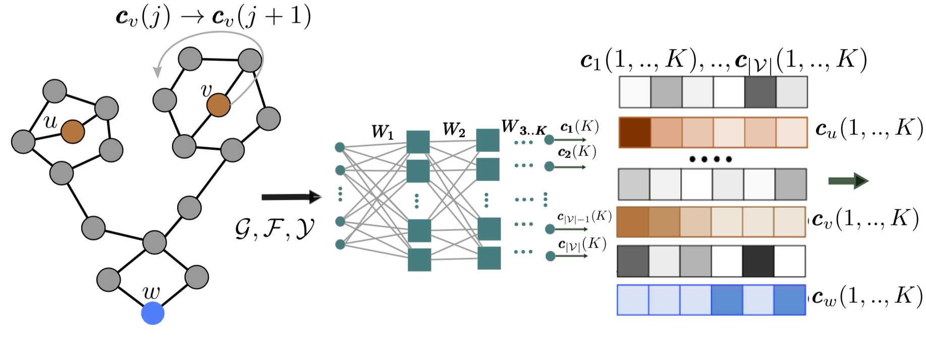
The probabilistic encoder
1. Compute node embeddings using (symmetric) aggregator functions:
C_{w}(1)
3
2
1
C₁(1),
C₂(1)
C₁(2),
C₂(2)
one hop encoding
two hop encoding

Slide 8
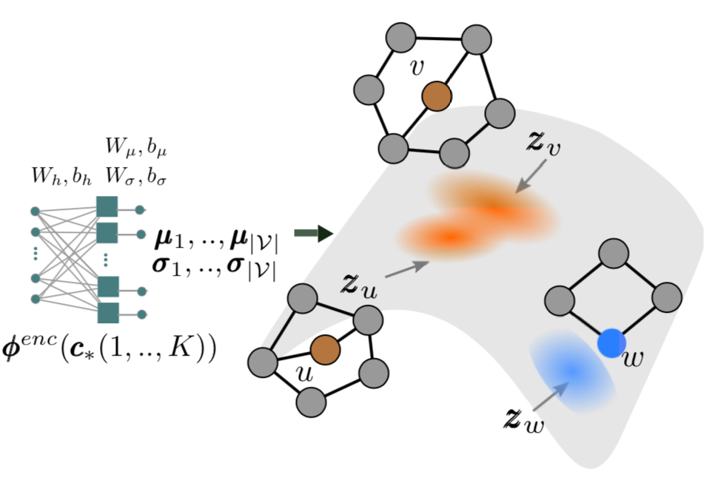
The probabilistic encoder
2. Compute latent variable distributions from node
embeddings:

Slide 9
Encoder has desirable properties
Permutation equivariance:
If we permute the node labels, their
embeddings c_{u}(k) get permuted in the same manner
u
w
v
v
w
u
c_{u} = x
c_{u} = z
c_{v} = y
c_{v} = y
c_{w} = z
c_{w} = x
Size independent:
The weight matrices W₁, …, W_{k} do not depend
on the number of nodes or edges
Notes:
Why

Slide 10
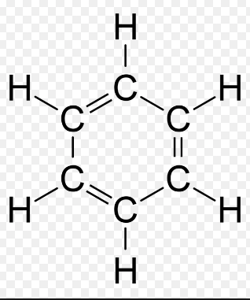
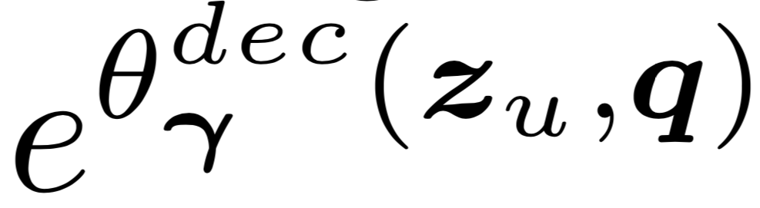
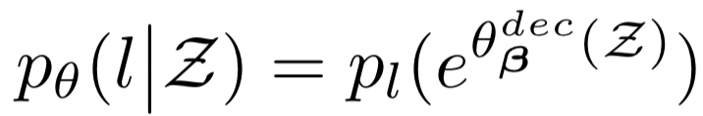
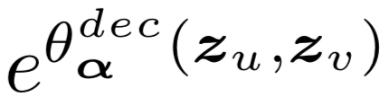

The probabilistic decoder (Block Diagram)
Node feature decoder
Edge number decoder
Edge decoder
Edge type decoder

Slide 11
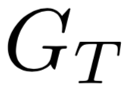
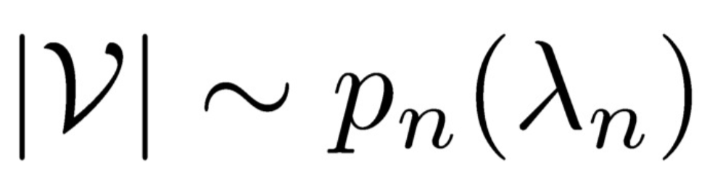
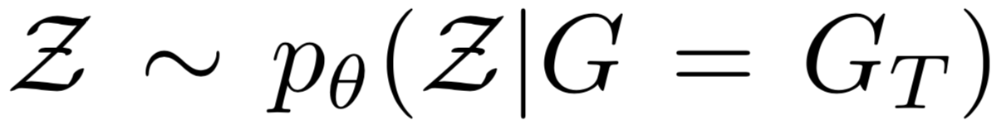
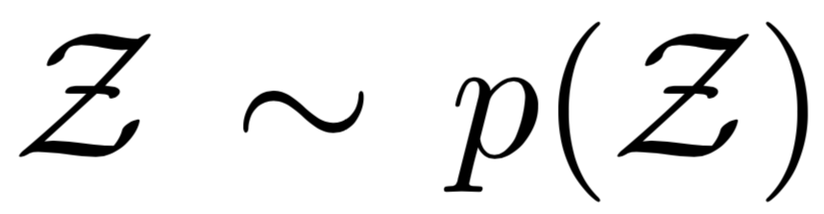
The probabilistic decoder
1. Latent variables:
Conditional
Unconditional

Slide 12
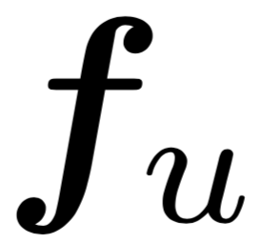

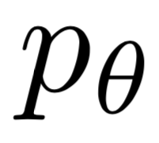
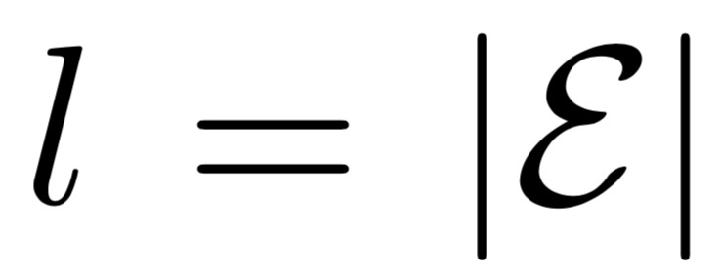
The probabilistic decoder
2. Node features decoder:
3. Edge number decoder
…
Softmax
Node feature decoder
Edge number decoder
Edge decoder
Edge type decoder

Slide 13
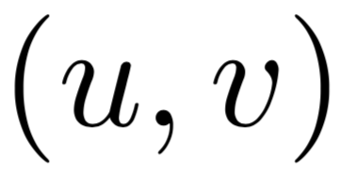





The probabilistic decoder
4. Edge decoder
…
Softmax
Already the legal connections are known
We extend negative sampling from the NLP literature to graphs:
Training time goes from to
Costly Training Time
As each node pair needs to be considered.

Slide 14
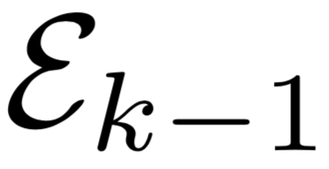
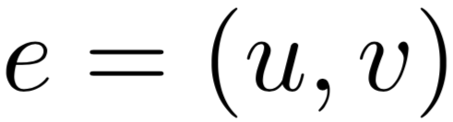
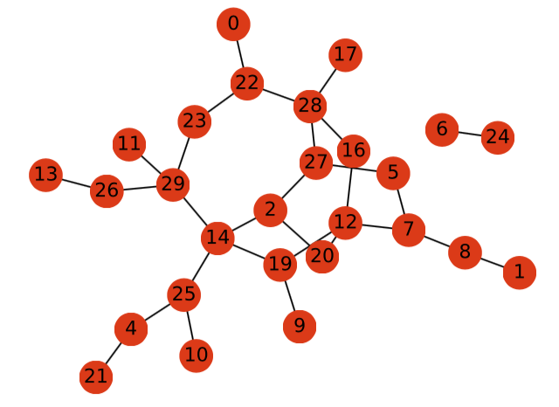
Decoder guarantees structural properties
Example (triangle free graph):
Given k-1 generated
edges
Update mask for each potential edge
Sample k-th edge
from multinomial
…
…
…
Disabled
potential edge
e = (20, 7)
Edge with
zero probability
It would create a triangle
if generated

Slide 15


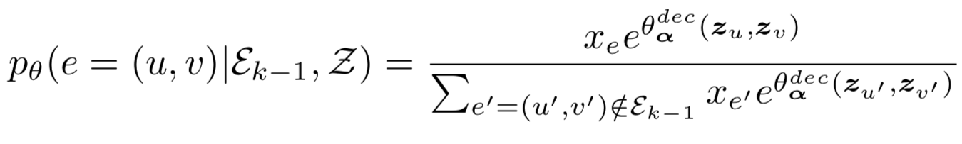
The probabilistic decoder
5. Edge feature decoder
Node feature decoder
Edge number decoder
…
Edge decoder
Softmax
Edge type decoder
Edge partition function

Slide 16
The probabilistic decoder (Permutation Invariant)
Node feature decoder
Edge number decoder
Edge decoder
Edge type decoder

Slide 17
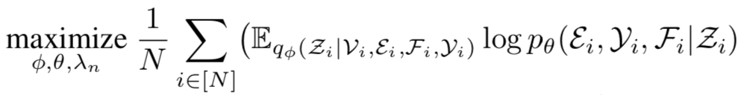

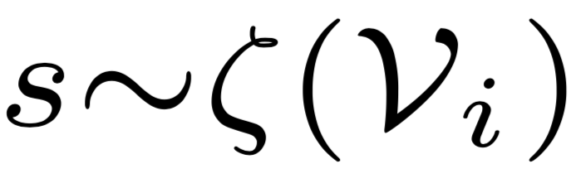
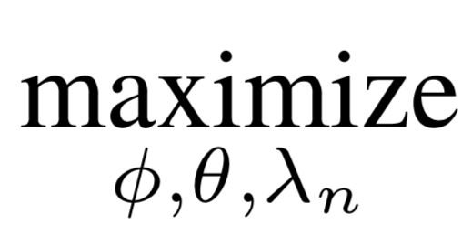
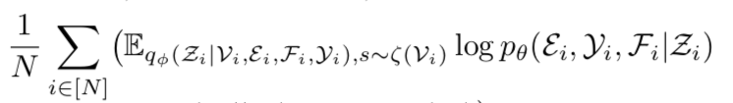
Training is permutation invariant
VAEs are typically trained by maximizing the ELBO using SGD:
How do we come up with a permutation invariant
ordering on the edges in each graph?
Breadth-first-search (BFS)
+
Sample source node
Source randomization
NeVAE is trained by maximizing a lower bound on ELBO
Notes:
Evidence Lower Bound

Slide 18
Experimental setup
We sample 10,000 molecules from two datasets
of drug-like molecules:
ZINC dataset [Irwin et al., 2012]
QM9 dataset [Ramakrishnan et al., 2014]
For each molecule in each dataset, we construct a molecular graph, where:
nodes ⟹ atoms
node features ⟹ {C, H, N, O}
edges ⟹ bonds
edge weights ⟹ {single, double, triple} bonds
For each dataset, we train two different models

Slide 19
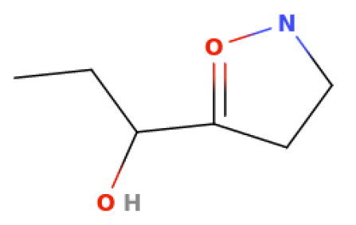
Quantitative evaluation metrics
Validity:
% of chemically valid molecules
✓
✓
✓
✕
Validity = 75%
Novelty: % of chemically valid molecules ∉ training dataset
✓
✓
✓
✕
Novelty = 33%
∈ training
∈ training
∉ training
Uniqueness: % of unique and chemically valid molecules
✓
✓
✓
✕
Uniqueness = 50%
Notes:
Using RDKit

Slide 20
Competing methods
GraphVAE [Simonovsky & Komodakis, Arxiv 2018]
JTVAE [Jin, Barzilay & Jaakkola, ICML 2018]
Graph-based
CGVAE [Liu et al., Arxiv 2018]
NeVAE* [our model without masking]
GrammarVAE [Kusner et al., ICML 2017]
Text-based
CVAE [Gomez-Bombarelli et al., ACS Central Science 2018]
SDVAE [Dai et al., ICLR 2018]

Slide 21
Validity of the discovered molecules
Dataset
ZINC
QM9
NeVAE
100%
99.9%
NeVAE*
59%
68.2%
GraphVAE
13.5%
45.8%
Graph-based
JTVAE
100%
99.7%
CGVAE
100%
100%
Underwhelming
GrammarVAE
44%
20%
Text-based
CVAE
2.1%
3.1%
SDVAE
43.2%
-

Slide 22
Novelty of the discovered molecules
Dataset
ZINC
QM9
NeVAE
100%
100%
Comparable
NeVAE*
100%
100%
GraphVAE
-
66.1%
Graph-based
JTVAE
99.9%
100%
CGVAE
100%
94.3%
GrammarVAE
100%
100%
Text-based
CVAE
98%
90.2%
SDVAE
100%
-

Slide 23
Uniqueness of the discovered molecules
Dataset
ZINC
QM9
NeVAE
99.9%
99.8%
NeVAE*
58.8%
67.6%
GraphVAE
-
30.5%
Comparable
Graph-based
JTVAE
99.1%
37.1%
CGVAE
99.8%
98.6%
GrammarVAE
27.3%
19.7%
Text-based
CVAE
2.1%
3.1%
SDVAE
100%
-

Slide 24
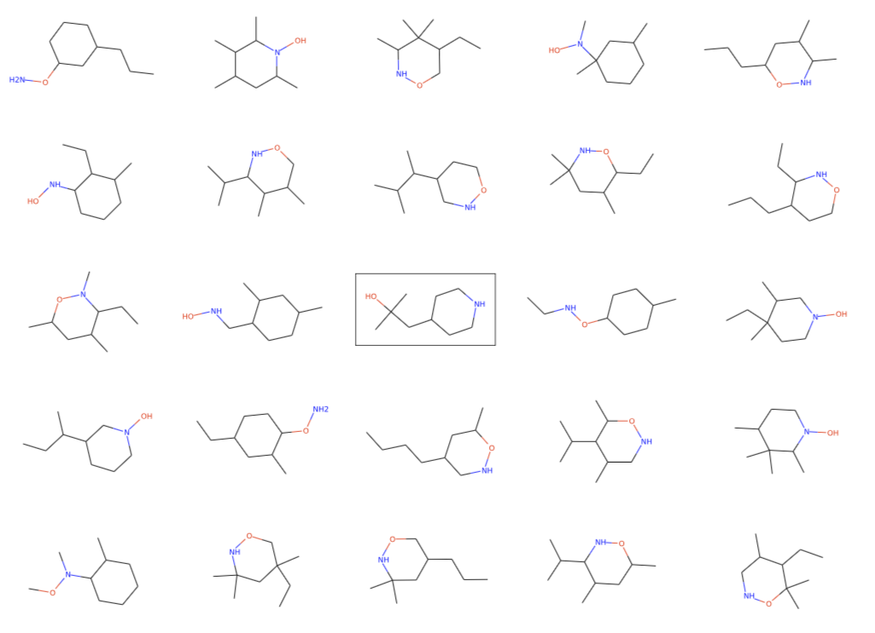
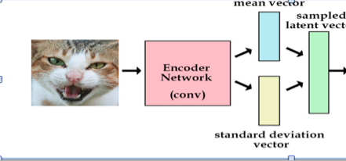

Smooth, meaningful space of molecules
Samples from [ZINC dataset]

Slide 25
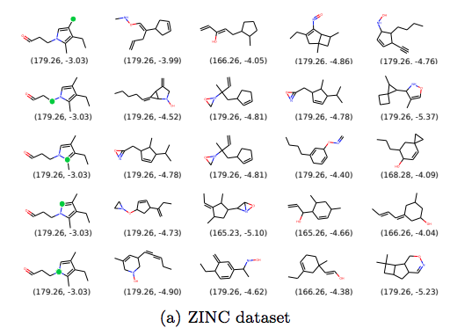
Interpolation on latent space
molecular weight and synthetic accessibility score are reported under every molecule

Slide 26
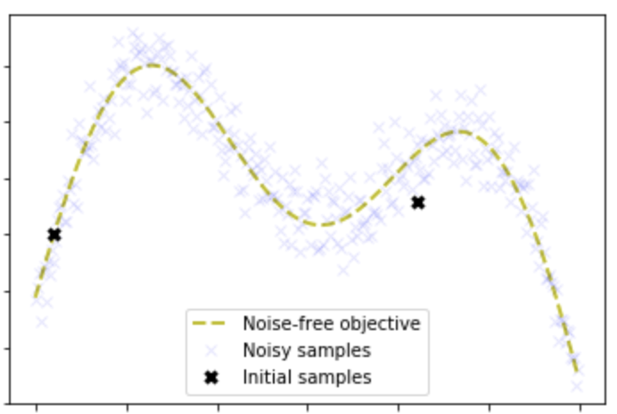
Predicting & optimizing for molecule properties
Drug design aims to
identify sizeable numbers of candidate molecules
with desirable properties
previous literature
Desirability score = log P + Synthetic Accesibility + # long cycles
Notes:
logP - Octanol partition coefficient

Slide 27
Predicting & optimizing for molecule properties
Drug design aims to
identify sizeable numbers of candidate molecules
with desirable properties
previous literature
Desirability score = log P + Synthetic Accesibility + # long cycles
We use graph embeddings from each model to:
Predict scores (Sparse GP)
Optimize for scores (Bayesian optimization)
We used rdKit to measure the property values
Notes:
logP – Octanal-water partition coefficient

Slide 28
Property prediction (Sparse Gaussian Process)
Objective
NeVAE
GrammarVAE
CVAE
JTVAE
LL
-1.45
-1.75
-2.29
-1.54
RMSE
1.23
1.38
1.80
1.25
NeVAE beats state of the art both in terms of
log-likelihood (LL) and root mean squared error (RMSE)

Slide 29
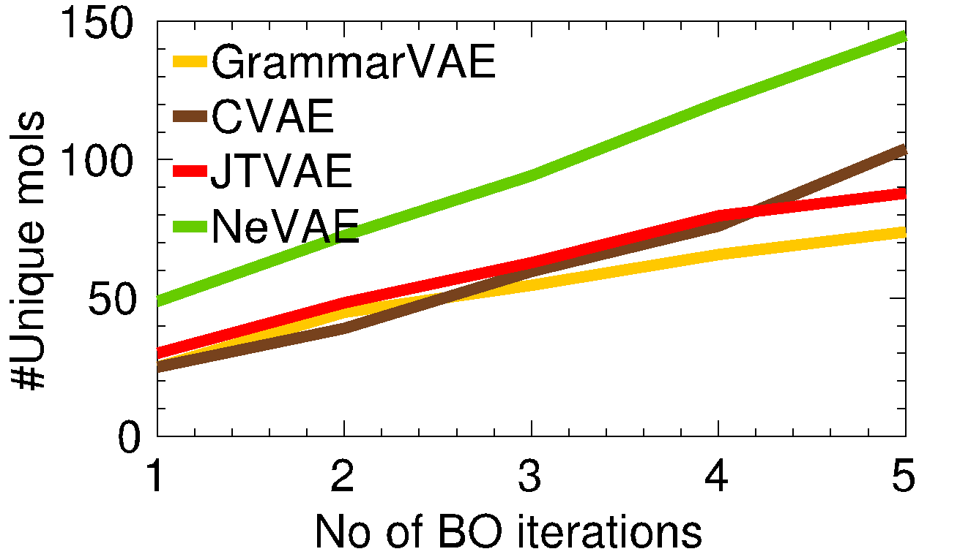
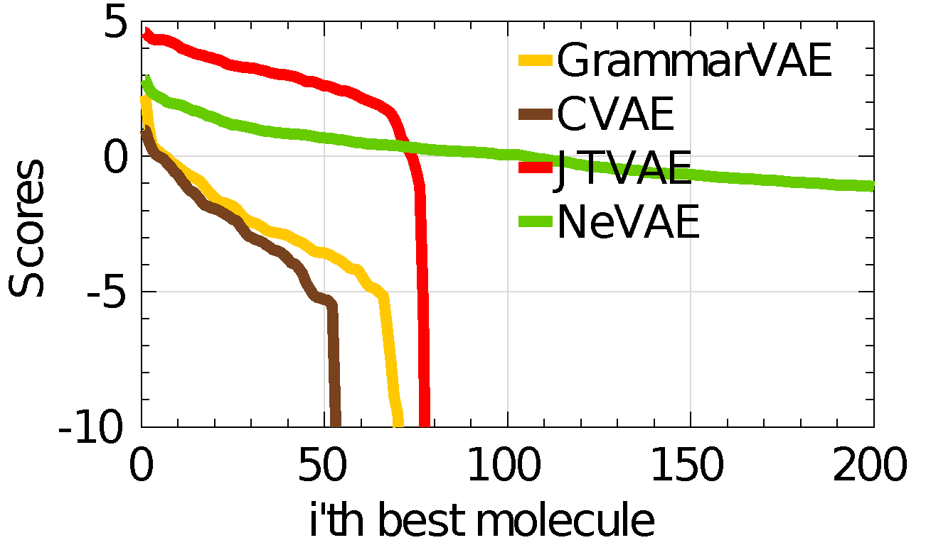
Property maximization (Bayesian Optimization)
1.4x
More molecules with high values
NeVAE finds higher number
of unique molecules per BO iteration
1. JTVAE finds a few molecules with higher score
2. NeVAE finds more molecules with high score values

Slide 30
Limitation
Generated 2-d structures, however molecules are in 3-d

Slide 31
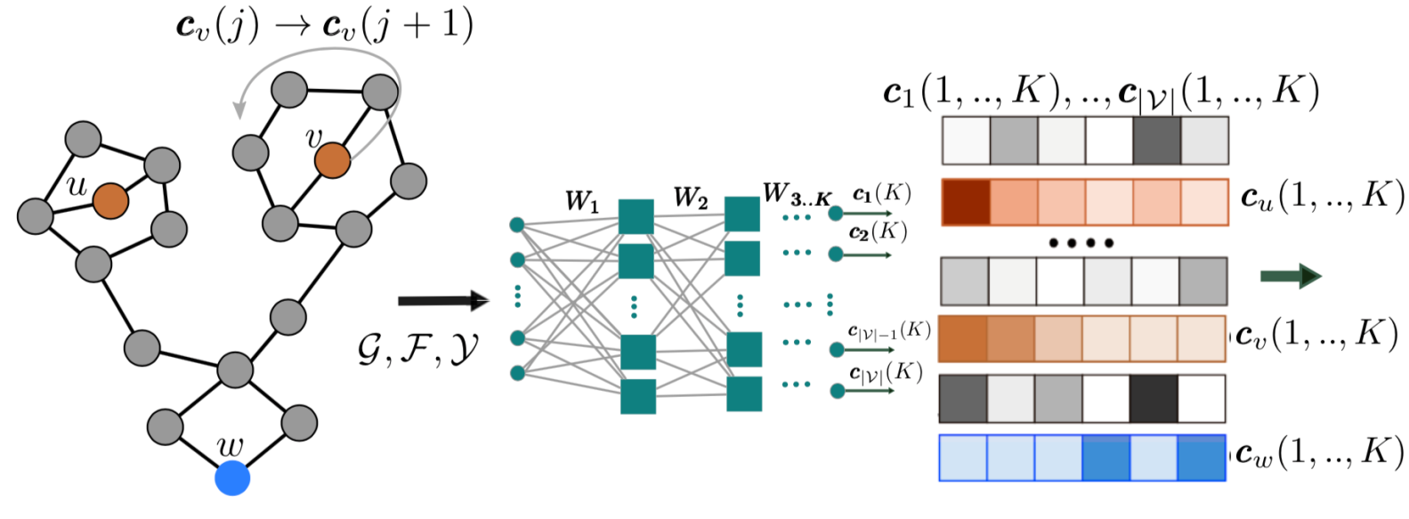
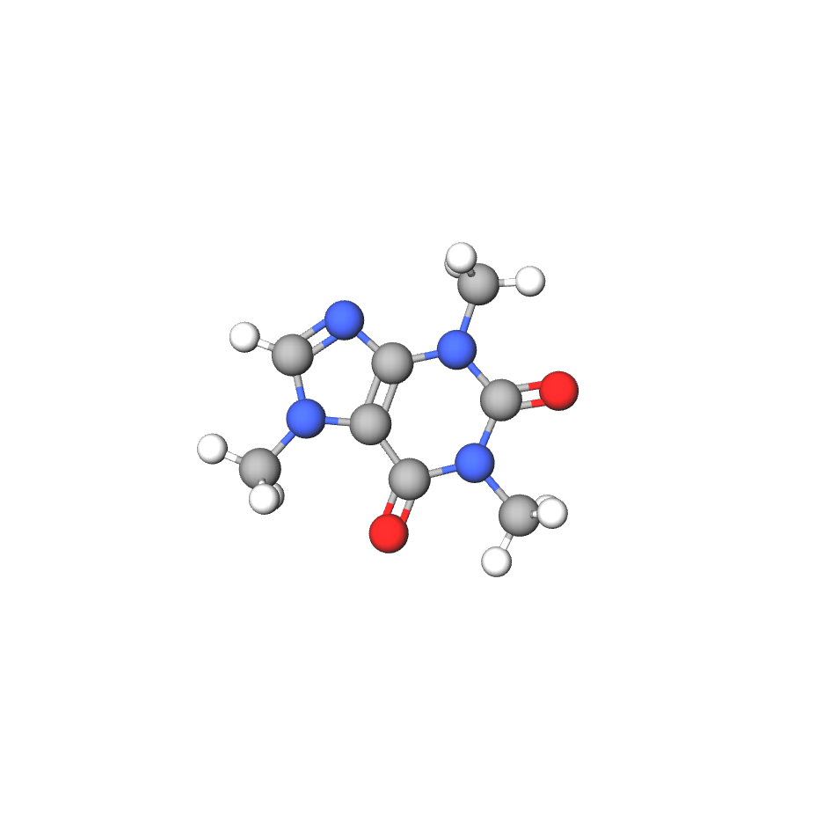




The probabilistic encoder
1. Compute node embeddings using (symmetric) aggregator functions:
-3.1371, -0.4436, -0.0003

Slide 32

The probabilistic encoder
2. Compute latent variable
distributions from node
embeddings (Similar to the previous model):
u
v

Slide 33














The probabilistic decoder
1. Latent variables:
2. Node features (Labels):
…
Conditional
Unconditional
Softmax
3. Number of edges, edges & edge features:
…
…
Softmax
Softmax

Slide 34



The probabilistic decoder
Generated graph
mean, covariance
matrix
4. Node features (Coordinates):
neural network
5. Post processing:
Feed the structure to Gaussian software to generate stable structure i.e. structure whose energy is minimum

Slide 35
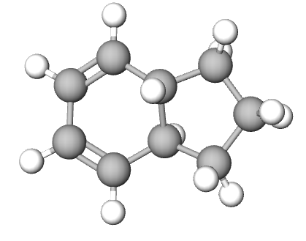
The property oriented decoder
Probabilistic encoder
Probabilistic decoder
Latent embedding
Property-oriented decoder
better property
value

Slide 36



The property oriented decoder (KL control)
Cost function
control parameter
loss function penalizes low values of the molecular property values of interest
penalizes property-oriented decoders whose generated molecules differ more from those that the original decoder

Slide 37
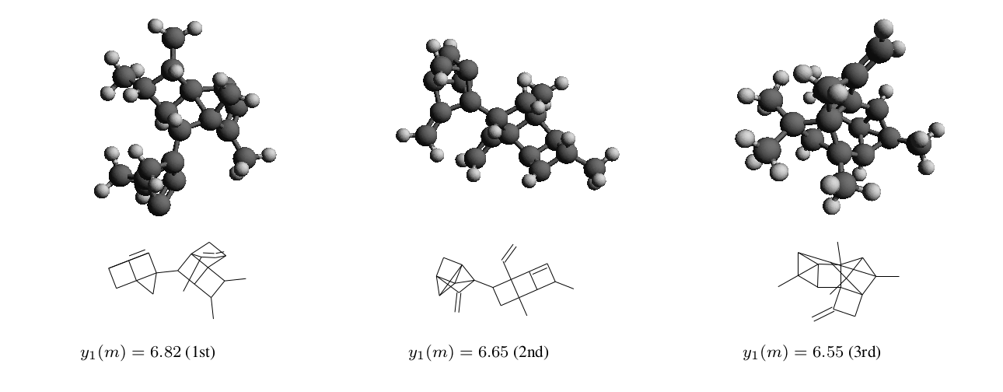
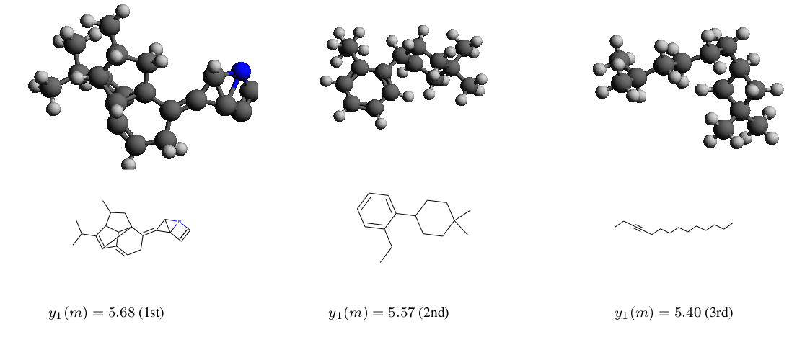
Effect of temperature parameter
= 0.0001
= 0.01
More Similar to the training data

Slide 38
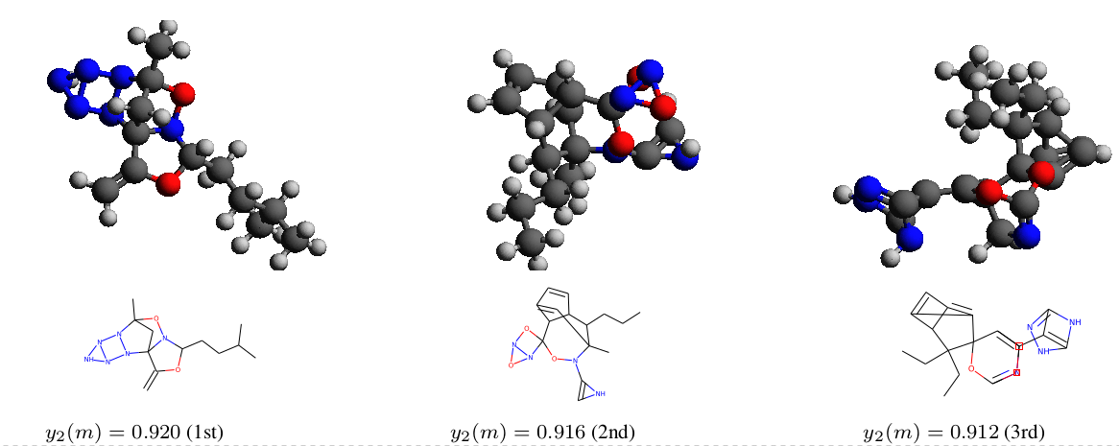
Best three molecules QED
Notes:
QED = quantitative estimation of drug-likeness

Slide 39
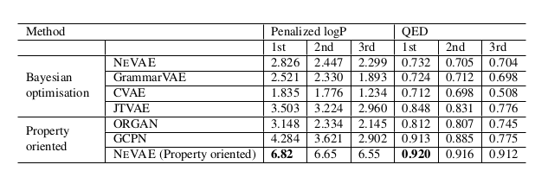
Property scores for first three molecules

Slide 40
Conclusions
We have introduced a variational autoencoder (VAE) for molecular graphs which, thanks to several technical innovations, beats the state of the art.
There are many interesting questions for future work:
1. Generative models of dynamic graphs would allow to simulate chemical synthesis
2. Generative model which learns to provide candidate molecules with desirable properties
3. Other applications for generative models of graphs

Slide 41
Thanks!
preprint at
https://arxiv.org/abs/1802.05283.pdf
code at
https://github.com/Networks-Learning/nevae

Slide 42
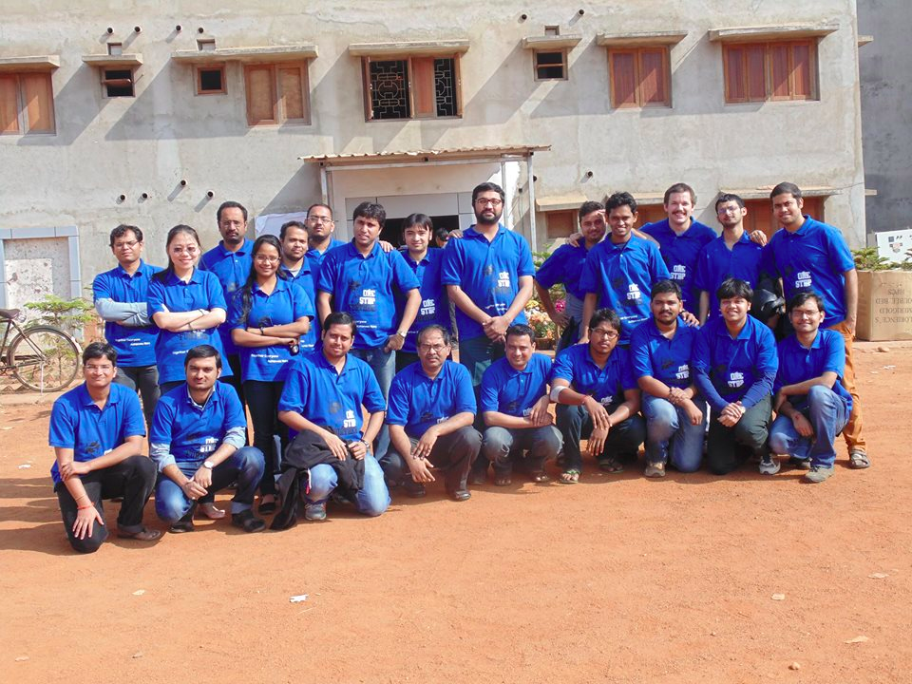
Thank you!
Follow the work of Complex Network Research Group (CNeRG), IIT KGP at:
Web: http://www.cnerg.org
Facebook: https://web.facebook.com/iitkgpcnerg
Twitter: https://www.twitter.com/cnerg

Slide 43

Training is efficient
Bottleneck due to…
Edge partition function
We extend negative sampling [Mikolov et al., 2013]
from the NLP literature to graphs:
We go down from to
Note that, in sparse graphs:

Slide 44
C_{w}(1)
3
2
1
C₁(1),
C₂(1)
C₁(2),
C₂(2)
one hop encoding
two hop encoding

Slide 45
We extend negative sampling [Mikolov et al., 2013]
from the NLP literature to graphs:
We go down from to

