Slide 1
Routing Algorithms Prof. Niloy Ganguly IIT Kharagpur

Slide 2
Broad Topics
The Network Layer
Design Issues in the Network Layer
Routing Algorithms
Network Layer in the Internet

Slide 3
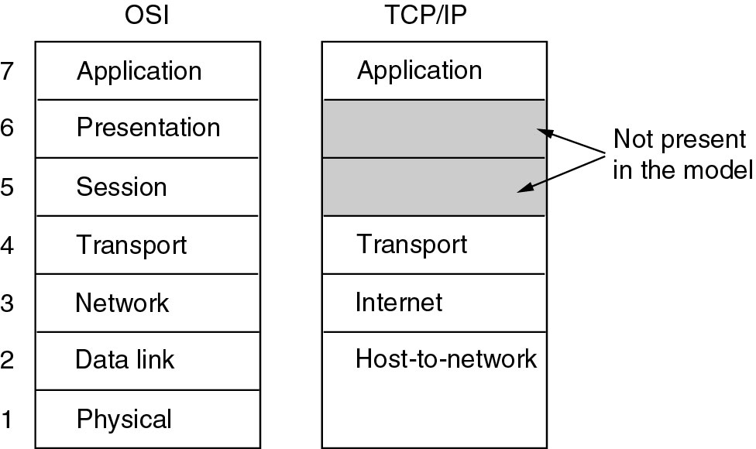
Reference Models

Slide 4
Protocols
Network Layer in the OSI model
Protocol: IP

Slide 5
The Network Layer
Concerned with getting packets from source to destination
May include multiple hops at intermediate routers
Lowest layer dealing with end-to-end transmission
Knowledge of network topology essential
Establishing connection between different networks

Slide 6
Network Layer Design Issues
Store-and-Forward Packet Switching
Services Provided to the Transport Layer
Implementation of Connectionless Service
Implementation of Connection-Oriented Service
Comparison of Virtual-Circuit and Datagram Networks

Slide 7
Store-and-Forward Packet Switching
Fig: The environment of the network layer protocols
Host sends packet to nearest router
Packet stored there until it has fully arrived, then forwarded to next router

Slide 8
Services Provided to the Transport Layer
Services independent of router technology
Transport layer should be shielded from the number, type and topology of routers
Network addresses made available to transport layer should use a uniform numbering plan, even across LANs and WANs
Debate regarding design of the network layer:
Internet Camp – Connectionless, e.g., IP
Telephone Companies – Connection-oriented, e.g., ATM

Slide 9
Implementation of Connectionless Service
Fig: Routing within a datagram network
Routing Algorithm – Algorithm that manages the tables and makes the routing decisions

Slide 10
Implementation of Connection-Oriented Service
Fig: Routing within a virtual-circuit subnet
Label switching, e.g., MPLS (Multi Protocol Label Switching - with IP packets wrapped in an
MPLS header having a 20-bit connection identifier or label.)

Slide 11
Comparison of Virtual-Circuit and Datagram Subnets

Slide 12
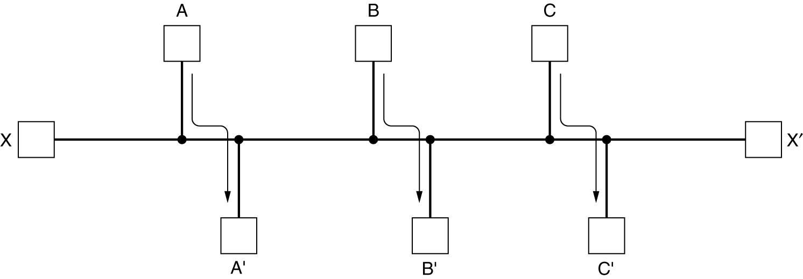
Fairness vs. Optimality
Conflict between fairness and optimality.
A – A’, B – B’, C – C’, can fill the channel, then X-X’ doesn’t get a chance

Slide 13
Types of Routing Algorithms
Non-adaptive (static)
Do not use measurements of current conditions
Static routes are downloaded at boot time
Adaptive Algorithms
Change routes dynamically
Gather information at runtime
locally
from adjacent routers
from all other routers
Change routes
Every delta T seconds
When load changes
When topology changes

Slide 14
Routing Algorithms
The Optimality Principle
Shortest Path Algorithm
Flooding
Distance Vector Routing
Link State Routing
Hierarchical Routing
Broadcast Routing
Multicast Routing
Anycast Routing
Routing for Mobile Hosts
Routing in Ad Hoc Networks

Slide 15
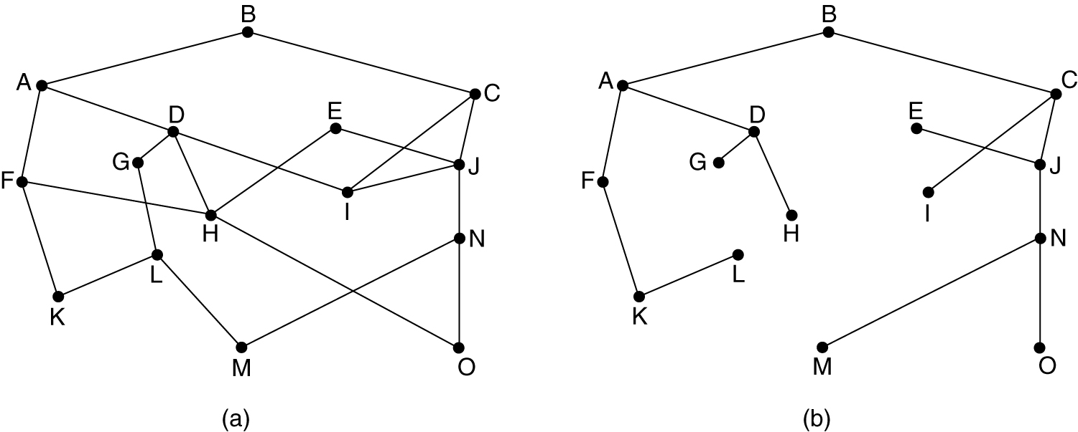
The Optimality Principle
Optimality Principle – If router J is on the optimal path from router I to router K, then the optimal path from J to K also falls along the same route.
(a) A network. (b) A sink tree for router B.

Slide 16
Shortest Path Algorithm
The first 5 steps used in computing the shortest path from A to D. The arrows indicate the working node. [Dijkstra’s Algorithm]

Slide 17
Flooding
Flooding – every incoming packet is sent out on every outgoing line except the one it arrived on.
Robust but expensive
Finds use in:
Military application
Wireless Networks
Distributed Database
Metric against which other routing algorithms can be compared

Slide 18
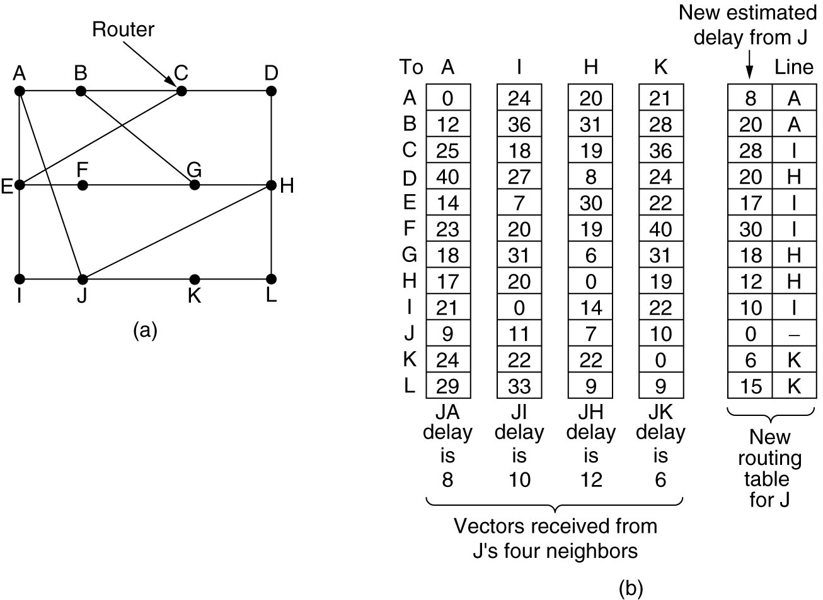
Distance Vector Routing
(a) A network. (b) Input from A, I, H, K, and the new routing table for J.

Slide 19
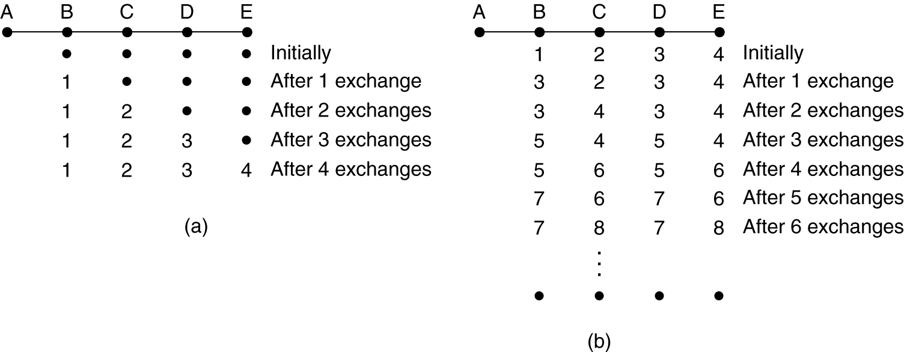
Distance Vector Routing (2)
The count-to-infinity problem.

Slide 20
Link State Routing
Each router must do the following:
Discover its neighbors, learn their network address.
Set the distance or cost metric to each of its neighbors.
Construct a packet telling all it has just learned.
Send this packet to all other routers.
Compute the shortest path to every other router.

Slide 21
Setting Link Costs
Bandwidth
Delay – measured by sending special ECHO packet

Slide 22
Building Link State Packets
(a) A network. (b) The link state packets for this network.

Slide 23
Basic Algorithm
Use flooding to distribute the link state packets to all routers.
To keep the flood in check, each packet contains a sequence number that is incremented for each new packet sent
Routers keep track of all the (source router, sequence) pairs they see.
When a new link state packet comes in, it is checked against the list of packets already seen.
If it is new, it is forwarded on all lines except the one it arrived on.
If it is a duplicate, it is discarded.
If a packet with a sequence number lower than the highest one seen so far ever arrives, it is rejected as being obsolete as the router has more recent data.

Slide 24
Few Problems
Algorithm – Sequence number less means obsolete
If sequence numbers wrap around, confusion will reign
Router crashes, sequence number is lost
Sequence number gets corrupted
Aging and then dropping the packet.
When a link-state packet comes in to router, it is not queued immediately, rather it waits to see if any other packets arrive.

Slide 25
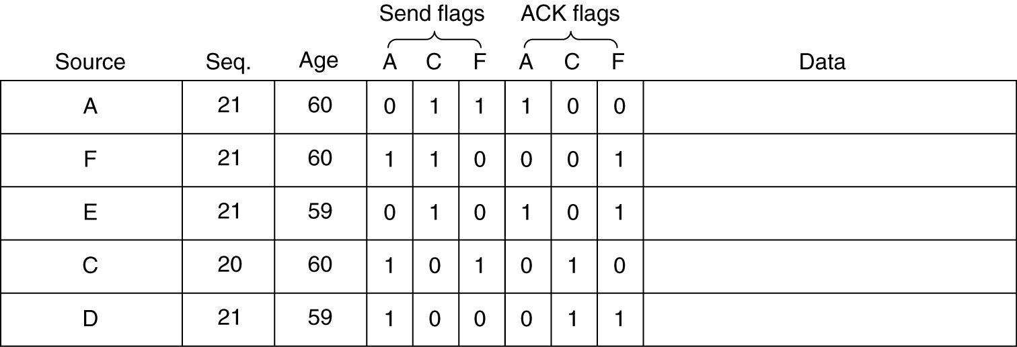
Distributing the Link State Packets
The packet buffer for router B in the previous slide.
E has arrived twice.
C’s copy arrives from F, then F will be ACK not sent.

Slide 26
Example Protocols
Example protocols for Link State Routing:
IS-IS (Intermediate System – Intermediate System)
OSPF (Open Shortest Path First)
Important Difference:
IS-IS can carry information about multiple network layer protocols at the same time (e.g., IP, IPX, and AppleTalk), but not OSPF

Slide 27
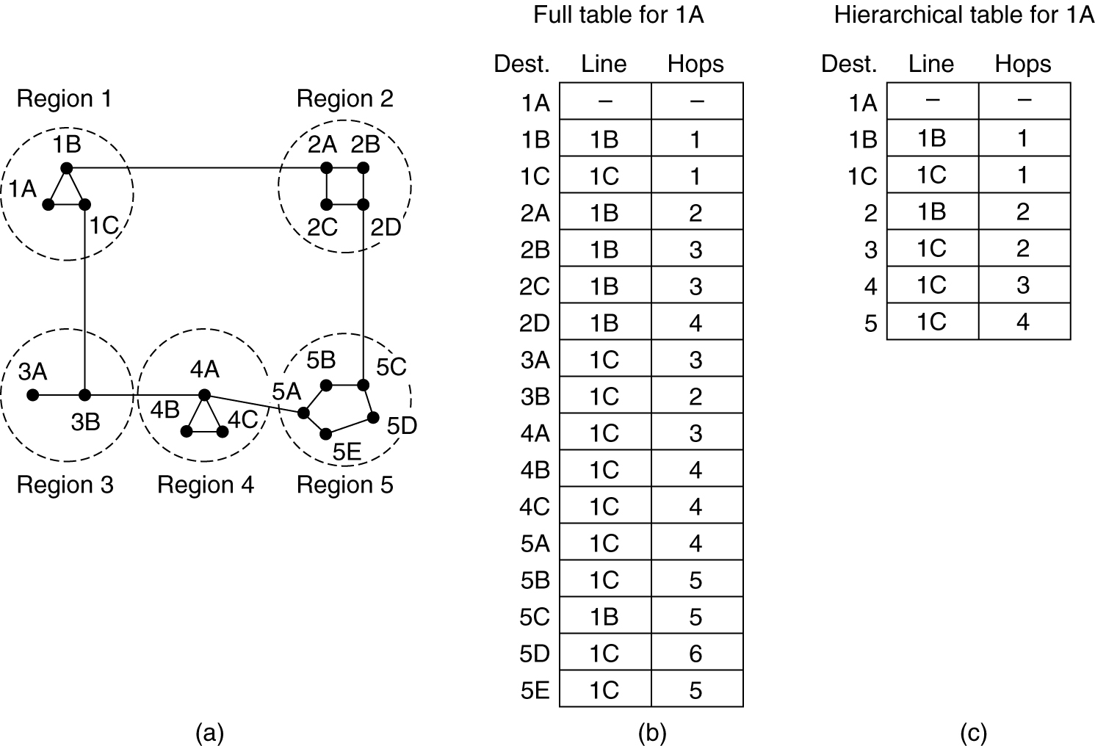
Hierarchical Routing
Hierarchical routing.
Problems – optimal paths are sacrificed

Slide 28
Hierarchical Routing (2)
How many levels of hierarchy?
Example:
720 routers.
720 routers in 24 regions.
Three levels of hierarchy – 8 clusters each containing 9 regions of 10 clusters.

Slide 29
Broadcast Routing
Multidimensional Routing
Each packet contains a list of destinations.
On arrival of a packet, router checks the set of destinations, and sends copies of packet along outgoing links to those destinations.
Flooding
Flood with a sequence number per source.
Spanning Tree
Build spanning tree (such as, a sink tree).
Forward packet along all links of spanning tree except the one from which packet is received.
Reverse Path Forwarding

Slide 30
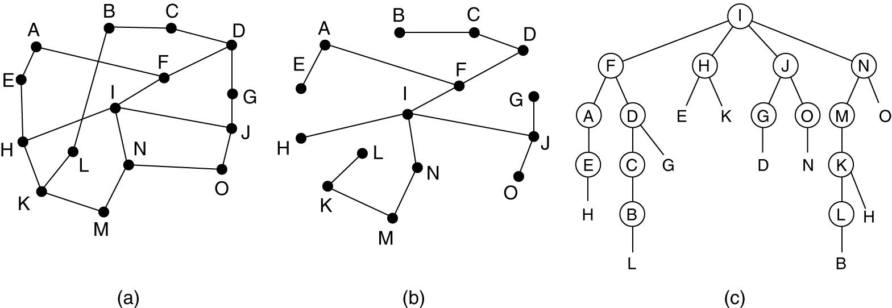
Broadcast: Reverse Path Forwarding
Broadcast.
Check if the packet has arrived following the correct hop or not.
If correct hop, then rebroadcast.
Reverse path forwarding.
(a) A network. (b) A sink tree.
(c) The tree built by reverse path forwarding.

Slide 31
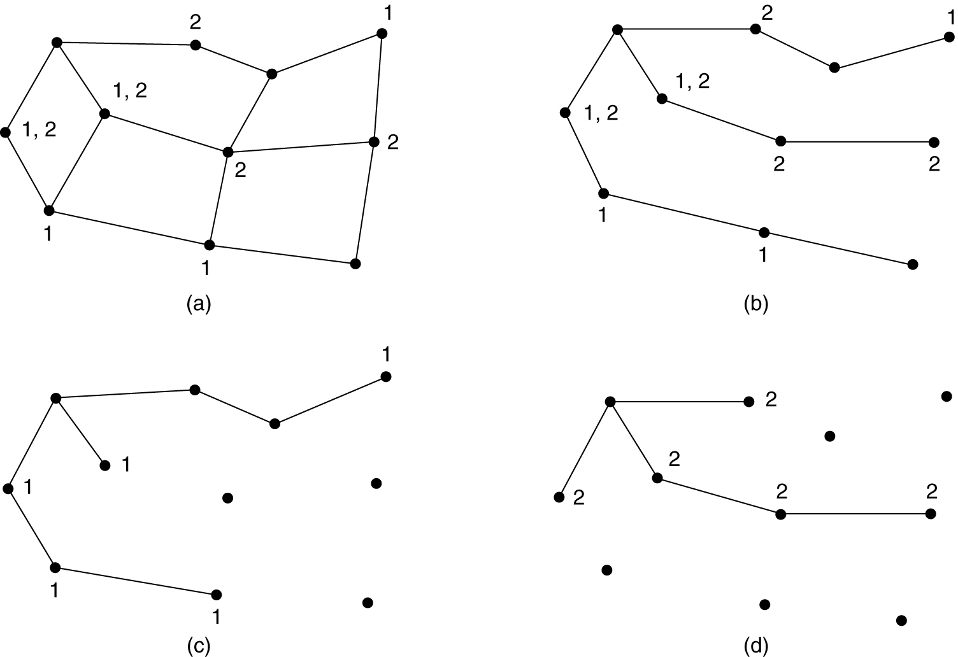
Multicast Routing
(a) A network. (b) A spanning tree for the leftmost router. (c) A multicast tree for group 1. (d) A multicast tree for group 2.
Typically done in Multi-state routing

Slide 32
Anycast Routing
A packet is delivered to the nearest member of a group, e.g., DNS
(a) Anycast routes to group 1. (b) Topology seen by the routing protocol.

Slide 33
Routing for Mobile Hosts
Packet routing for mobile hosts.

Slide 34
Node Lookup in Peer-to-Peer Networks
P2P: Large connection of computers, without central control where typically each node has some information of interest.
No central control for routing
No central data repository
Two basic questions:
How to make data at each node available?
How to find required information?
The questions are interrelated, but will be looked at separately.

Slide 35
Assumption
Each record (data to be shared) can be identified by a ASCII string such as the filename.
Over the past years, there have been several proposals for P2P architectures.
We shall look at Chord.

Slide 36
Basics of Chord
Uses a hash function such as SHA-1.
SHA-1 converts a variable length input into a highly random 160 bit value
Using SHA-1, Chord hashes:
node IP addresses node identifiers (160 bits)
names of records keys (160 bits)

Slide 37
Storing Records
(a) A set of 32 node identifiers arranged in a circle. The shaded ones correspond to actual machines. The arcs show the fingers from nodes 1, 4, and 12. The labels on the arcs are the table indices.
(b) Examples of the finger tables.

Slide 38
Storing Records (2)
successor (k) is the first real node after k.
To store data name, a node N creates a tuple (name, N's IP address) and stores the tuple at successor(hash(name)). The original data remain at N, just the tuple is stored at successor(hash(name)).
If hash(name) = 22, then the tuple is stored at node 27.
To find information name, a node does key = hash(name), then gets the record tuple from successor(key).
Simple? Mostly, except for implementing successors(key) efficiently.

Slide 39
Finding Records
Each node needs to store the IP addresses of its successor.
Initially, the network start out with just a few nodes:
All nodes know each other.
They can easily arrange themselves into a the Chord ring.
3. successor(k) can be computed.
When a node tries to join:
It calculates its node ID say p.
Then asks any node already in the ring to find successor(p).
Asks successor(p) for successor(p)'s predecessor and inserts itself between them.
Any node in the ring can find successor(k) by propagating the query around the ring starting with its successor.

Slide 40
Finger Table
Even if both successor and predecessor pointers are used, a sequential search will take time on average O(n/2) [n is the number of nodes].
Chord reduces this search time using a finger table at each node.
The finger table contains up to m entries where each entry i consists of IP address of successor(start[i])
To find a record for key k, a node can directly jump to the closest predecessor of k.
Average time can be reduced to O(log n).

Slide 41
Look Up
Looking up key 16 at node 1
Nearest pred. 9 so query sent to 12
At 12 nearest pred. of 16 is 14 so query sent to 15
15 knows that 16 is between itself and its successor so 15 send back 20's IP address to 1

Slide 42
Maintaining Finger Table
Maintaining the finger table does not come for free.
Every time a new node is added a few successors and predecessor entries will change.

Slide 43
Internetwork Routing (1)
Challenges in internetwork routing:
The networks may internally use different routing algorithms (e.g., link state routing and distance vector routing) – finding shortest path becomes tricky.
Networks run by different operators:
Different ideas about what is a good path through the network – one operator wants least delay, another least cost.
One operator may not want another operator to know details of the paths in its network.
Individual networks may not need hierarchical solutions, while the combined network (internet) is huge and requires such solutions.

Slide 44
Internetwork Routing (2)
Two-level routing algorithm:
Interior Gateway Protocol (IGP): Intra-domain routing protocol, used within individual networks.
Border Gateway Protocol (BGP): Inter-domain routing protocol, used across the networks which make up the network.
Since each network is operated independently of all the others, it is often referred to as an AS (Autonomous System).
Routes across networks determined by:
Business arrangements between ISPs.
Government laws for countries if internetwork routing requires crossing international boundaries.

Slide 45
OSPF—An Interior Gateway Routing Protocol (1)
An autonomous system

Slide 46
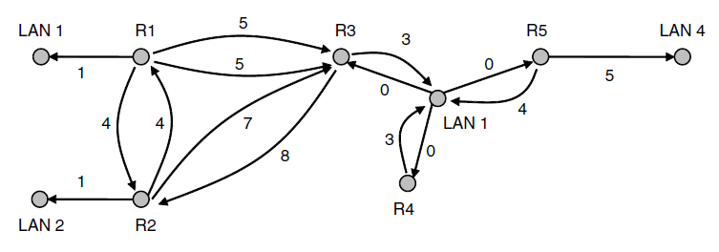
OSPF—An Interior Gateway Routing Protocol (2)
A graph representation of the previous slide.

Slide 47
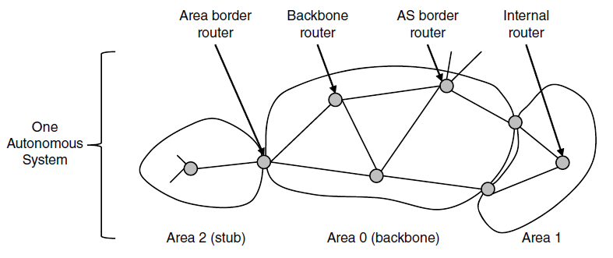
OSPF—An Interior Gateway Routing Protocol (3)
The relation between ASes, backbones, and areas in OSPF.

Slide 48
OSPF—An Interior Gateway Routing Protocol (4)
The five types of OSPF messages

Slide 49
OSPF—An Interior Gateway Routing Protocol (5)
Salient Features:
Open source
Support variety of distant metrics
Dynamic algorithm – have to adapt
Load balancing and not the best path
Hierarchical systems
Security is needed
OSPF supports connection – point-to-point/multi-access with broadcast
Notes:
What is tunnelling

Slide 50
BGP—The Exterior Gateway Routing Protocol (1)
Examples of routing constraints:
No commercial traffic for education network
Never put Iraq on route starting at Pentagon
Choose cheaper network
Choose better performing network
Don’t go from Apple to Google to Apple

Slide 51
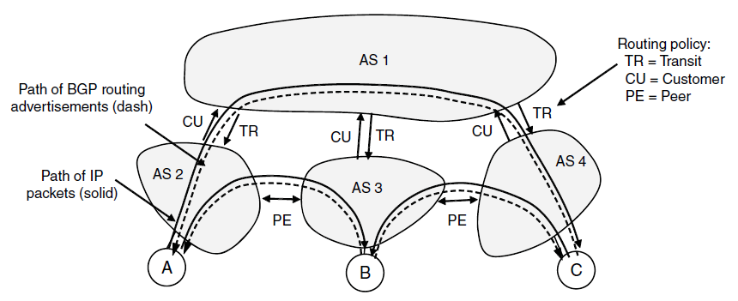
BGP—The Exterior Gateway Routing Protocol (2)
Routing policies between four Autonomous Systems

Slide 52
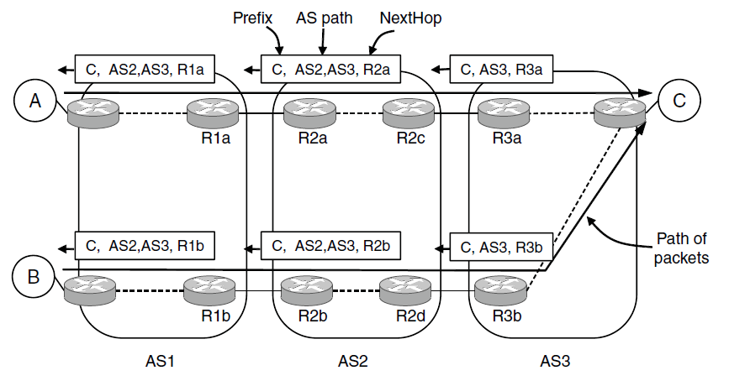
BGP—The Exterior Gateway Routing Protocol (3)
Propagation of BGP route advertisements

Slide 53
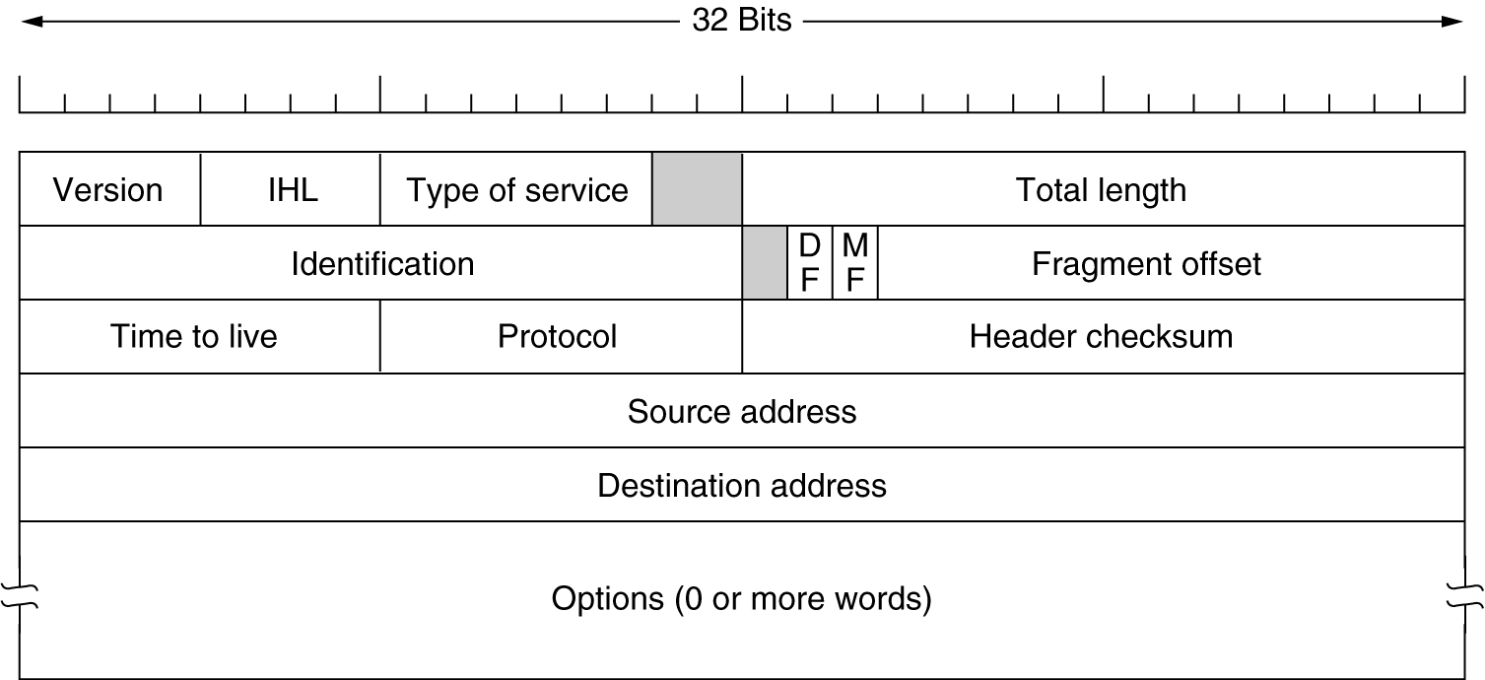
The IP Protocol
The IPv4 (Internet Protocol) header.

Slide 54
The IP Header (1)
Version – IPv4 / IPv6
IHL – how long the header is – in 32 bit word, minimum is 5, maximum is 15 (60 bytes)
Type of Service – (6 bits) – four queuing priority, three discard probabilities and the historical class

Slide 55
IHL
The Type of service field provided 3 bits to signal priority and 3 bits to signal whether a host cared more about delay, throughput, or reliability.
However, no one really knew what to do with these bits at routers, so they were left unused for many years.
When differentiated services were designed, IETF threw in the towel and reused this field.
Now, the top 6 bits are used to mark the packet with its service class - expedited and assured services.
The bottom 2 bits are used to carry explicit congestion notification information, such as whether the packet has experienced congestion;
we described explicit congestion notification as part of congestion control.

Slide 56
The IP Header (2)
Total Length – header + data, maximum is 65,535
Identification Field – fragments of a datagram have same Identification value
DF – Don’t Fragment (may mean moving through sub-optimal route, MF- More Fragments (all except the last fragment set).

Slide 57
The IP Protocol (2)
5-54
Some of the IP options.

Slide 58
IP Addresses (1)
An IP prefix.

Slide 59
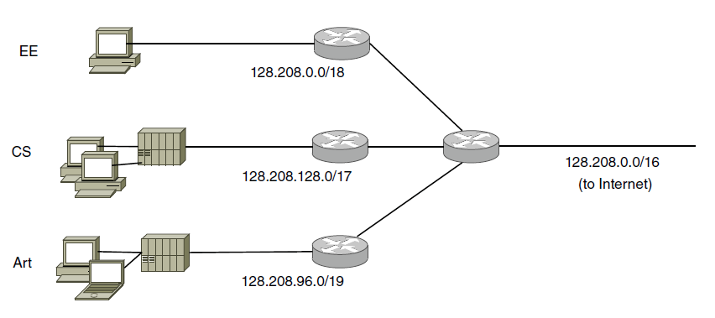
IP Addresses (2)
Splitting an IP prefix into separate networks with subnetting.

Slide 60
IP Addresses (3)
A set of IP address assignments

Slide 61
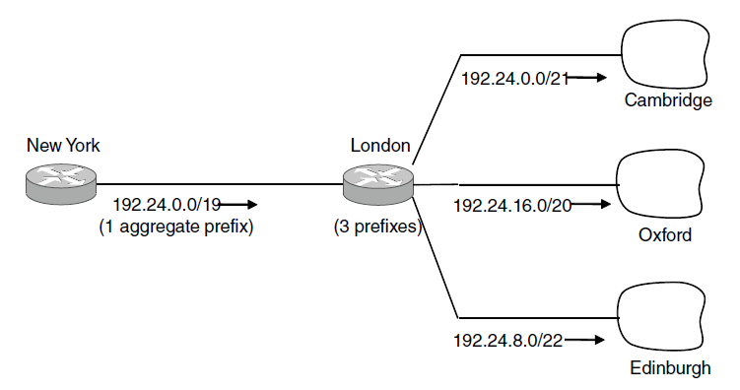
IP Addresses (4)
Aggregation of IP prefixes

Slide 62
IP Addresses (5)
Longest matching prefix routing at the New York router.

Slide 63
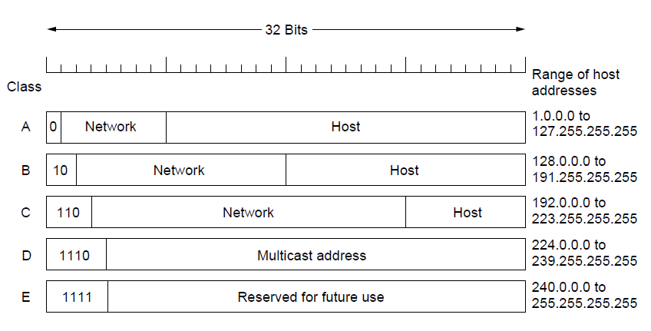
IP Addresses (6)
IP address formats

Slide 64
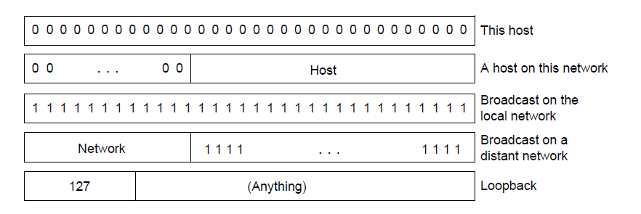
IP Addresses (7)
Special IP addresses

Slide 65
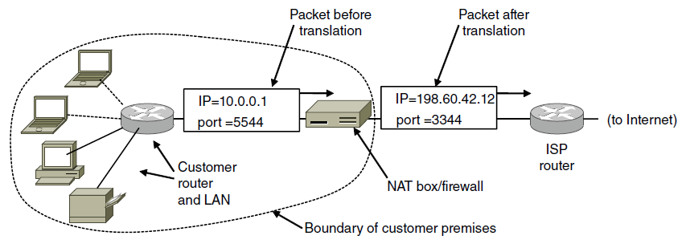
IP Addresses (8)
Placement and operation of a NAT box.

Slide 66
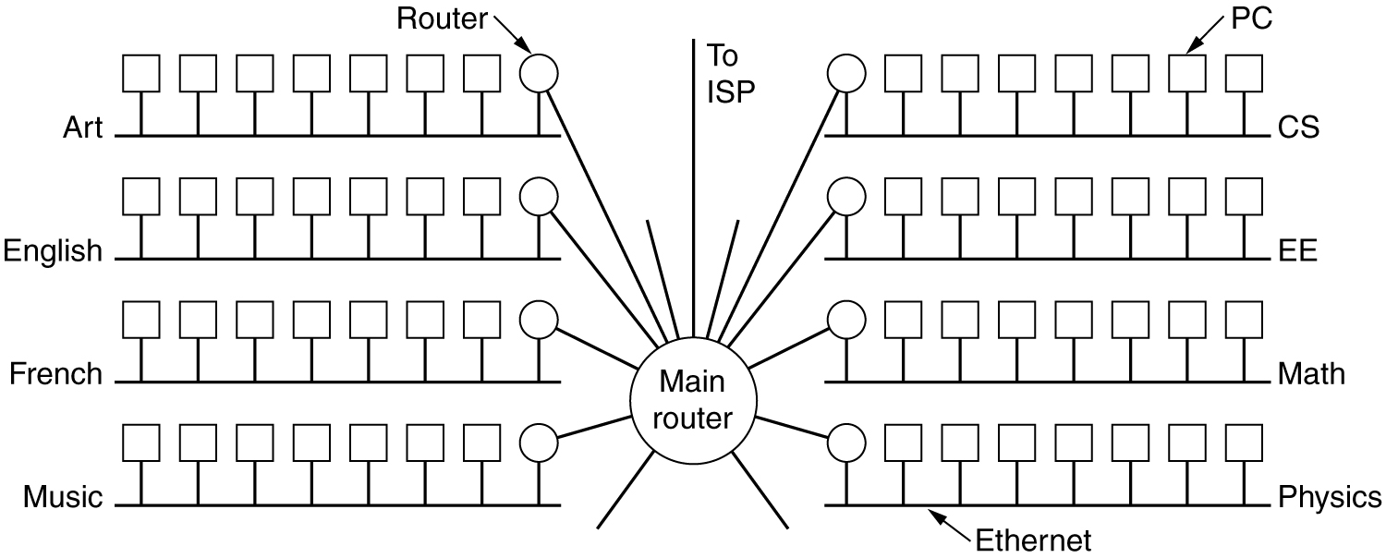
Subnets
A campus network consisting of LANs for various departments.

Slide 67
Subnets (2)
A class B network subnetted into 64 subnets.

Slide 68
CIDR – Classless Inter-Domain Routing
5-59
A set of IP address assignments.

Slide 69
Address Moving in CIDR
A packet comes in addressed to 194.24.17.4 –compare it with each mask.
Largest Suffix match
Aggregated entry of the three –
194.24.0.0/19
Omaha → Minneapolis, New York, Dallas, Denver
194.24.12.0/22

Slide 70
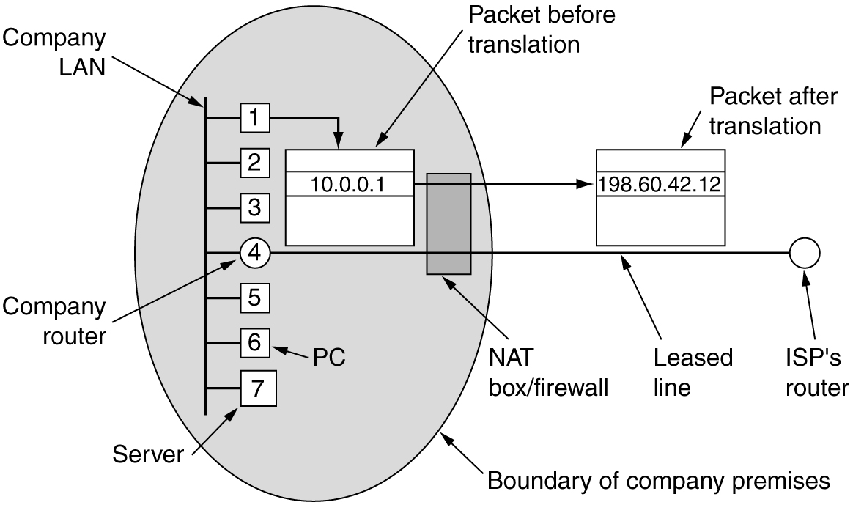
NAT – Network Address Translation
Placement and operation of a NAT box.

Slide 71
NAT
While leaving – IP, port are put in table, checksum is calculated and inserted into the packets.
While coming back – IP, port, checksum of IP and port checksum
Three ranges of IP addresses as private
10.0.0.0
172.16 ---- 172.31
192.168

Slide 72
NAT – Criticism
Architectural model of IP where each IP is identified by a single machine
Internet from connection-less to connection-oriented
NAT violates the most fundamental rule of protocol layering
Processes on the Internet are not required to use TCP or UDP
Some application insert IP address in their body – (FTP) – NAT doesn’t know about it.

Slide 73
Congestion Control Algorithms
Approaches to Congestion Control
Traffic-Aware Routing
Admission Control
Traffic Throttling
Load Shedding

Slide 74
Congestion
When too much traffic is offered, congestion sets in and performance degrades sharply.

Slide 75
General Principles of Congestion Control
Monitor the system
detect when and where congestion occurs.
Pass information to where action can be taken.
Adjust system operation to correct the problem.
Difference between Congestion control and flow control – Elaborate
Problem of infinite buffer - Elaborate

Slide 76
Approaches to Congestion Control
Two solutions possible:
Increase resources
Decrease load
Admission control in virtual networks – no more provisioning

Slide 77
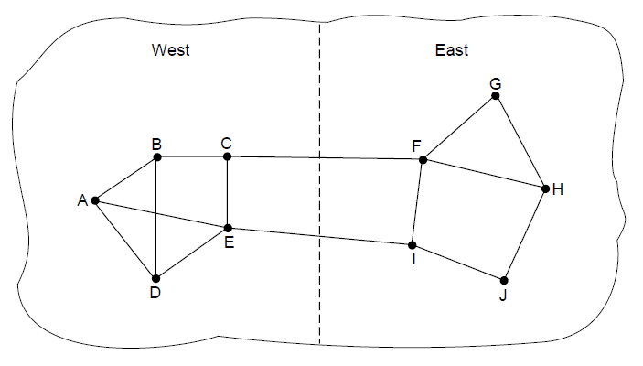
Traffic-Aware Routing
A network in which the East and West parts are connected by two links.

Slide 78
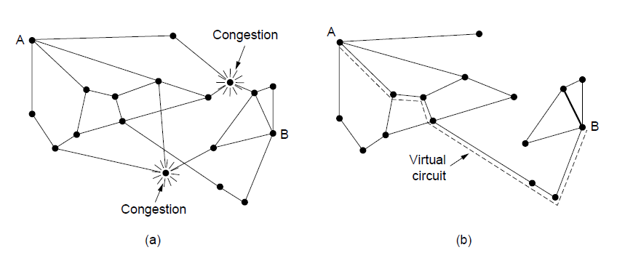
Admission Control
A congested network. (b) The portion of the network that is not congested. A virtual circuit from A to B is also shown.
Problem is in virtual circuits – there may be provisioning but not real usage.

Slide 79
Traffic Throttling:Congestion Detection
Routers must determine when congestion is approaching, ideally before it has arrived.
Each router can continuously monitor the resources it is using.
3 possibilities:
1. utilization of the output links
2. buffering of queued packets inside the router (most useful)
3. no. of packets that are lost due to insufficient buffering
EWMA (Exponentially Weighted Moving Average)
d_{new} = αd_{old} + (1 − α)s,
where, the constant α determines how fast the router forgets recent history.
Whenever d moves above the threshold, the router notes the onset of congestion.

Slide 80
Traffic Throttling: Feedback
Routers must deliver timely feedback to the senders that are causing the congestion.
The router must identify the appropriate senders.
It must then warn them carefully, without sending many more packets into the already congested network.
Many feedback mechanisms:
Mechanism 1: Explicit Congestion Notification (ECN)

Slide 81
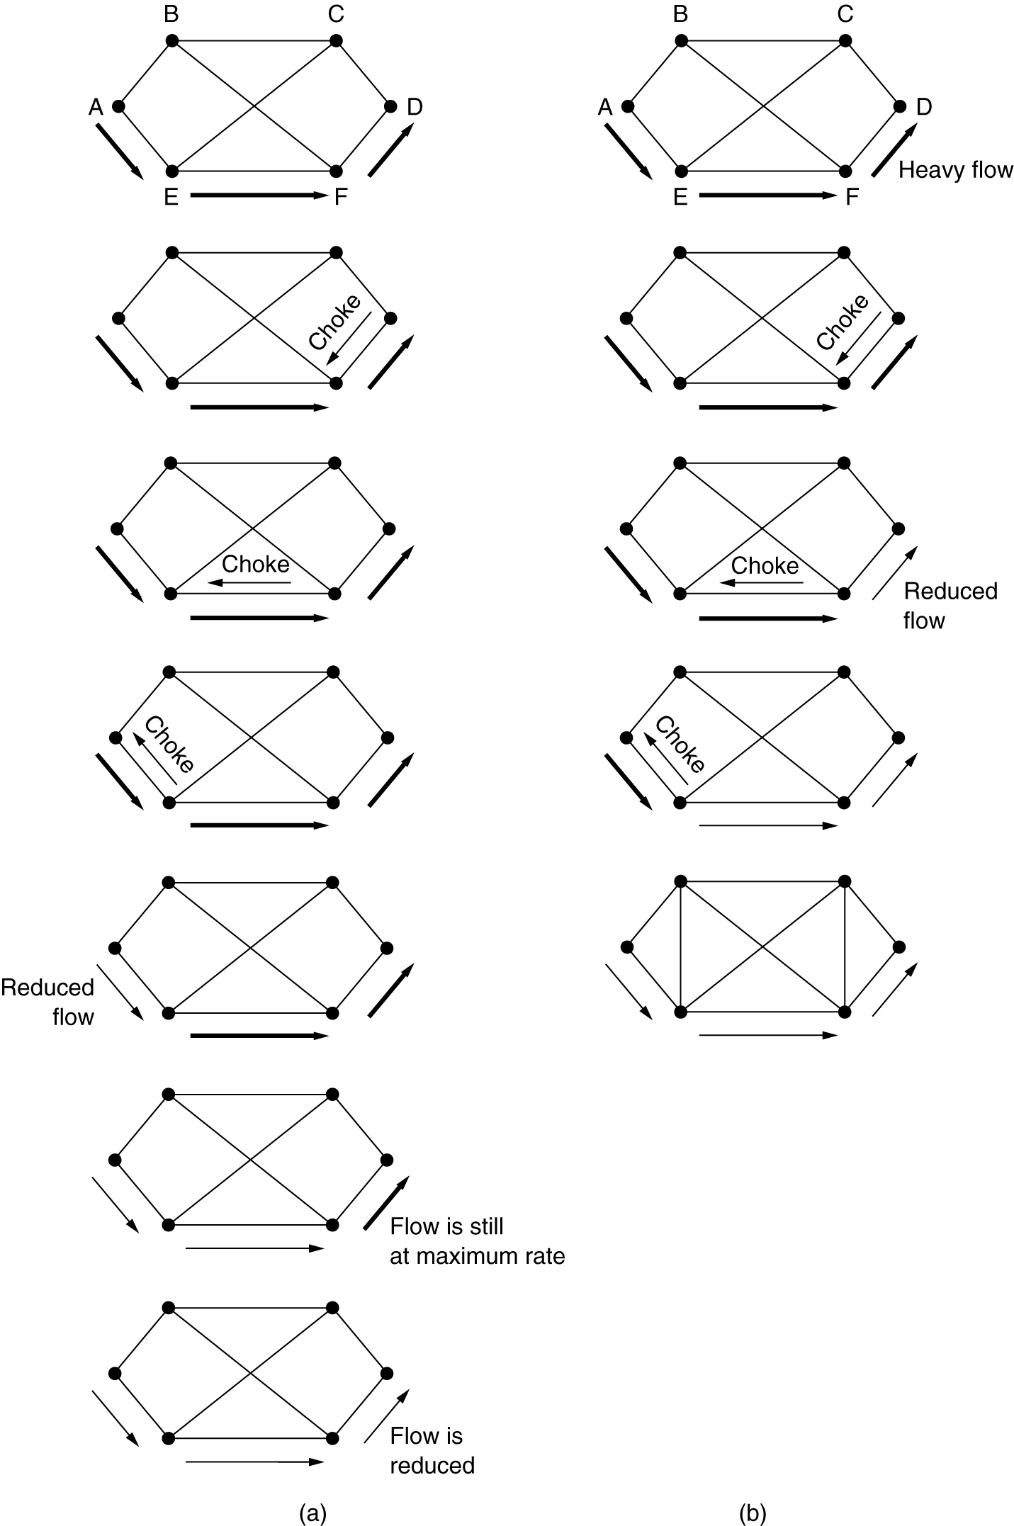
Mechanisms 2 & 3: Direct Choke Packets, Hop-by-Hop Backpressure
M-2: A choke packet that affects only the source.
M-3: A choke packet that affects each hop it passes through.
Sending choke packets to the source may be costly.

Slide 82
Mechanism 4: Load Shedding
Performed when all other strategies fail.
Cause blackout in some areas to save the entire network from failing.
Intelligent packet drop policy desired.
Which packets to discard may depend on application
Multimedia – old packets (full frame not to be discarded)
Text – Recent Packets
Packet’s importance can be marked in the beginning (application layer), then decision on which packets to discard can be taken.

Slide 83
Mechanism 5: Random Early Detection
Discard packets before all the buffer space is really exhausted.
To determine when to start discarding, routers maintain a running average of their queue lengths.
When average queue length exceeds a threshold, the link is said to be congested – small fraction of packets dropped at random.
The affected sender will notice the loss when there is no acknowledgement – transport protocol slowed down.

Slide 84
Four issues must be addressed to ensure quality of service:
1. What applications need from the network.
2. How to regulate the traffic that enters the network.
3. How to reserve resources at routers to guarantee performance.
4. Whether the network can safely accept more traffic.

Slide 85
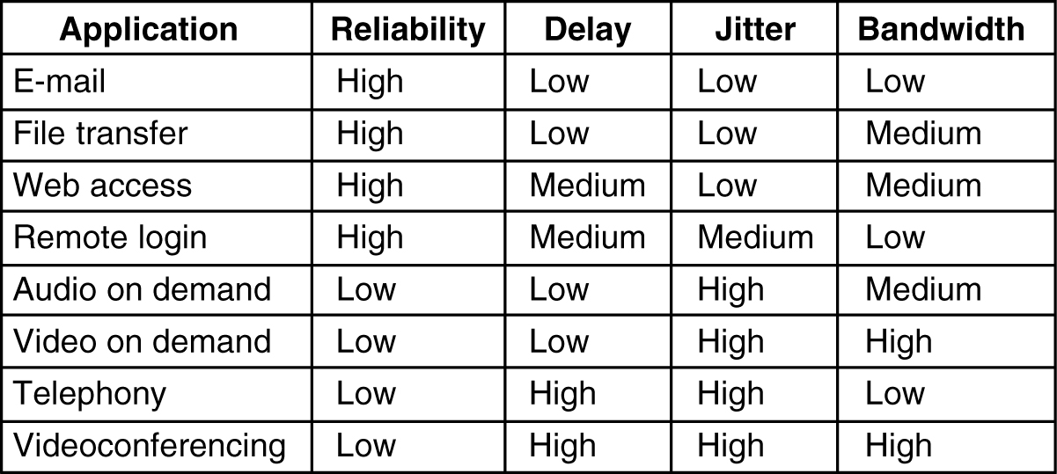
Requirements
How stringent the quality-of-service requirements are.
5-30

Slide 86
Categories of QoS and Examples
Constant bit rate
Telephony
Real-time variable bit rate
Compressed videoconferencing
Non-real-time variable bit rate
Watching a movie on demand
Available bit rate
File transfer

Slide 87
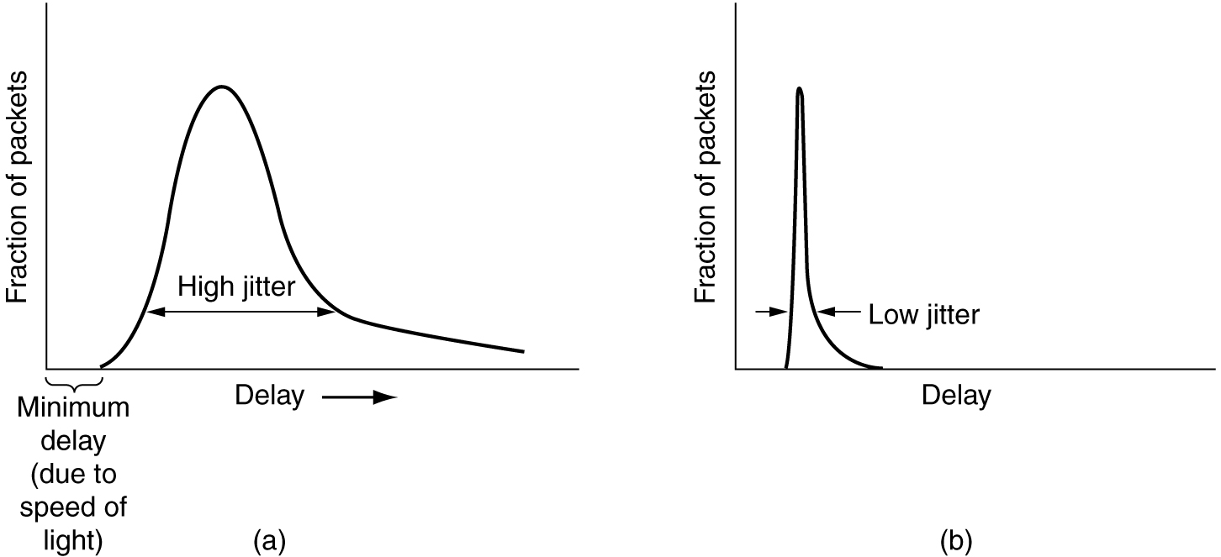
Jitter Control
Schedule Delay according to Deadline Miss
(a) High jitter. (b) Low jitter.

Slide 88
Buffering
Smoothing the output stream by buffering packets.

Slide 89
Traffic Shaping
Traffic in data networks is bursty – typically arrives at non-uniform rates as the traffic rate varies.
Traffic shaping is a technique for regulating the average rate and burstiness of a flow of data that enters the network.
When a flow is set up, the user and the network agree on a certain traffic pattern (shape).
Sometimes this agreement is called an SLA (Service Level Agreement).

Slide 90
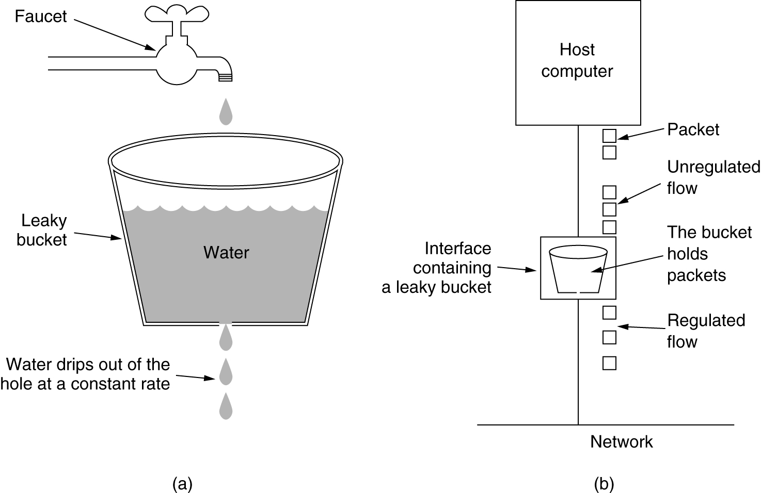
The Leaky Bucket Algorithm
(a) A leaky bucket with water. (b) a leaky bucket with packets.

Slide 91
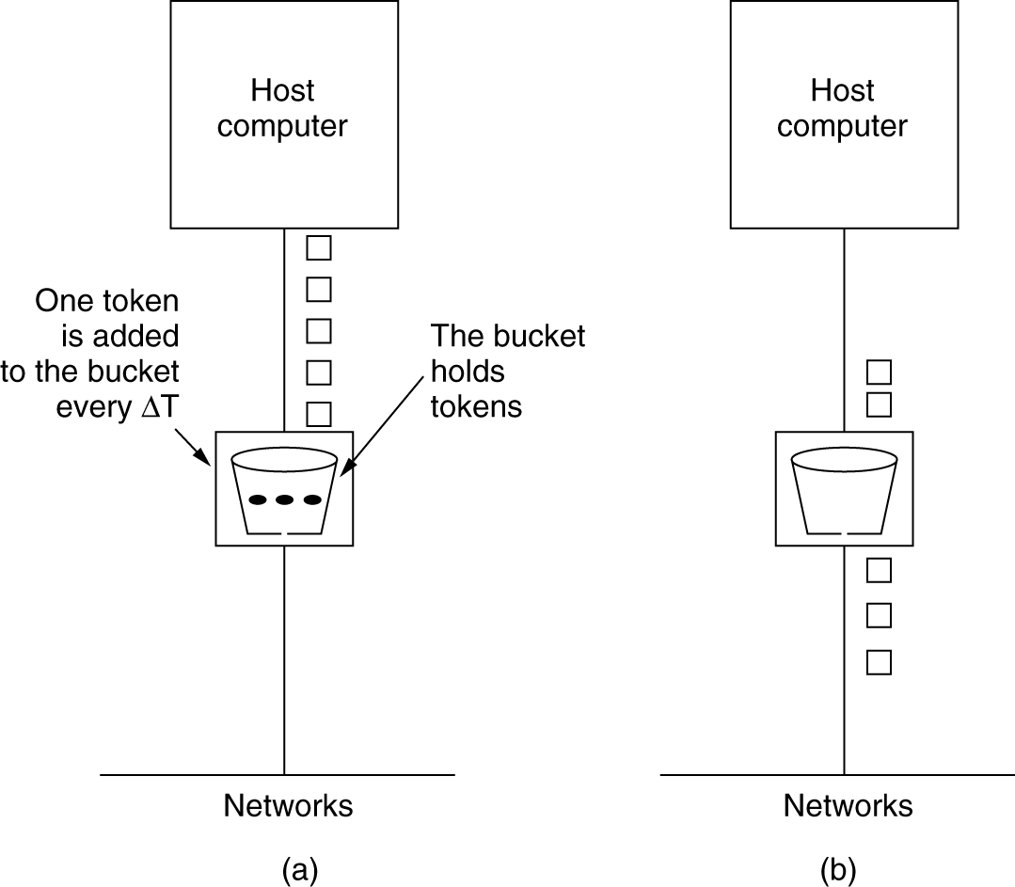
The Token Bucket Algorithm
5-34
(a) Before. (b) After.

Slide 92
Token Bucket Algorithm (2)
Burst length – S sec.
Maximum output rate – M bytes/sec
Token bucket capacity – B bytes
Token arrival rate – R bytes/sec
An output burst contains a maximum of (B + RS) bytes.
The number of bytes in a maximum speed burst of length S seconds is MS.
Hence, we have: B + RS = MS
This equation can be solved to get S = B /(M − R)

Slide 93
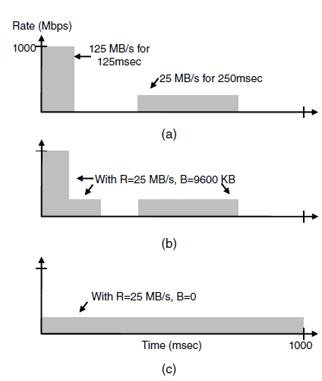
Traffic Shaping (2)
(a) Traffic from a host. Output shaped by a token bucket of rate 200 Mbps and capacity (b) 9600 KB, (c) 0 KB.

Slide 94
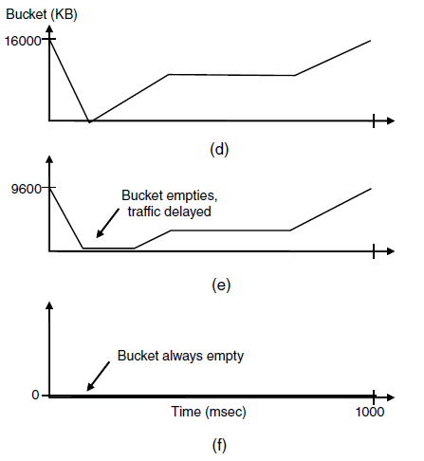
Traffic Shaping (3)
Token bucket level for shaping with rate 200 Mbps and capacity (d) 16000 KB, (e) 9600 KB, and (f) 0KB..

Slide 95
Packet Scheduling
Kinds of resources that can potentially be reserved for different flows:
Bandwidth.
Buffer space.
CPU cycles.

Slide 96
Packet Scheduling (2)
Round-robin Fair Queuing

Slide 97
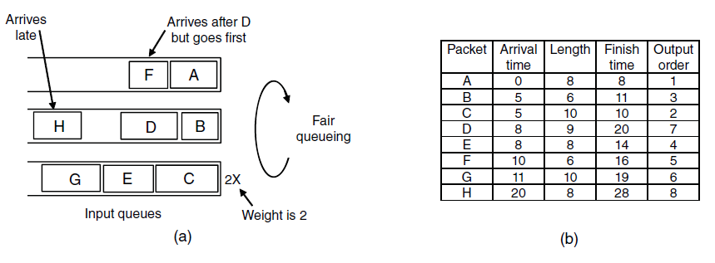
Packet Scheduling (3)
Weighted Fair Queueing.
Finishing times for the packets.

Slide 98
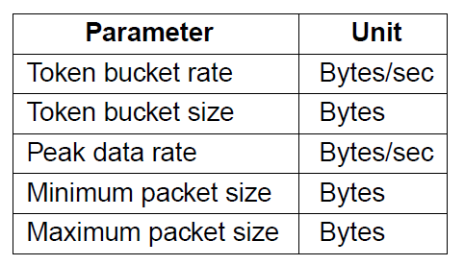
Admission Control (1)
An example flow specification

Slide 99
T = 1/\mu X 1/(1-\lambda/\mu) -- \lambda = 0.95Mpackets/sec
\mu = 1Mb packets/sec

Slide 100
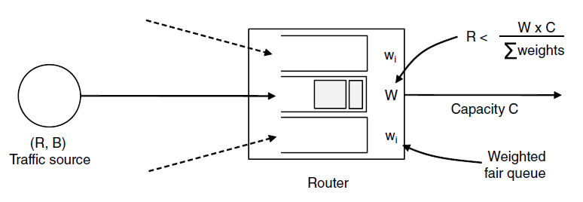
Admission Control (2)
Bandwidth and delay guarantees with token buckets and WFQ.

Slide 101
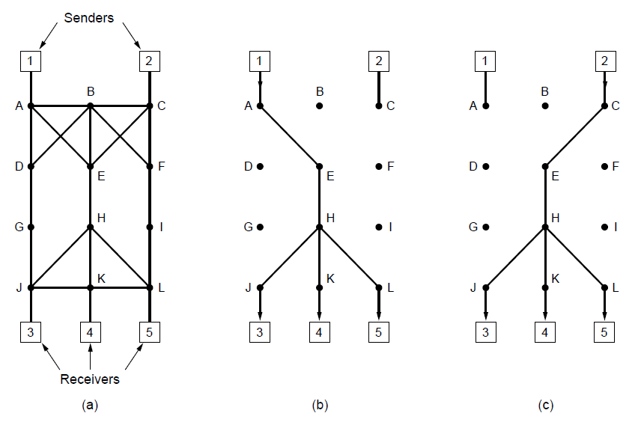
Integrated Services: RSVP—The Resource reSerVation Protocol
(a) A network. (b) The multicast spanning tree for host 1. (c) The multicast spanning tree for host 2.

Slide 102
Hosts 1 and 2 are multicast sender
3,4, 5 are multicast receiver
Host 3 reserves for Host 1 and the Host 2
Host 5 reserves Host 1 (so the common path is utilized). However depending on need (Host 5 may be a bigger TV) – provision is made for the greediest part

Slide 103
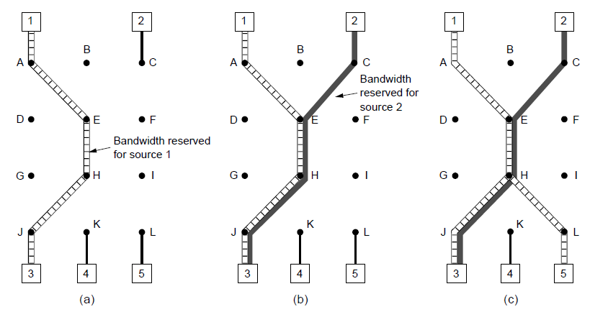
RSVP (2)
(a) Host 3 requests a channel to host 1. (b) Host 3 then requests a second channel, to host 2. (c) Host 5 requests a channel to host 1.

Slide 104
Differentiated Services: Expedited Forwarding
Expedited packets experience a traffic-free network

Slide 105
Class-Based Service
Per Hop Behaviors
Traffic within a class are given preferential treatment
Expedited Forwarding
Packets marked – Regular or Expedited
Assured Forwarding
Gold, Silver, Bronze, common
Packets that face congestion
low (short burst), medium and high _ this classes are determined by tocken bucket algorithm

Slide 106
Differentiated Services: Assured Forwarding
A possible implementation of assured forwarding, weighted fair scheduling, RED (randome Early Detection discards packet according to the class).

Slide 107
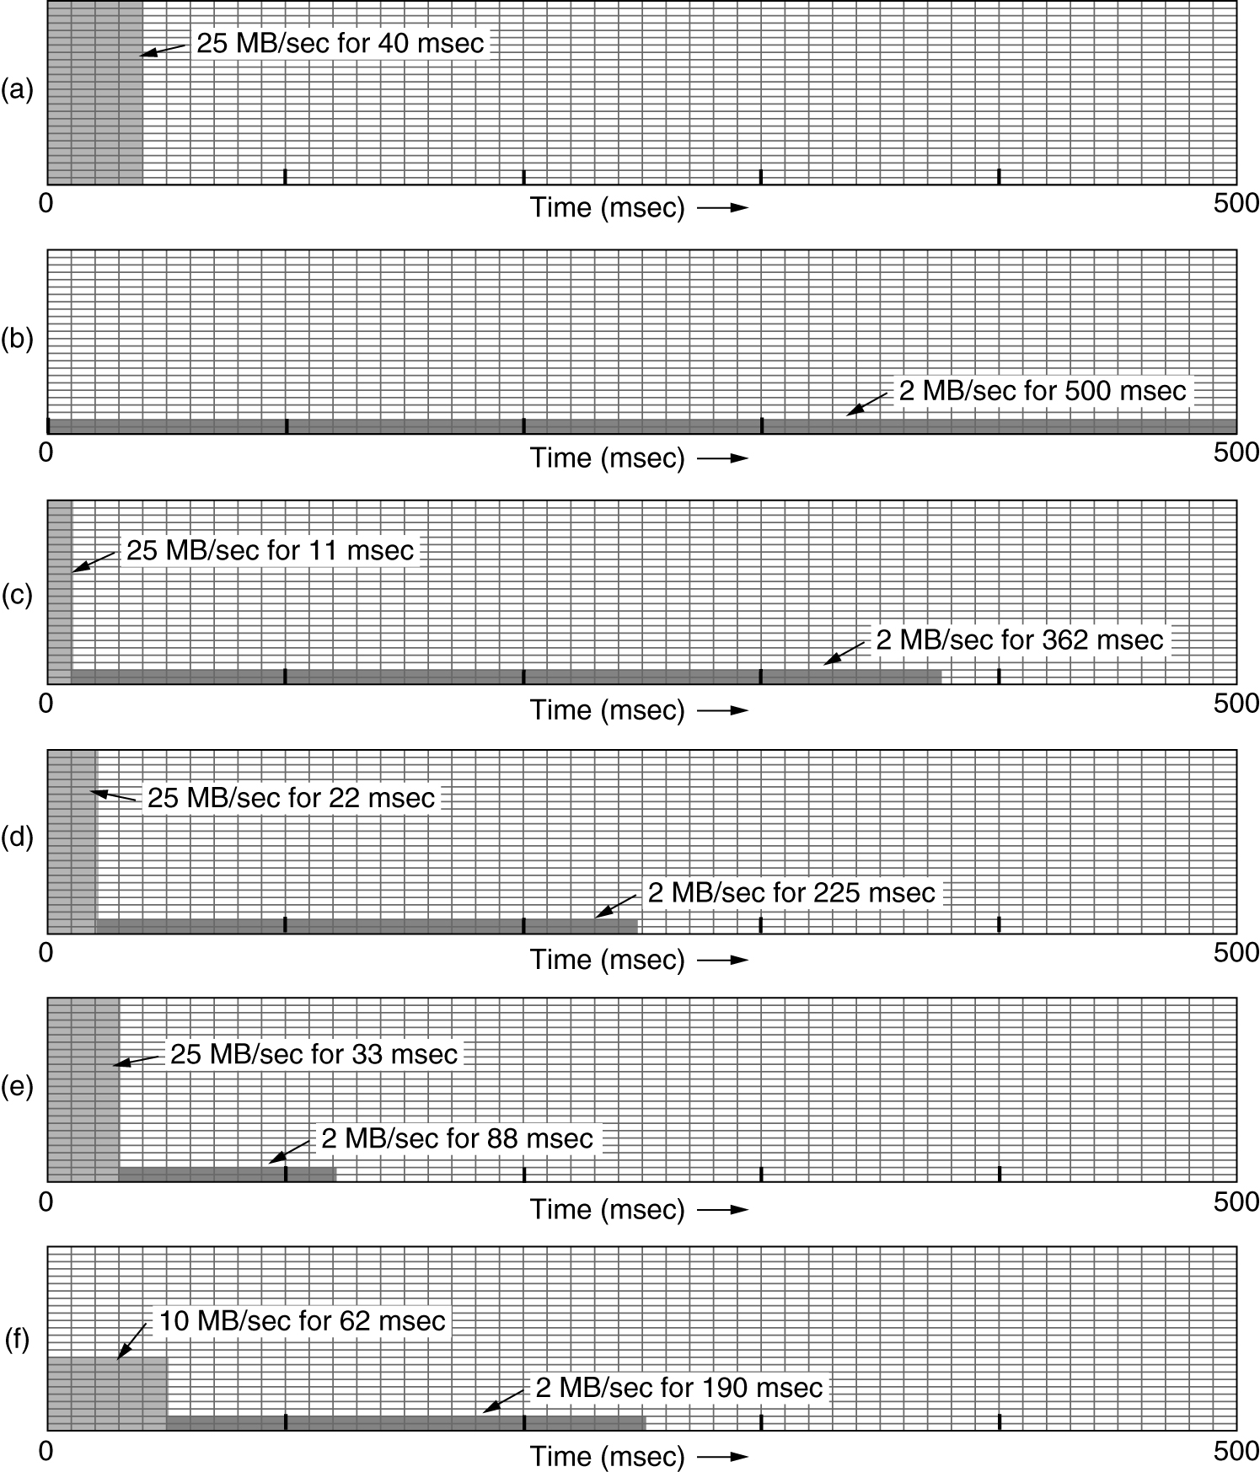
The Leaky Bucket Algorithm
(a) Input to a leaky bucket. (b) Output from a leaky bucket. Output from a token bucket with capacities of (c) 250 KB, (d) 500 KB, (e) 750 KB, (f) Output from a 500KB token bucket feeding a 10-MB/sec leaky bucket.

Slide 108
Quality of Service
Requirements
Minimum throughput and maximum latency
Techniques for Achieving Good Quality of Service
Integrated Services
Differentiated Services
Label Switching and MPLS

Slide 109
Internetworking
How networks differ
How networks can be connected
Tunneling
Internetwork routing
Packet fragmentation

Slide 110
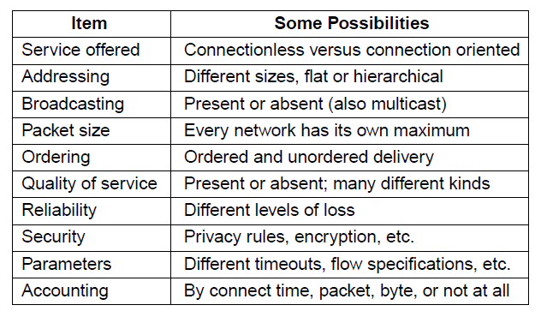
How Networks Differ
Some of the many ways networks can differ

Slide 111
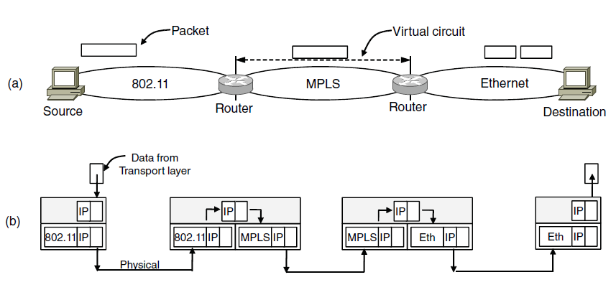
How Networks Can Be Connected
A packet crossing different networks.
Network and link layer protocol processing.
From 802.11 to MPLS – multi-protocol router strips the 802.11 frame and put the MPLS frame and then fragments when it is sent over IP

Slide 112
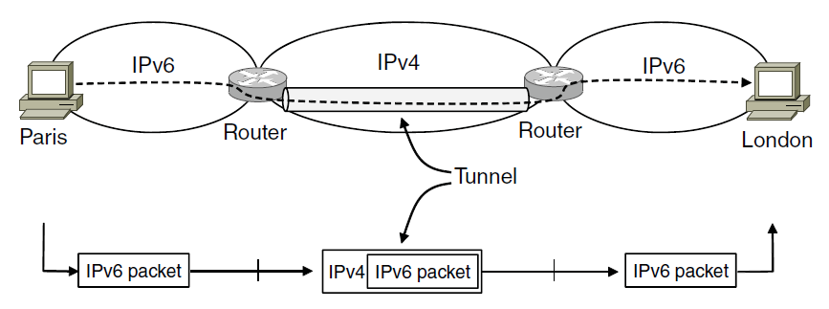
Tunneling (1)
Tunneling a packet from Paris to London.

Slide 113
Tunneling (2)
Tunneling a car from France to England
The disadvantage of tunneling is that none of the hosts on the network that is tunneled over can be reached because the packets cannot escape in the middle of the tunnel

Slide 114
Internetwork Routing (1)
Challenges in internetwork routing:
The networks may internally use different routing algorithms (e.g., link state routing and distance vector routing) – finding shortest path becomes tricky.
Networks run by different operators:
Different ideas about what is a good path through the network – one operator wants least delay, another least cost.
One operator may not want another operator to know details of the paths in its network.
Individual networks may not need hierarchical solutions, while the combined network (internet) is huge and requires such solutions for scaling

Slide 115
Internetwork Routing (2)
Two-level routing algorithm:
Interior Gateway Protocol (IGP): Intra-domain routing protocol, used within individual networks.
Border Gateway Protocol (BGP): Inter-domain routing protocol, used across the networks which make up the network.
Since each network is operated independently of all the others, it is often referred to as an AS (Autonomous System).
Routes across networks determined by:
Business arrangements between ISPs.
Government laws for countries if internetwork routing requires crossing international boundaries.

Slide 116
Packet Fragmentation (1)
Packet size issues:
Hardware
Operating system
Protocols
Compliance with (inter)national standard.
Reduce error-induced retransmissions
Prevent packet occupying channel too long.

Slide 117
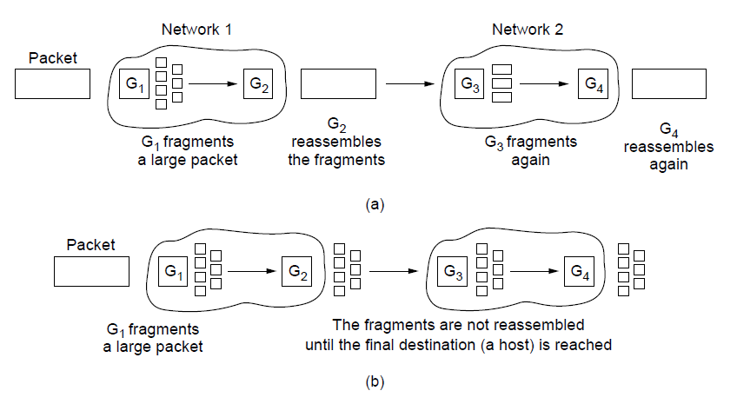
Packet Fragmentation (2)
Transparent fragmentation.
Nontransparent fragmentation

Slide 118
Packet Fragmentation (3)
Fig.: Fragmentation when the elementary data size is 1 byte. (a) Original packet, containing 10 data bytes.

Slide 119
Packet Fragmentation (4)
Fig. (contd.): Fragmentation when the elementary data size is 1 byte
(b) Fragments after passing through a network
with maximum packet size of 8 payload bytes plus header.

Slide 120
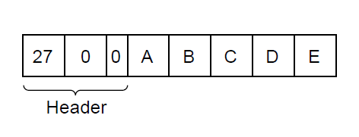
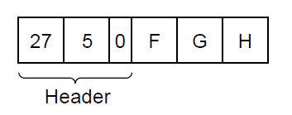
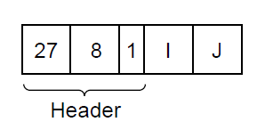
Packet Fragmentation (5)
Fig. (contd.): Fragmentation when the elementary data size is 1 byte
(c) Fragments after passing through a size 5 gateway.

Slide 121
Packet Fragmentation (6)
Path MTU Discovery
MTU: Maximum Transmission Unit – pushes the fragmentation to host from network

Slide 122
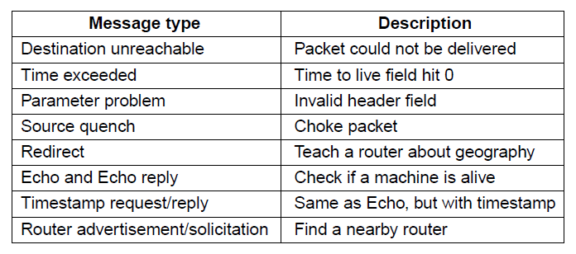
Internet Control Message Protocol
The principal ICMP message types.

Slide 123
Time exceeded path – when TTL becomes zero, the control packet comes back… Can be used for Traceroute
Congestion control – mainly done in transport layer
Redirect – router notices a packet is routed incorrectly
Echo – ping
Timestamp – arrival time and departure time
Router Advertisement – let hosts find nearby server

Slide 124
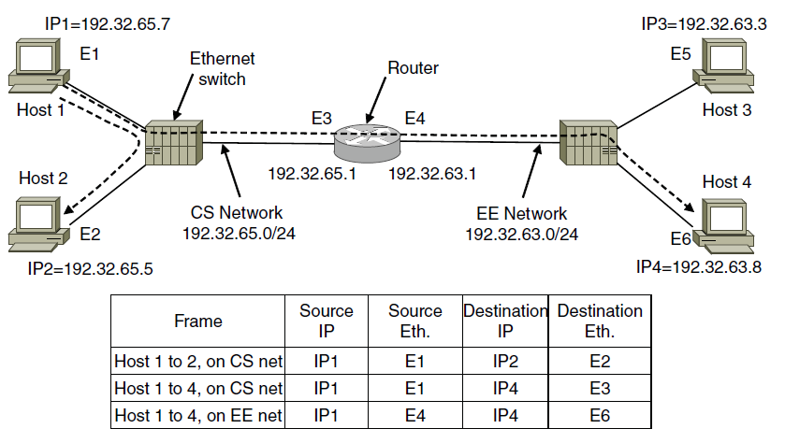
ARP– Address Resolution Protocol
Two switched Ethernet LANs joined by a router

Slide 125
Optimizations on ARP
Two Broad Techniques
Have configuration file
Broadcast
Optimizations for ARP:
Caching
Broadcast the mapping when booting (gratuitous ARP)
Send it to router if not local

Slide 126
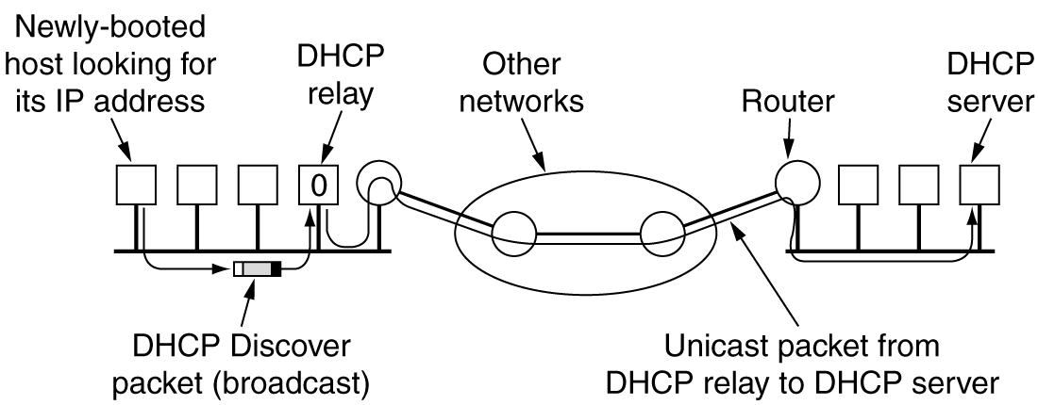
Dynamic Host Configuration Protocol
Operation of DHCP.
DHCP Relay, Broadcasts a DISCOVER,
Leasing of IP, if not renewed it is taken back.

Slide 127
OSPF—An Interior Gateway Routing Protocol (1)
An autonomous system

Slide 128
OSPF—An Interior Gateway Routing Protocol (5)
Salient Features:
O – open source
Support variety of distant metrics
Dynamic algorithm – have to adapt
Load balancing and not the best path
Hierarchical systems
Security is needed
OSPF supports connection – point-to-point/multi-access with broadcast
Notes:
What is tunnelling

Slide 129
OSPF—An Interior Gateway Routing Protocol (2)
A graph representation of the previous slide.

Slide 130
OSPF—An Interior Gateway Routing Protocol (3)
The relation between ASes, backbones, and areas in OSPF.

Slide 131
OSPF—An Interior Gateway Routing Protocol (4)
The five types of OSPF messages

Slide 132
BGP—The Exterior Gateway Routing Protocol (1)
Examples of routing constraints:
No commercial traffic for educat. network
Never put Iraq on route starting at Pentagon
Choose cheaper network
Choose better performing network
Don’t go from Apple to Google to Apple

Slide 133
BGP—The Exterior Gateway Routing Protocol (2)
Routing policies between four Autonomous Systems

Slide 134
BGP—The Exterior Gateway Routing Protocol (3)
Propagation of BGP route advertisements

Slide 135
END

Slide 136
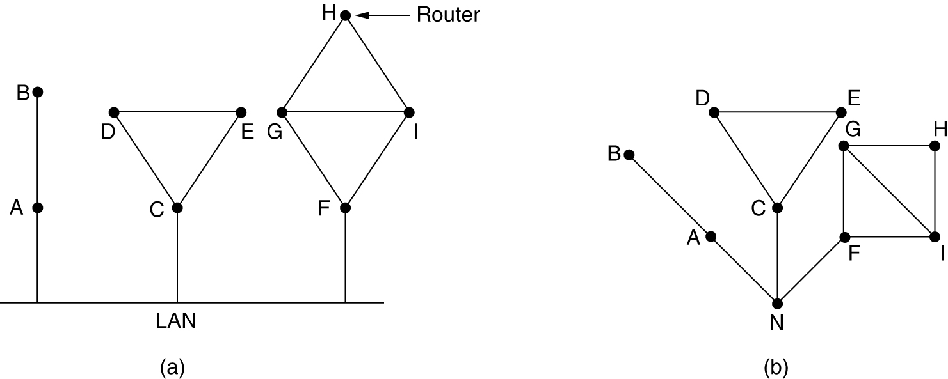
Learning about the Neighbors
(a) Nine routers and a LAN. (b) A graph model of (a).

