Slide 1
Computer Networking
Industry Perspective
IIT Kharagpur, Spring 2017
Amit Saha

Slide 2
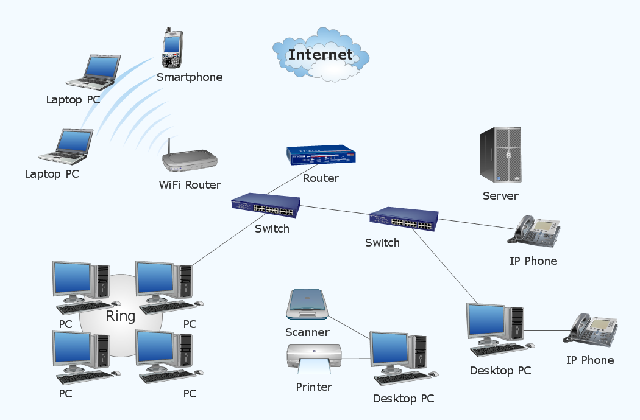

Slide 3
Connecting to a WiFi Access Point
Scanning
Joining
Authentication
Association
The station feels as if it is “plugged” into a wired network
Notes:
Use acrylic wifi program to show ssids that are visible right now

Slide 4
Communicating with a WiFi AP
Wireless is a half duplex channel – either speak or listen
  Signal strength is inversely proportion to square of distance
Carrier Sense Multiple Access / Collision Avoidance (CSMA/CA)
  Fancy name for how humans talk ☺
This is generally true of all wireless systems (including humans)
Notes:
Draw out RTS/CTS or simply DATA/ACK

Slide 5
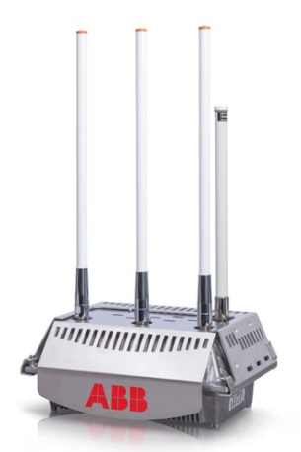
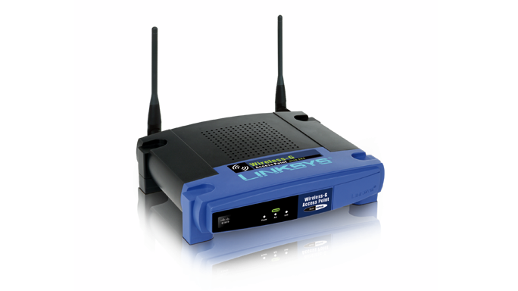
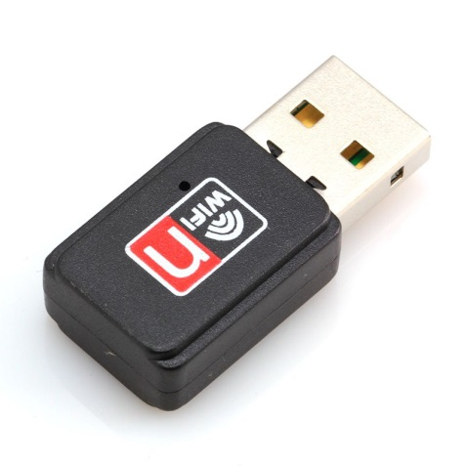
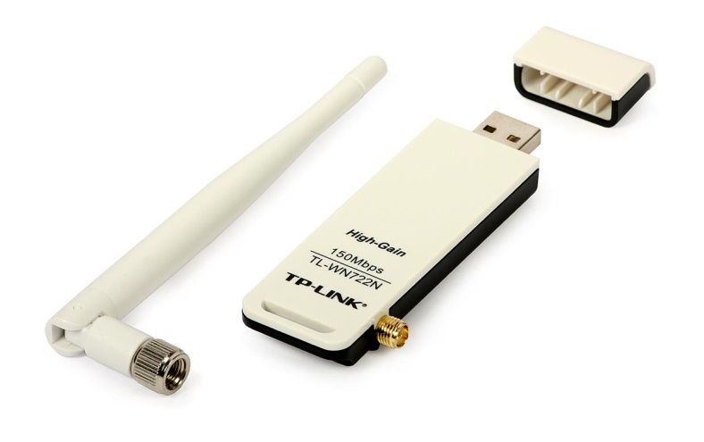
WiFi Equipment

Slide 6
Wired First Hop - Ethernet
IEEE 802.3 standard
If two ends of the Ethernet cable (e.g., RJ45) is electrically up, connection is up.
  Some authentication steps are usually there but we will skip those

Slide 7
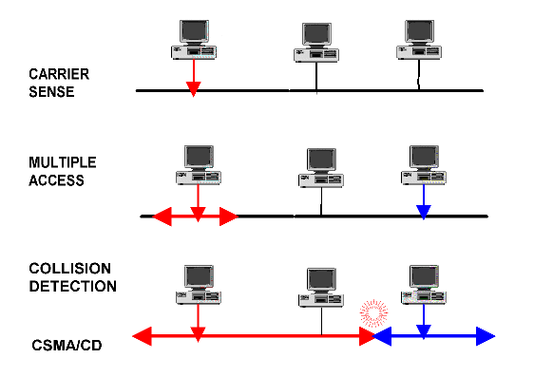
CSMA/CD
Carrier Sense Multiple Access / Collision Detect
Notes:
Minimum size frame

Slide 8
Ethernet Frame – with VLAN
88 bytes minimum
Notes:
Minimum size frame

Slide 9
Main issue in Ethernet
Loop prevention – for multiple VLANs
STP, MSTP

Slide 10
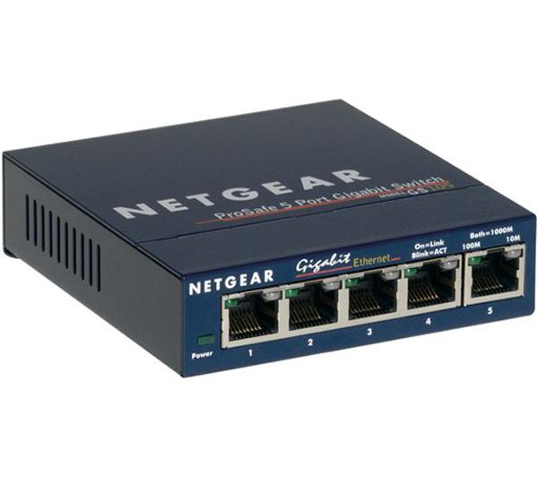
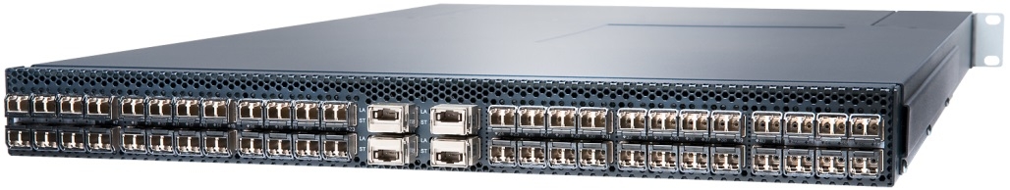
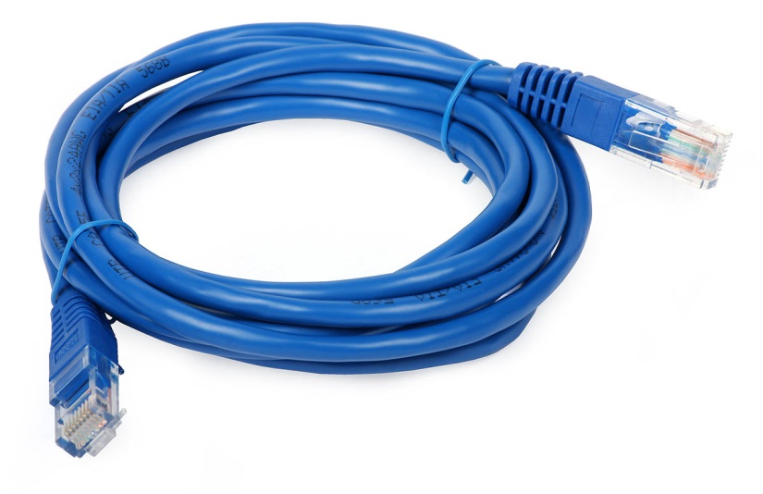
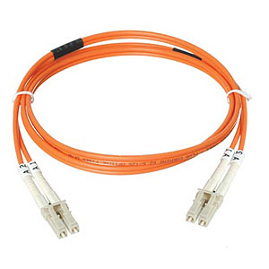
Ethernet Equipment

Slide 11
Getting an IP address
DHCP – DHCP clients get IP addresses and networking parameters from DHCP server
Based on BOOTP
DHCPv6 (for IPv6) is also available

Slide 12
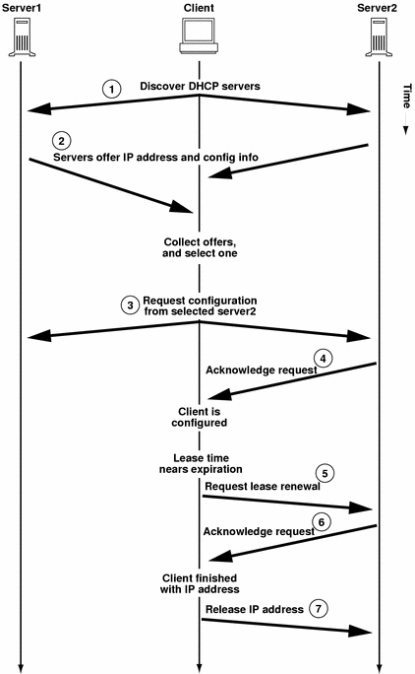
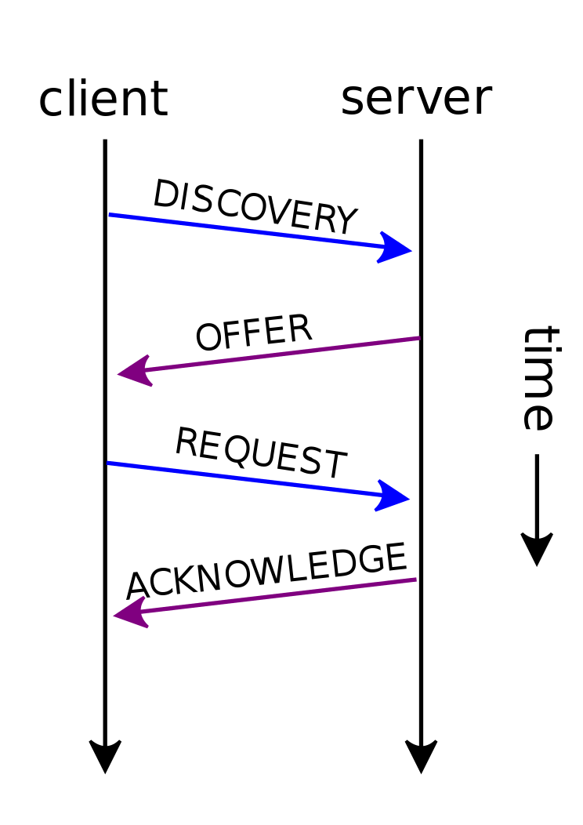

DHCP Packets
Discovery
Offer (possibly multiple)
Request
Acknowledge
Renew
Release
Why do we need an IP address?
Notes:
Ask why do we need a request and acknowledge and not just a discover and offer?

Slide 13
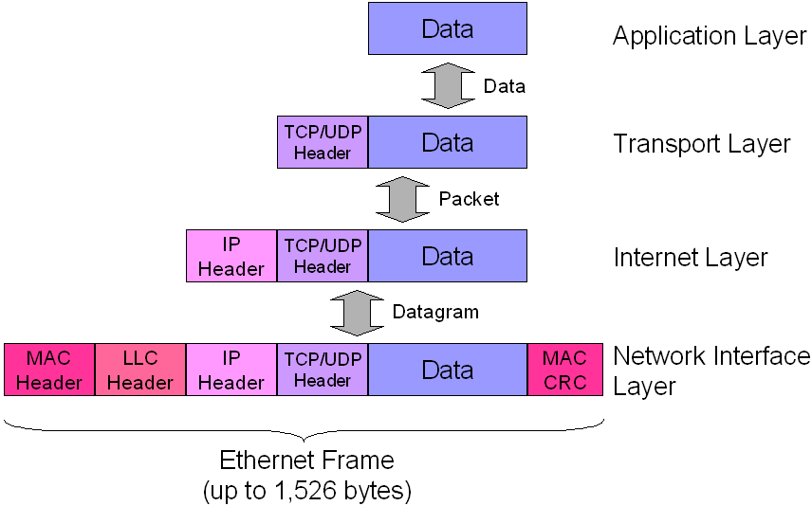
IP Packet Format

Slide 14
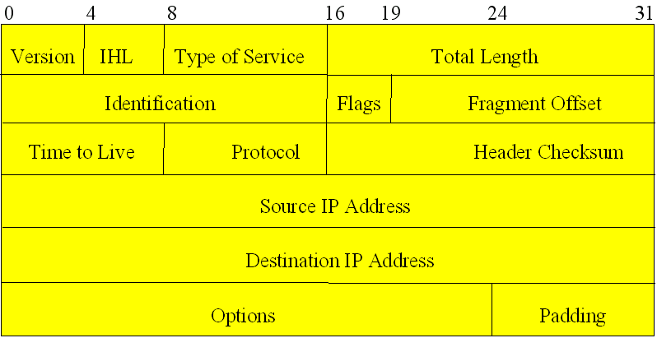
IPv4 Header Format

Slide 15
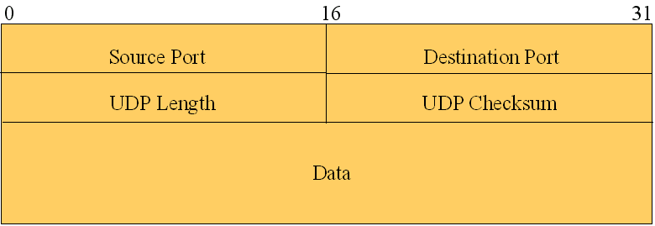

Slide 16
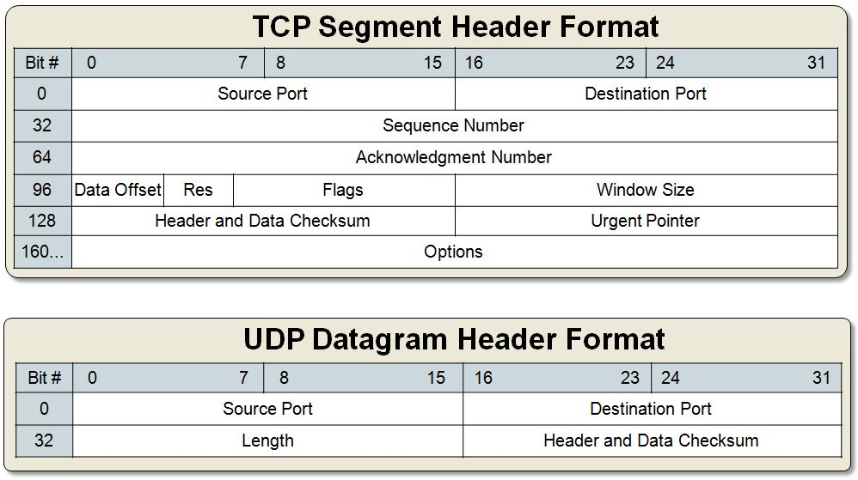
TCP/UDP Header

Slide 17
Got an IP! Hurray!
But now what? How do I “go to” some website?
IP is just an identity
Still need to “route” to somewhere

Slide 18
Domain Name Service
We almost always try to reach a human readable name
But machines route based on IP addresses
There must be a mapping from names to IP addresses
But who is going to do this translation?

Slide 19
Default Gateway
If host does not know how to route, who does it ask?
There must be a “goto” guy in the network

Slide 20
Routing table – Host
ubuntu@ubuntu-VirtualBox:~/Projects/OpenStack/New/cinder$ route
Kernel IP routing table
Destination Gateway Genmask Flags Metric Ref Use Iface
default 10.0.2.2 0.0.0.0 UG 0 0 0 eth0
10.0.2.0 * 255.255.255.0 U 1 0 0 eth0

Slide 21

Are we ready to send?

Slide 22
ARP
What is the MAC address for a given IP?
ARP resolves network layer address to link layer address

Slide 23
Layer in packet format
We can now send

Slide 24
Homework
Wireshark
Download wireshark and capture packets to see for yourselves

Slide 25
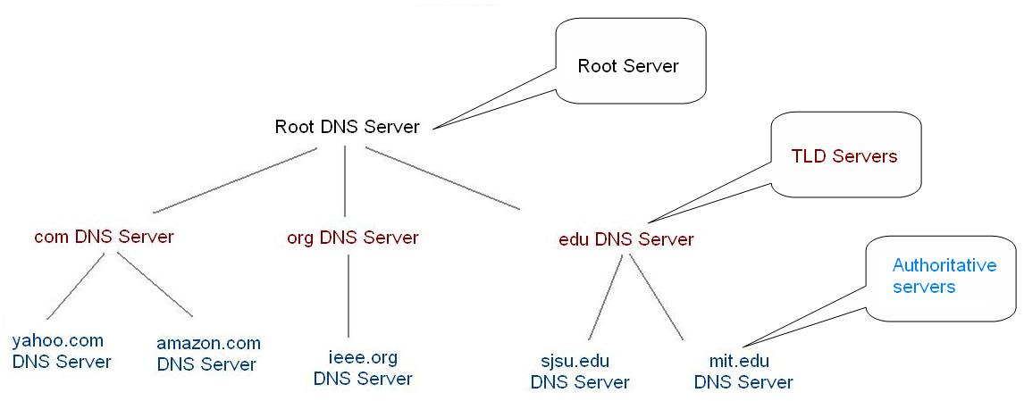
DNS – Domain Name Service
Hierarchical way of managing name space
Managed by Internet Assigned Numbers Authority (IANA)
http://www.iana.org/domains/root/db

Slide 26
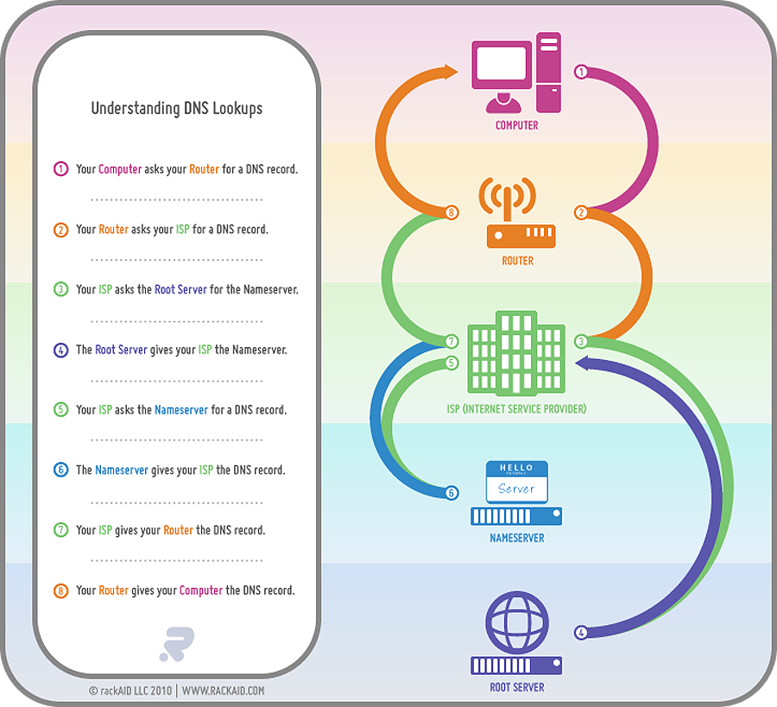

Slide 27
DNS – Root Servers
<a-m>.root-servers.net – 13 hostnames, around 500 instances
  Use anycast to reach “nearest” instance – BGP supports this
  12 of the 13 root servers A-M exist in multiple locations
  11 on multiple continents
    Root server ‘h’ exists in two U.S. locations.
    Root server ‘b’ exists in a single location in the Los Angeles Area
http://www.root-servers.org/

Slide 28
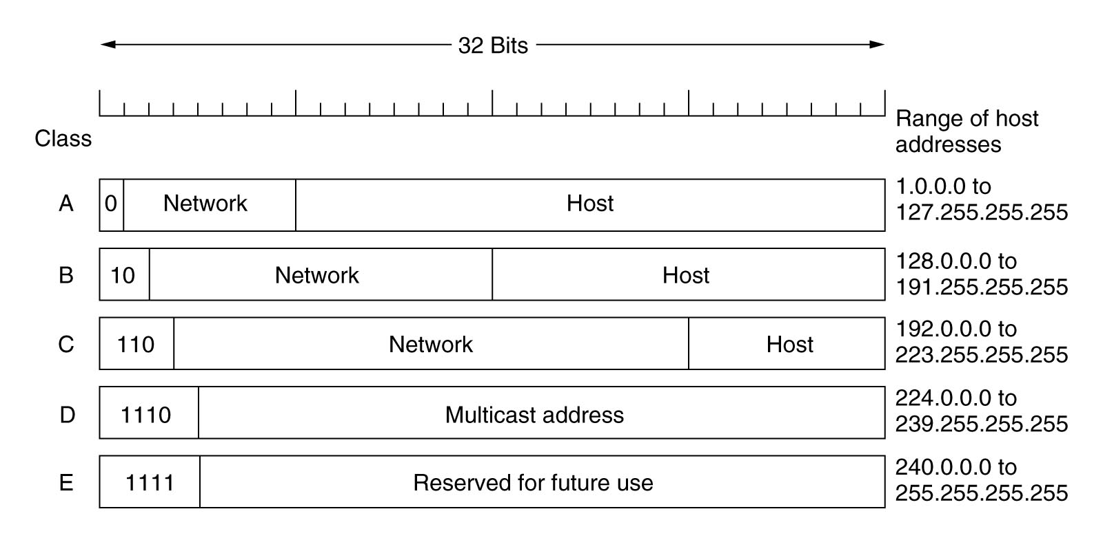
Subnetting
Routing to each individual hosts does not scale
Addresses grouped into different classes

Slide 29
CIDR
Any “class system” is bad ☺
IPv4 was running out of unique IP addresses
  Hence IPv6 but…
Classless Inter Domain Routing
  Network portion can be of any size
  Addresses need to specify subnet mask as well

Slide 30
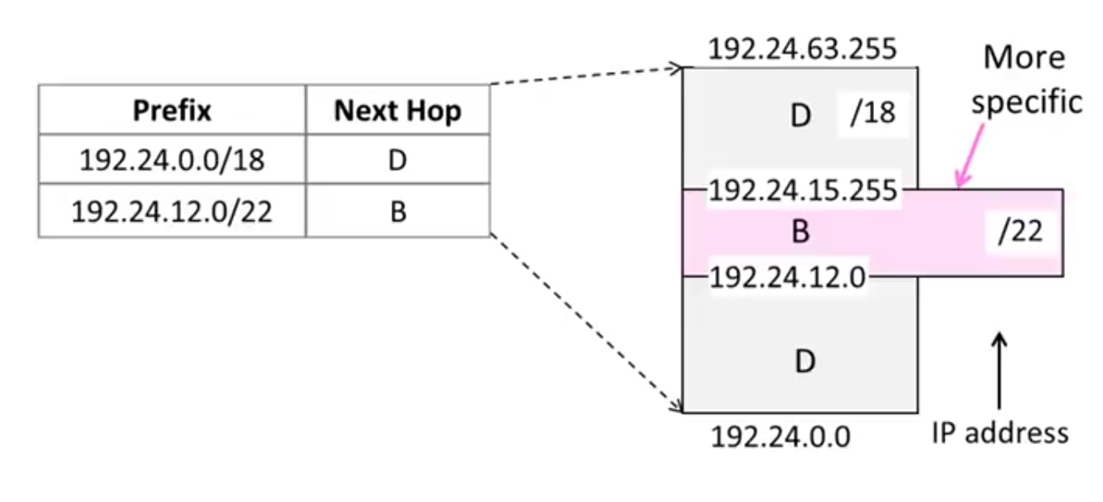
Route Lookup – Longest Prefix Match

Slide 31
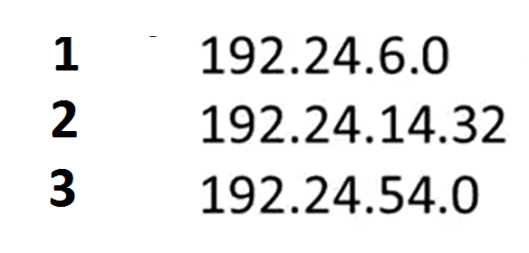
How are the packets with above three destination IP addresses forwarded?
1->D, 2->B, 3->B
1->D, 2->B, 3->D
1->B, 2->D, 3->D
1->D, 2->D, 3->D

Slide 32
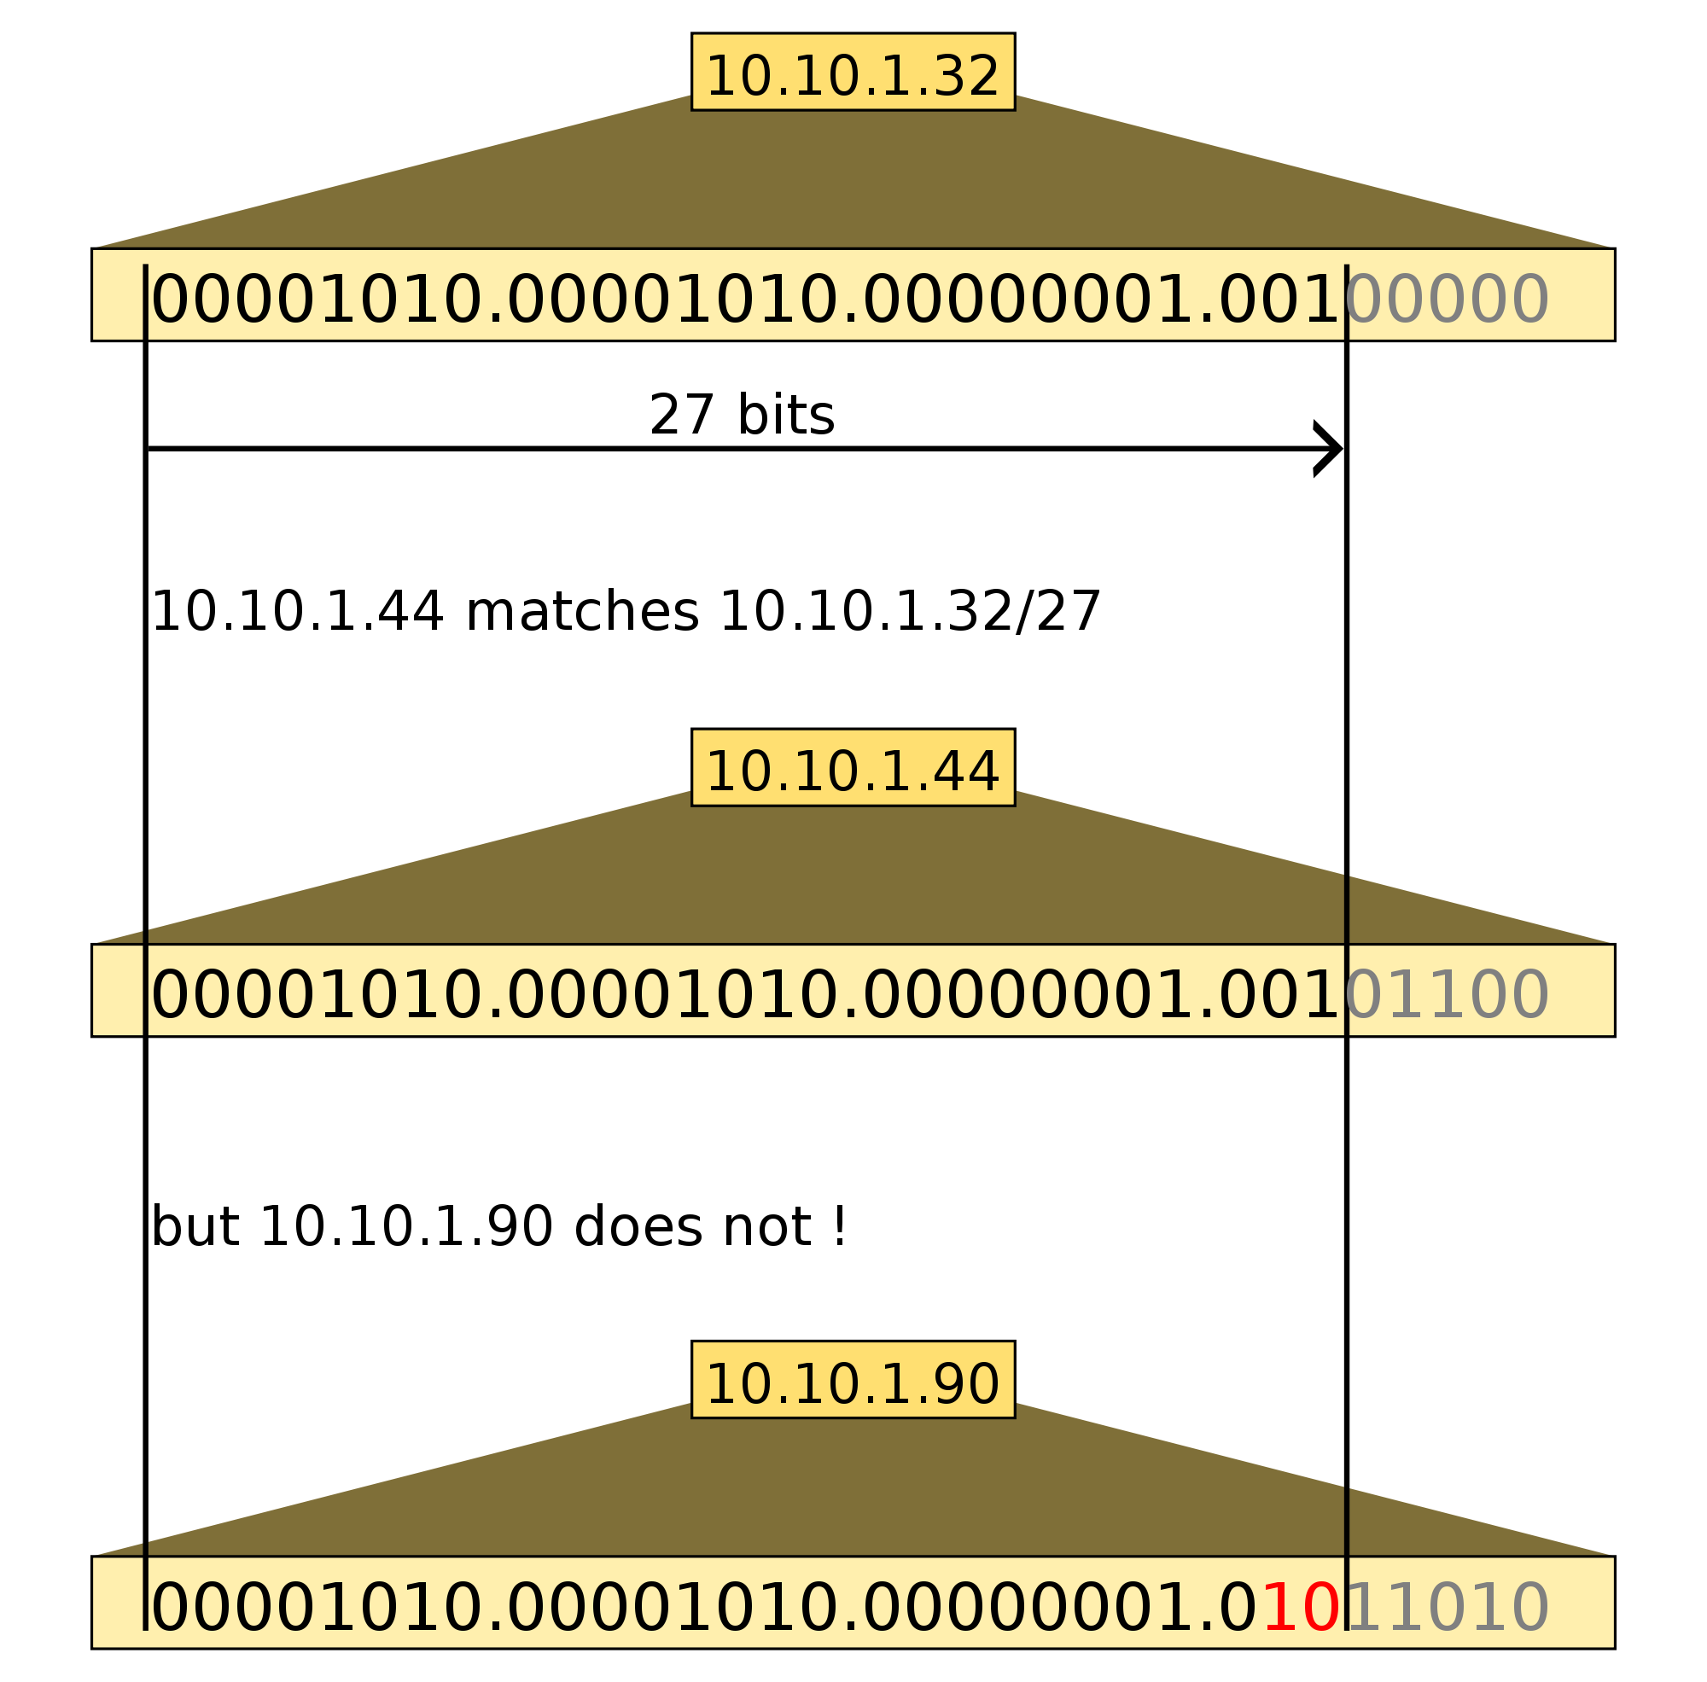
Longest Prefix Match

Slide 33
Route Lookup – Longest Prefix Match

Slide 34
How are the packets with above three destination IP addresses forwarded?
1->D, 2->B, 3->B
1->D, 2->B, 3->D
1->B, 2->D, 3->D
1->D, 2->D, 3->D

Slide 35
Longest Prefix Match

Slide 36
Real Products

Slide 37
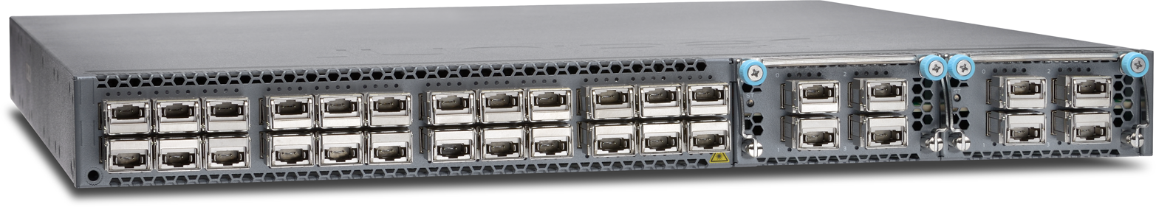
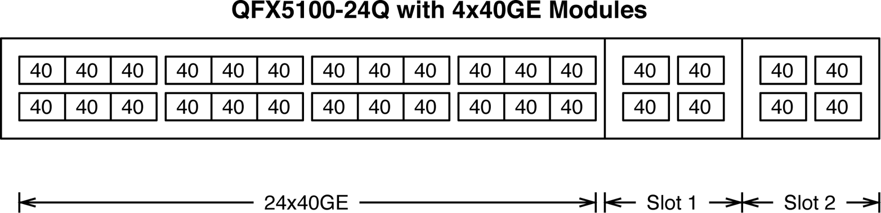

Slide 38
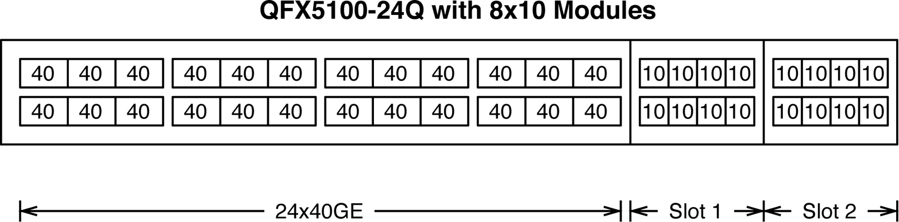

Slide 39
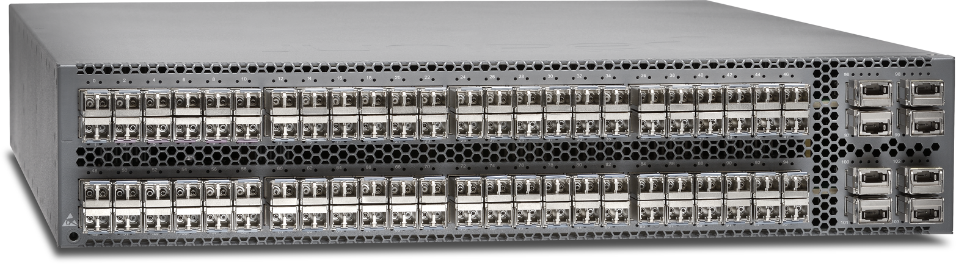
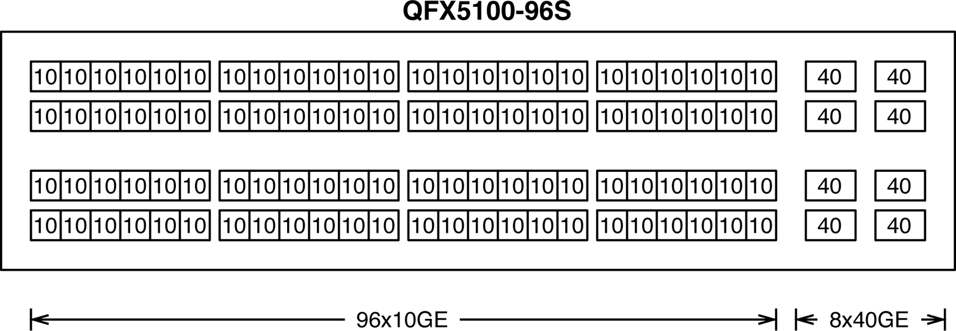

Slide 40
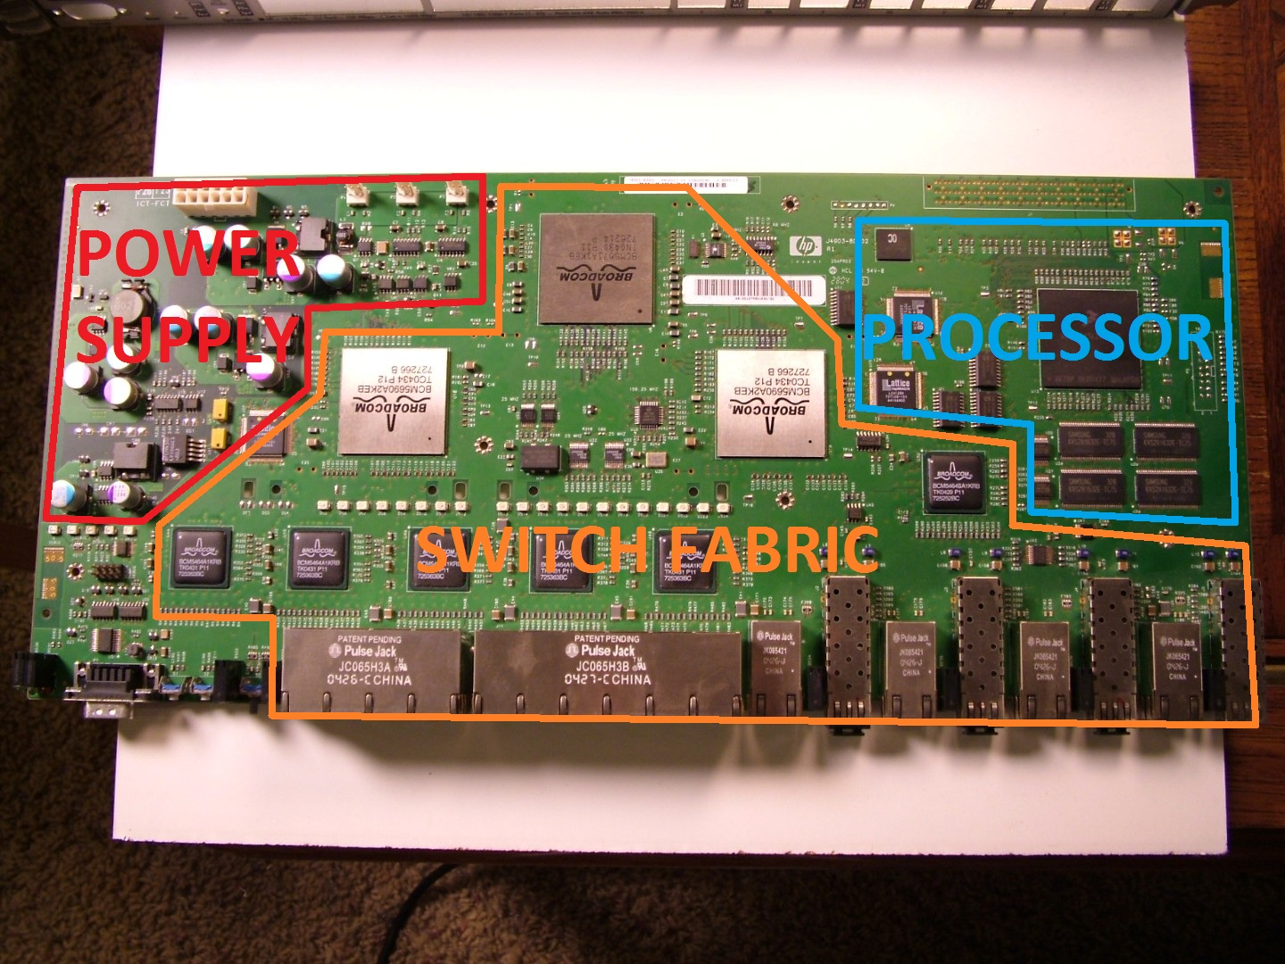

Slide 41
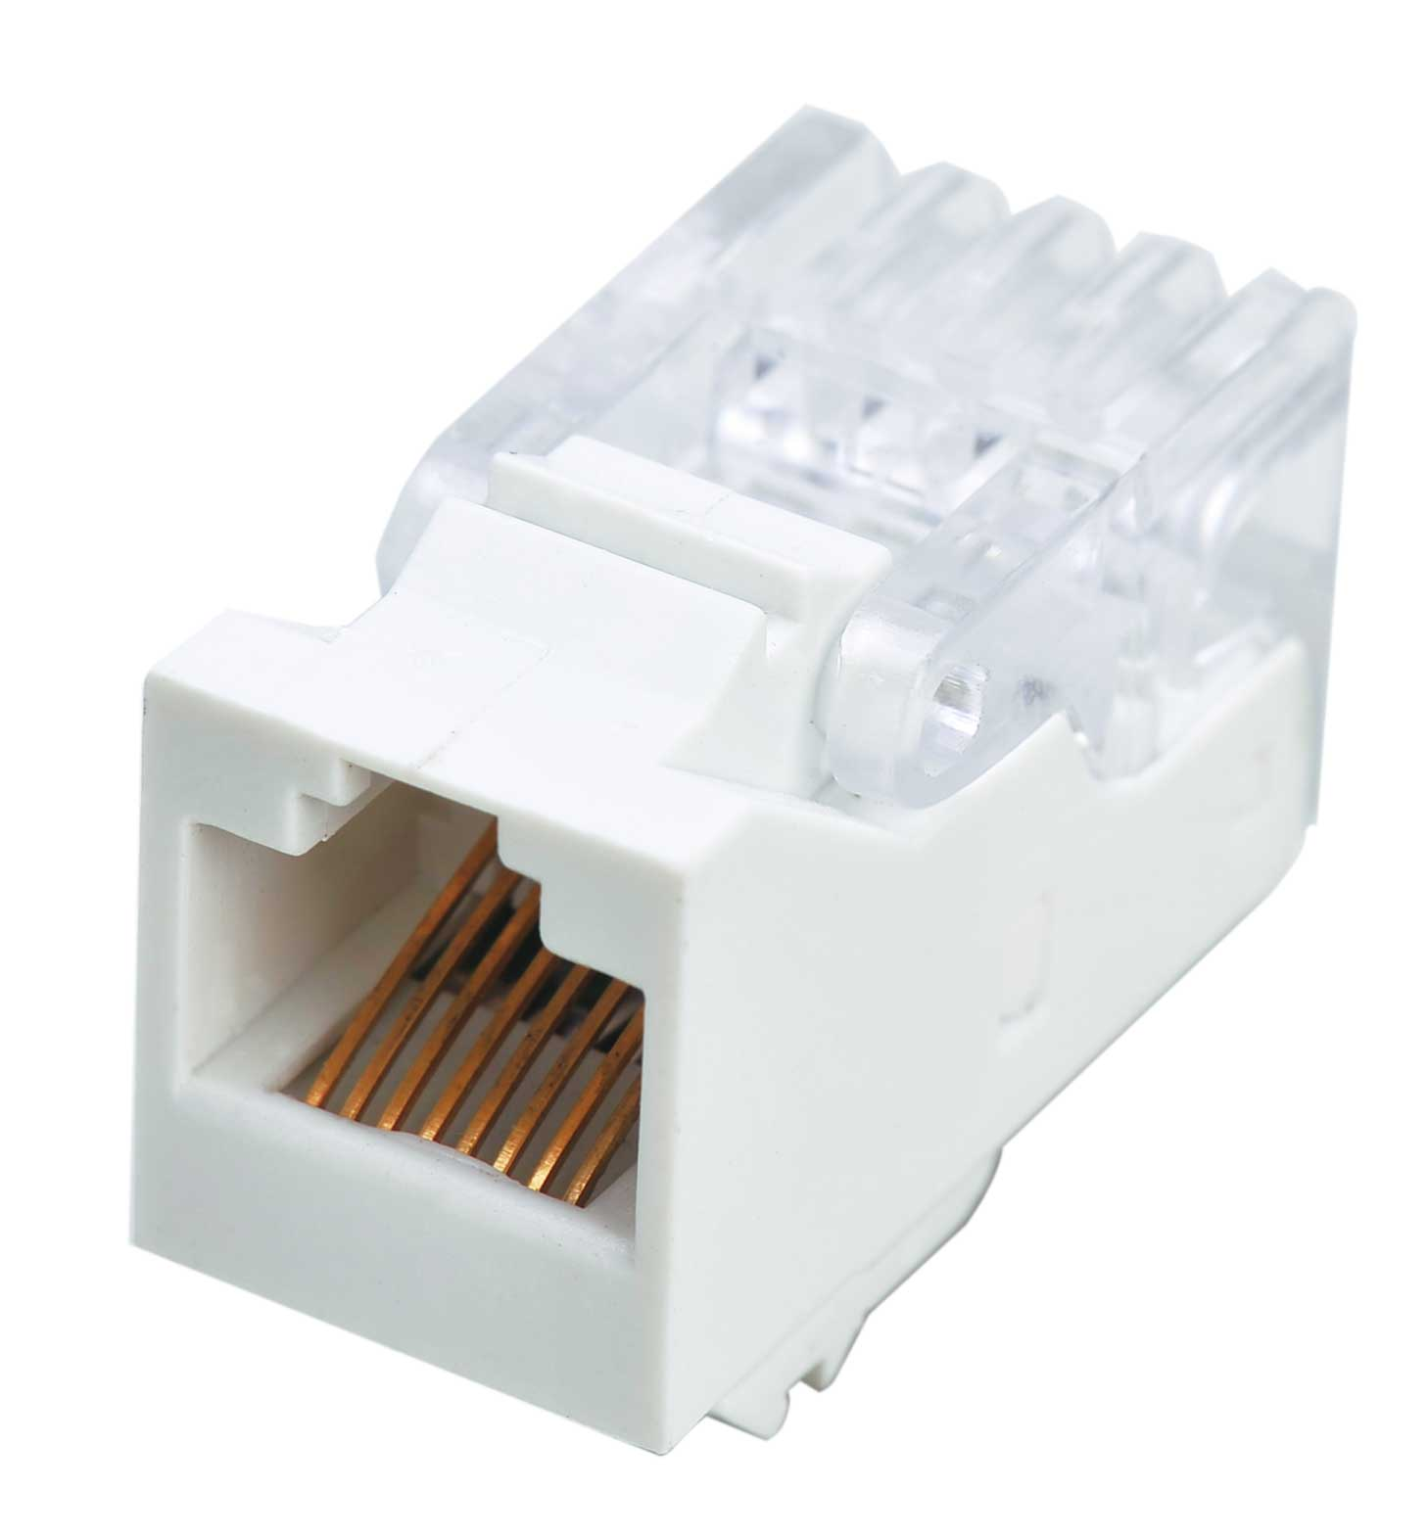
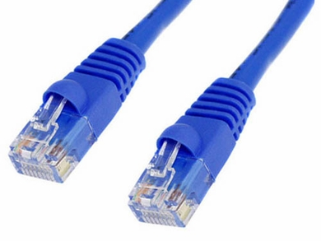
RJ45 Port and Connector
Copper

Slide 42
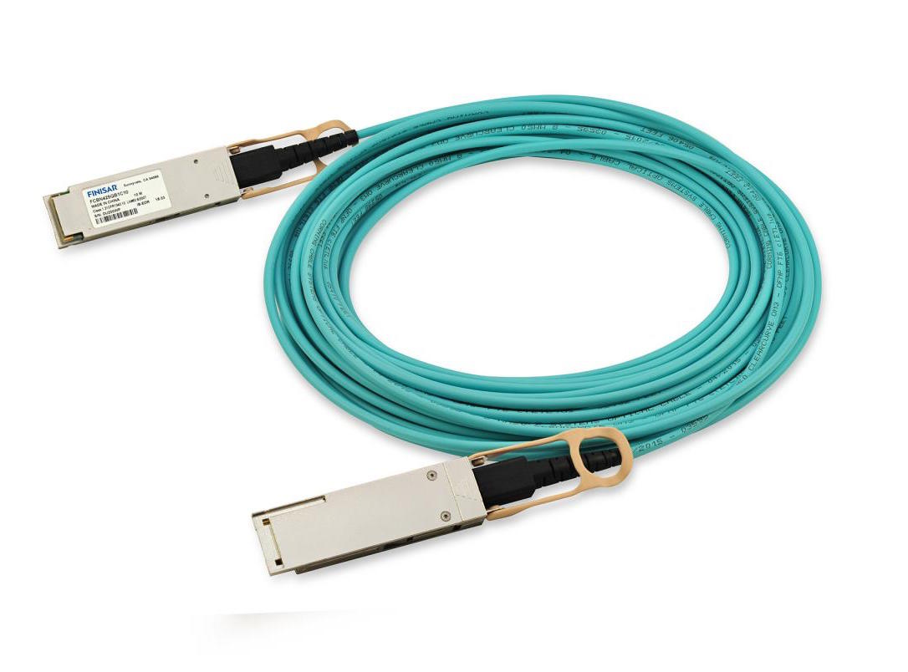
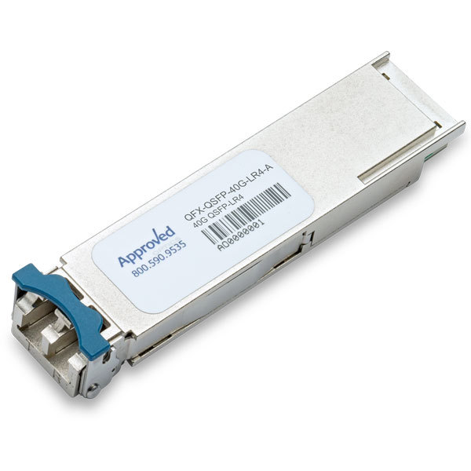
SFP and QSFP
Fiber Optic
Higher Capacity

Slide 43
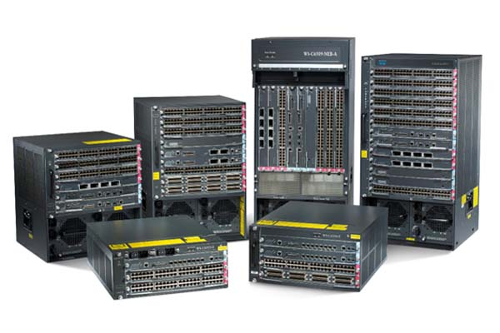

Slide 45
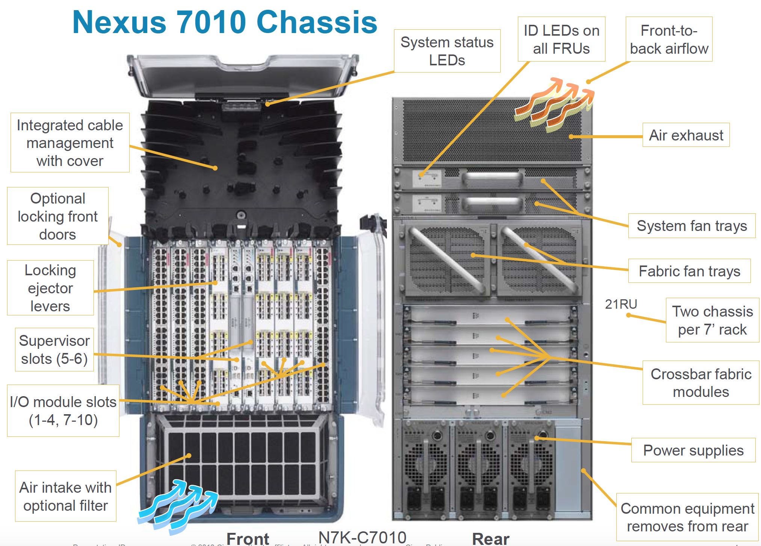

Slide 46
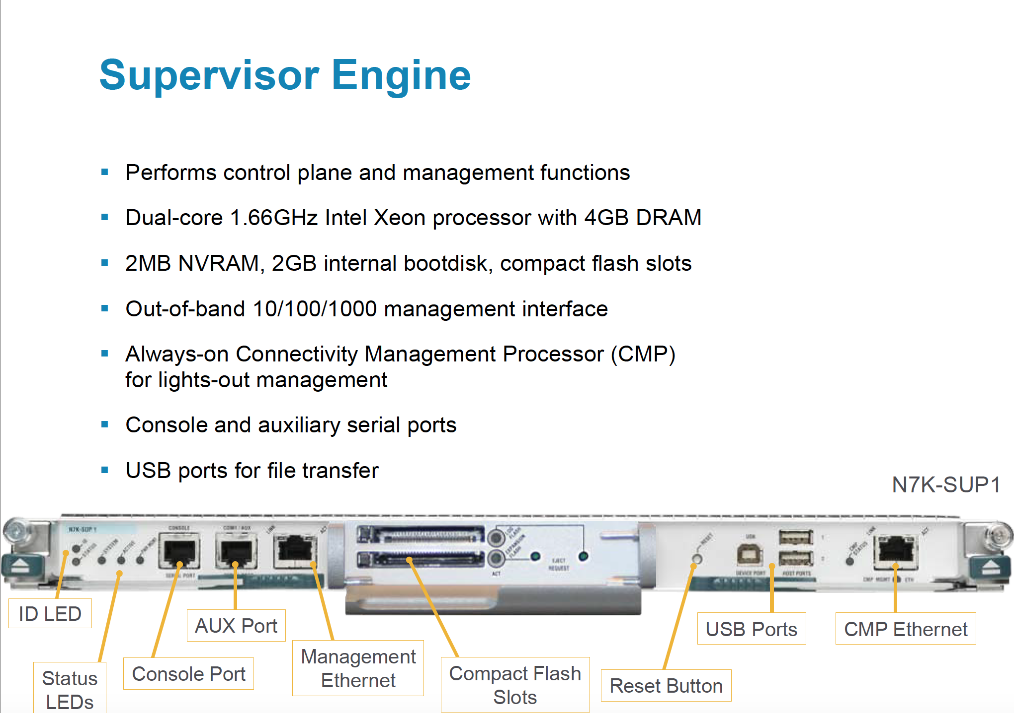

Slide 47
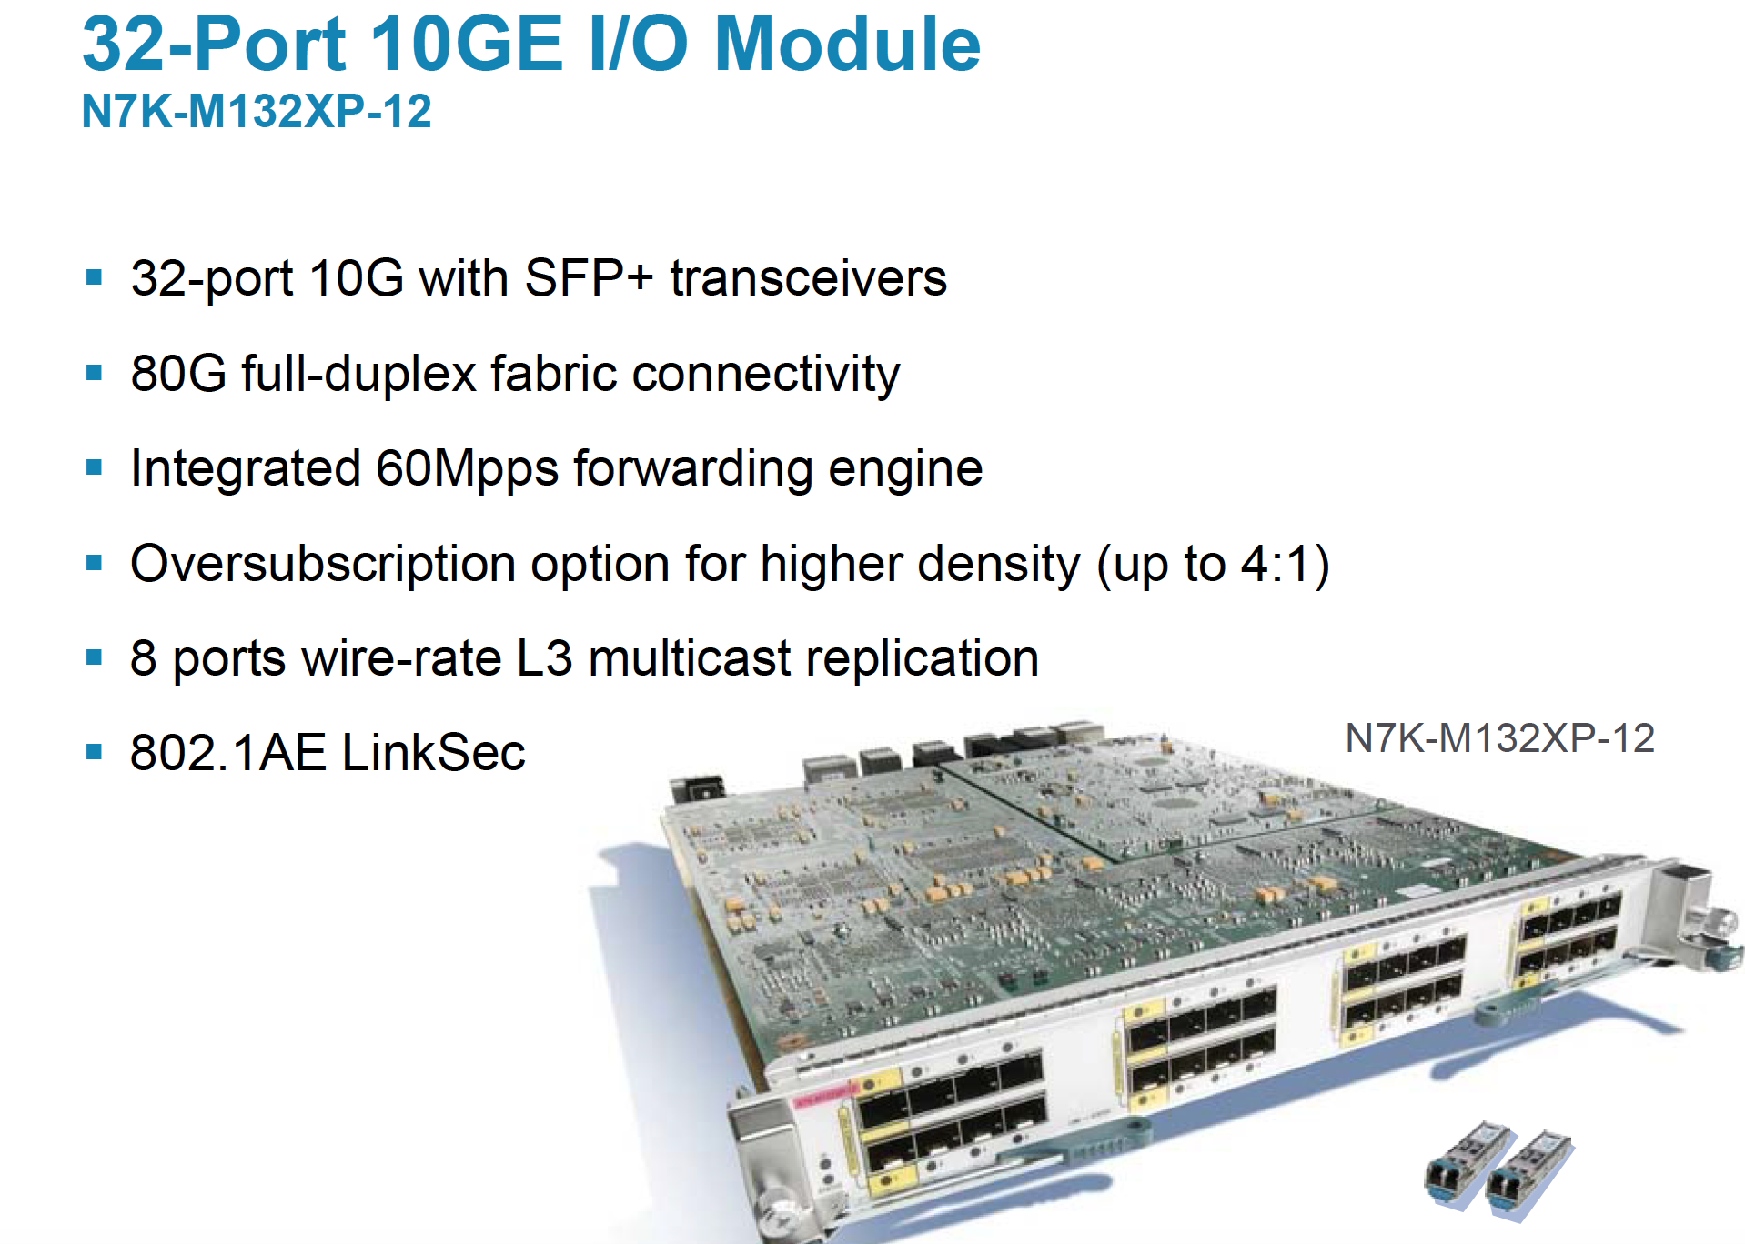

Slide 48
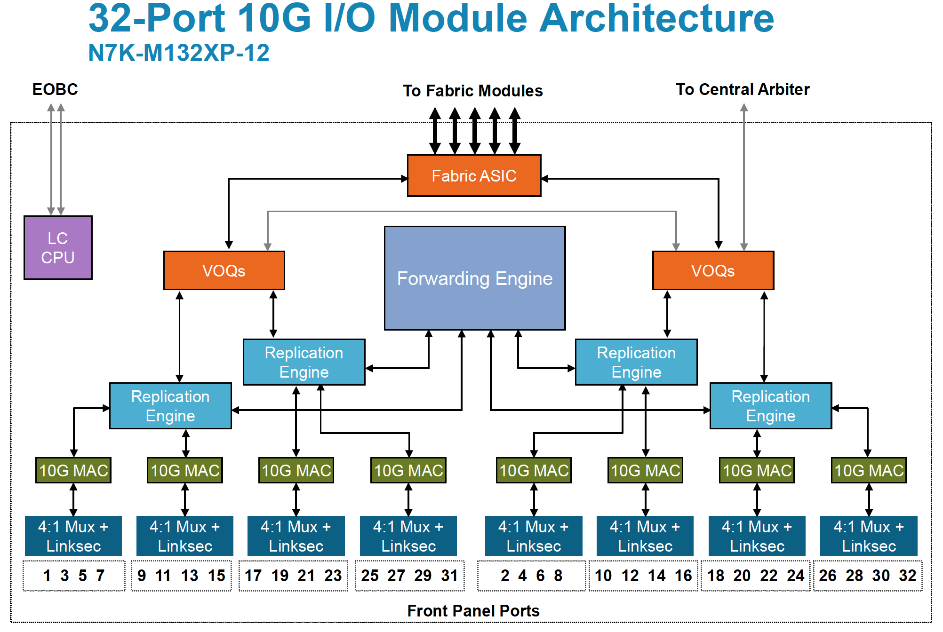

Slide 49
Replication Engine | Frames that must be sent to multiple ports are duplicated and dispatched from this chip as needed (more below)
Forwarding Engine | This is the chip with TCAM lookup tables and makes the routing and/or switching decisions. In other words, a table of addresses and output ports eg. an Ethernet frame with a destination MAC address 000c:1234:4567 is dispatched to Port 2.
VOQs | Virtual Output Queues. This is a very high speed memory modules that performs frame queueing in silicon. Queueing is needed to ensure that the fabric is not overrun in the outbound direction. Also, packets arriving from the fabric must not overrun the MAC interfaces.
Fabric | Interface chip to the switch fabric. For the NX7K, this is a five interface connection to the fabric modules on a clos switch design.
10G MAC | Media Access Control for 10 gigabit Ethernet port. Think of it as the signal encoder for SFP interface.
Linksec | Encryption processor for line rate cryptography if you are using Linksec.

Slide 50
Separation of duty
Decouple control plane and data plane
Routing tables built in control plane
  Static configuration or routing protocols (OSPF, RIP, BGP, etc.)
Downloaded to data plane/forwarding engine where it is called forwarding information base (FIB)
Notes:
Why?

Slide 51
Control Plane
More like a regular computer running multiple programs

Slide 52
Data Plane - ASIC
Speed, speed, speed! But how fast?
No need to look at entire packet

Slide 53
Event | Latency
L1 cache hit | 0.5 nano seconds (ns)
L2 cache hit | 7 ns
Main memory hit | 100 ns
Disk seek | 10,000,000 ns
Time to process line rate packet (10Gbps) | ~ 70 ns

Slide 54
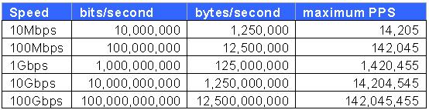
88 bytes

Slide 55
Layer 2 Forwarding
Hardware MAC learning – can learn ~100K entries
SMAC lookup to learn new <mac, vlan> entries
DMAC lookup to figure which port to exit
How would you design this?

Slide 56
Layer 3 Forwarding
Longest Prefix Match (route lookup)
  Hit returns next hop (interface)
How would you design this?
Lots of other stuff (buffering, quality of service, firewalls, security features…)

Slide 57
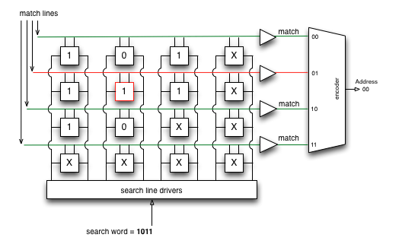
Prefix/Mask | TCAM entries
101/3 | 101X
111/3 | 111X
10/2 | 10XX
0/0 | XXXX ⬅ Default

Slide 58
Layer 3 Sundry
Lots of other stuff (buffering, quality of service, firewalls, security features…)

Slide 59
