Slide 1
MicroCast: Cooperative Video Streaming on Smartphones
Lorenzo Keller, Anh Le, Blerim Cic, Hulya Seferoglu
LIDS, Christina Fragouli, Athina Markopoulou
MobiSys’12, June 25–29, 2012
Speaker : Chia-Chih,Lin

Slide 2
Outline
Introduction
Related Work
MicroCast Architecture
MicroCast Algorithm
Implementation in Details
Evaluation
Discussion
Conclusion
Comment

Slide 3
Introduction
Motivation
  Video traffic increasing(3G and 4G as well)
  A group of users want to watch same video within proximity of each other
Problem
  Each phone’s individual cellular connection may not be sufficient for providing high video quality

Slide 4
MicroCast System Intro.
  MicroCast
    MicroDownload
      Scheduler
      Two interface for data delivery
    MicroNC-P2
      all-to-all dissemination scheme for local sharing content
      Combination of WiFi overhearing and network coding
      Significantly outperforms state-of-the-art P2P schemes
    MicroBroadcast
      High rate packet broadcast(first android-based system)

Slide 5
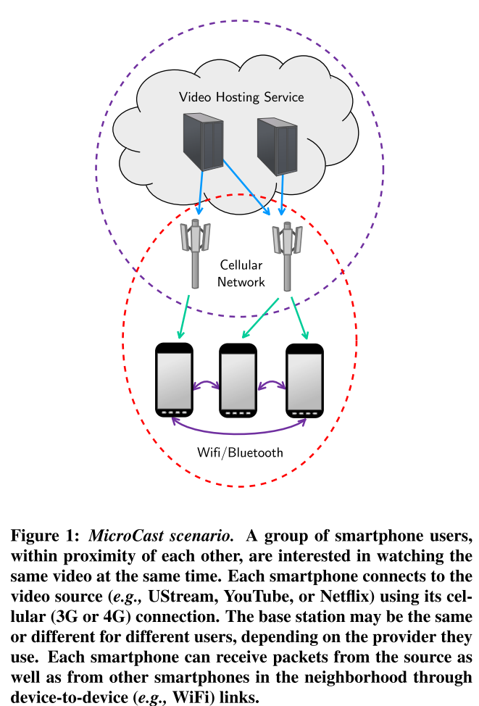
MicroCast System Scenario

Slide 6
Outline
Introduction
Related Work
MicroCast Architecture
MicroCast Algorithm
Implementation in Details
Evaluation
Discussion
Conclusion
Comment

Slide 7
Related Work
Cooperative Mobile/Wireless Systems
WiFi direct in Android(Ice Cream Sandwich)
Network Coding
  Cooperative/Wireless Systems
  Implementation
  Peer-to-Peer system
  Optimization
Contribution

Slide 8
Outline
Introduction
Related Work
MicroCast Architecture
MicroCast Algorithm
Implementation in Details
Evaluation
Discussion
Conclusion
Comment

Slide 9
MicroCast Architecture
Setup
  3G to server and WiFi to local users
Assumptions
  Small number of users(6-7)
  Users know and trust each other
  All user are within proximity of each other
  All local links have similar rates on average
  In every phone, cellular connection for the downlink and WiFi to establish local links(parallel)

Slide 10
MicroCast Architecture
MicroDownload
  Only runs on one of the phones that initiate download
MicroNC-P2
  Distributing segments using local wireless network
MicroBroadcast
  Pseudo-broadcast over WiFi
Requester
  Retrieves segments of video from the video source
Storage
Graphical User Interface(GUI)
Notes:
MicroDownload : only run on one of phones(in the group) that initiates the download, instructs the requesters of all phones which segments to download from the server

Slide 11
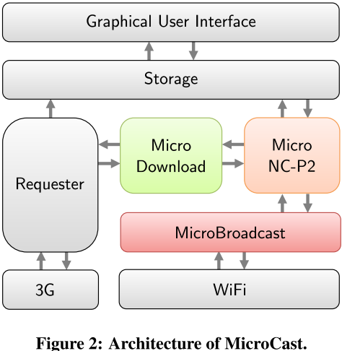
Architecture

Slide 12
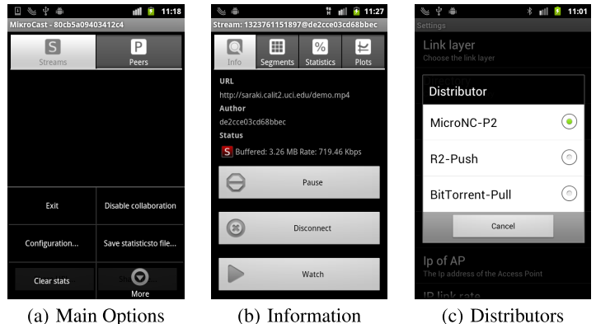
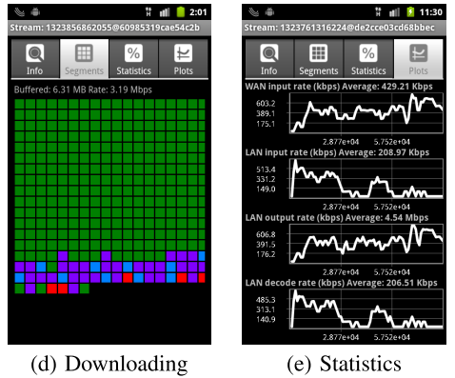
GUI

Slide 13
Outline
Introduction
Related Work
MicroCast Architecture
MicroCast Algorithm
Implementation in Details
Evaluation
Discussion
Conclusion
Comment

Slide 14
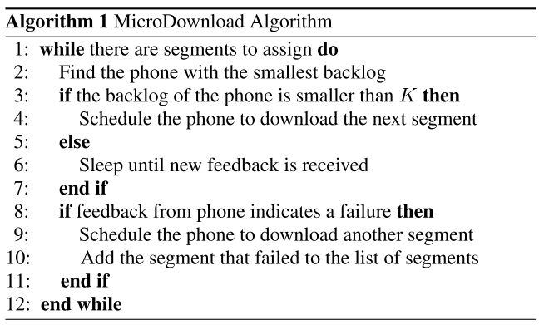
MicroCast Algorithm

Slide 15
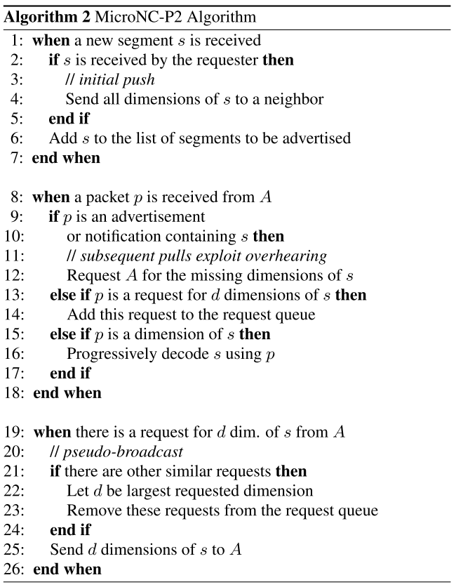
MicroCast Algorithm

Slide 16
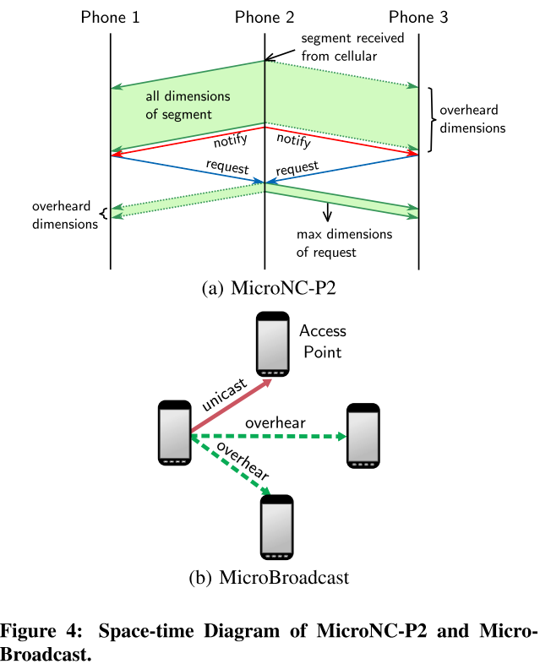
MicroCast Algorithm

Slide 17
Reception Rate
Where Rl is Receive rate in local,Rc is Receive rate in cellular, and N is the number of phones

Slide 18
Outline
Introduction
Related Work
MicroCast Architecture
MicroCast Algorithm
Implementation in Details
Evaluation
Discussion
Conclusion
Comment

Slide 19
Architecture Details
Devices
Requester
  Three types of sources: HTTP, file, and content
Storage
  Java API,
  Android MediaPlayer(for playback)
GUI
MicroBroadcast
  Application layer implementation of a network stack
Notes:
HTTP from server
File means local file
Content represents ContentProvider API by android , (e.g., camera)

Slide 20
Multiple Network Interface
Downlink(3G or WiFi)
Local cooperation(WiFi or Bluetooth)
Not suggest WiFi+Bluetooth
Challenges from android connectivity manager
  Shut down when both interface are activated

Slide 21
Network Coding
Use generation-based network coding
CPU Limitations
  NC is CPU intensive operation
  Need an efficient way to encode/decode
  Java vs native code (C)

Slide 22
Implementing High-Rate WiFi Broadcast
Disadvantages in 802.11 broadcast mode
  Lacks a back-off mechanism
  Transmission rate is limited(base rate, 1Mbps)
  Not always adapt on Android phone(wireless driver and firmware limitation)

Slide 23
High-Rate WiFi Broadcast cont.
Possible sol : Pseudo-broadcast(overhearing)
Challenges:
  Phone do not support the promiscuous mode
  Android do not support pseudo-broadcast
  Overhearing is not available in ad-hoc mode
Implement “pseudo-ad-hoc mode”(Fig 4.(b))

Slide 24
Outline
Introduction
Related Work
MicroCast Architecture
MicroCast Algorithm
Implementation in Details
Evaluation
Discussion
Conclusion
Comment

Slide 25
Evaluation
Download time
Video rate
Testbed :
  4 Samsung Captivate 3Nexus S
  1G Cortex-A8 CPU
  512MB RAM
  6 use Android 2.3, 1 use Android 4.0

Slide 26
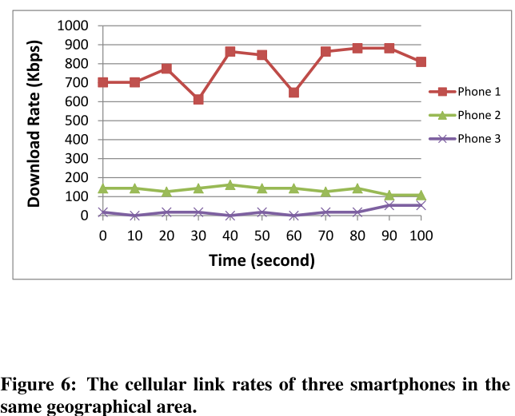
MicroDownload

Slide 27
MicroNC-P2
Compare to
  BitTorrent-based distributor (BitTorrent-Pull)
  R2-based distributor (R2-Push)
Consider
  Clique and star topologies
  using UDP packets locally

Slide 28
BitTorrent-Pull&R2-Rush
BitTorrent-Pull
  Three main types of messages
    Bitfield and have
    Request
    Piece
R2-Push
  Two main types of messages
    Data
    brake

Slide 29
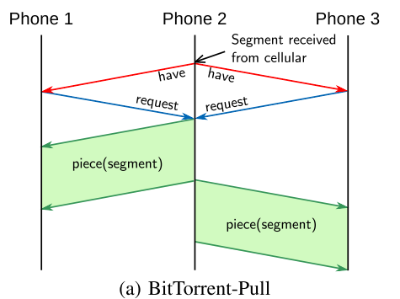
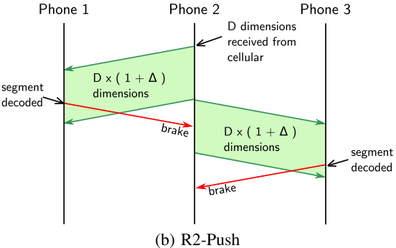
BitTorrent-Pull&R2-Rush

Slide 30
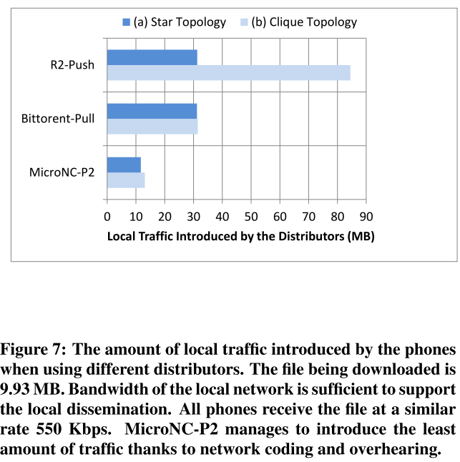
Evaluation of MicroNC-P2

Slide 31
Evaluation of MicroCast
7 phones
  4 has 3G
Locally UDP
Support up to 20 Mbps UDP traffic
Star topology
Use pseudo-adhoc
9.93 MB file
Average of 3 experiments

Slide 32
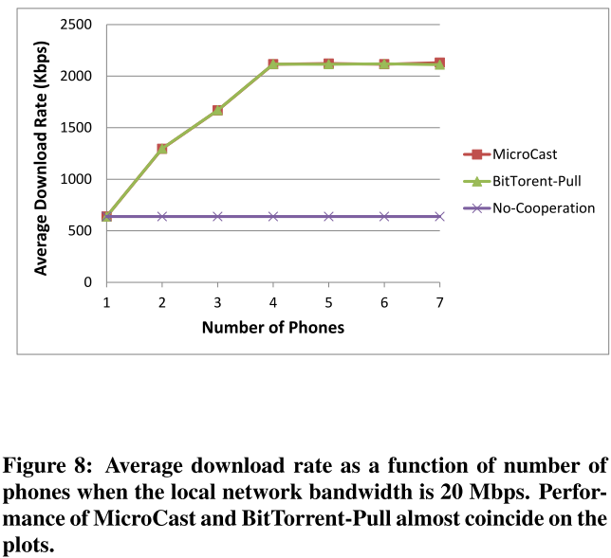
Evaluation of MicroCast

Slide 33
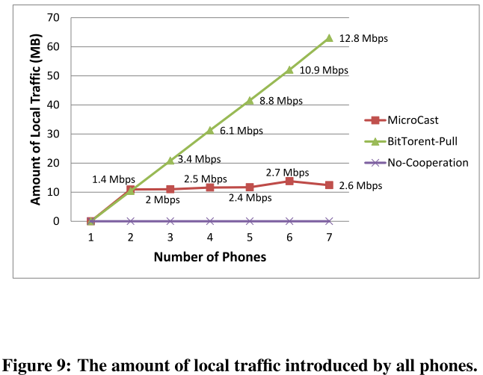
Evaluation of MicroCast

Slide 34
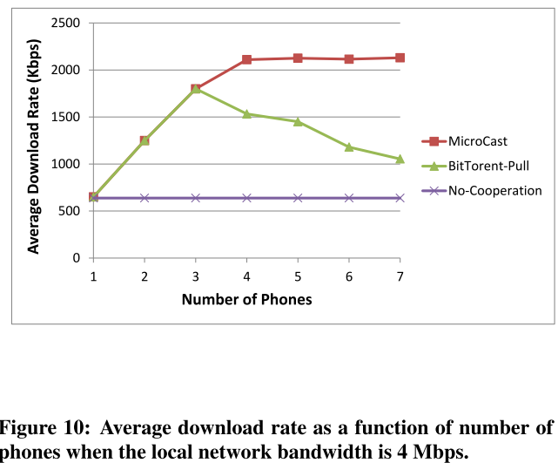
Evaluation of MicroCast

Slide 35
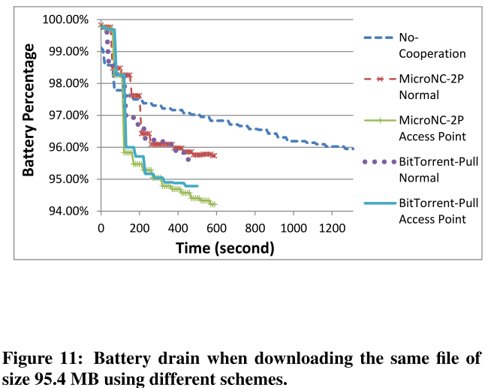
Energy consumption

Slide 36
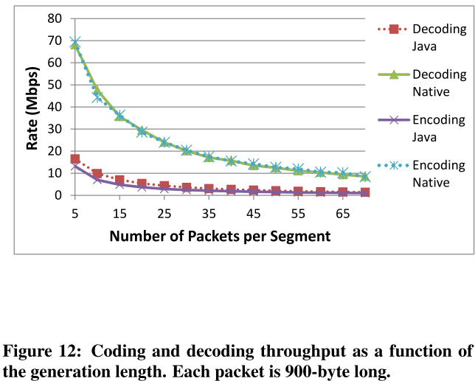
Evaluation of NC Implementations

Slide 37
Outline
Introduction
Related Work
MicroCast Architecture
MicroCast Algorithm
Implementation in Details
Evaluation
Discussion
Conclusion
Comment

Slide 38
Discussion
Limitations and Extensions
  Highly modular
  Bluetooth vs WiFi for local sharing
    Pros and cons
      Need not to root the phone
      Support single and mulit-hop
      But not support broadcast
  WiFi vs cellular for download from server
    No longer independent as they both use WiFi
  MicroDownload can be improved
  Small number of trusted users(under 7 users)

Slide 39
Outline
Introduction
Related Work
MicroCast Architecture
MicroCast Algorithm
Implementation in Details
Evaluation
Discussion
Conclusion
Comment

Slide 40
Conclusion
MicroCast enables users to watch the same video from the internet
It cooperatively uses the resources on all smartphone of the group
Three mainly components
Results demonstrate significant performance without battery penalty

Slide 41
Outline
Introduction
Related Work
MicroCast Architecture
MicroCast Algorithm
Implementation in Details
Evaluation
Discussion
Conclusion
Comment

Slide 42
Comment
Simple but good idea
Can try WIFI direct
Lack of some evaluation pictures

Slide 43
Q&A
Thanks for listening

