Slide 1
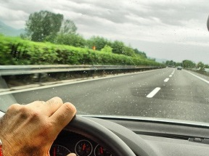






CarSafe
Alerting Drowsy and Distracted Drivers using Dual Cameras on Smartphones
Chuang-Wen (Bing) You, Nicholas D. Lane,
Fanglin Chen, Rui Wang, Zhenyu Chen, Thomas J. Bao, Martha Montes-de-Oca, Yuting Cheng, Mu Lin, Lorenzo Torresani, Andrew T. Campbell
0
Notes:
Hi,

Slide 2
Outline
Outline
Motivation
Approach
Design & implementation
Evaluation
Related work
Conclusion

Slide 3
Outline
Outline
Motivation
Approach
Design & implementation
Evaluation
Related work
Conclusion

Slide 4
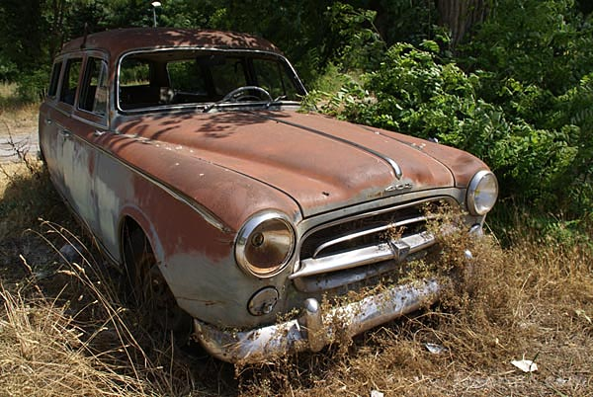
What do you do if you can’t afford a top end car with all those safety features?

Slide 5
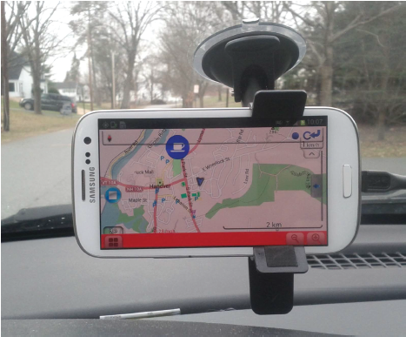
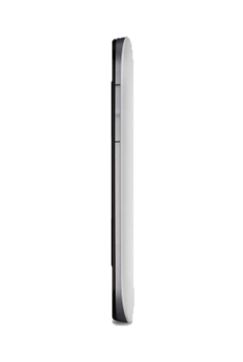
CarSafe
First dual-camera app

Slide 6
Outline
Outline
Motivation
Approach
Design & implementation
Evaluation
Related work
Conclusion

Slide 7
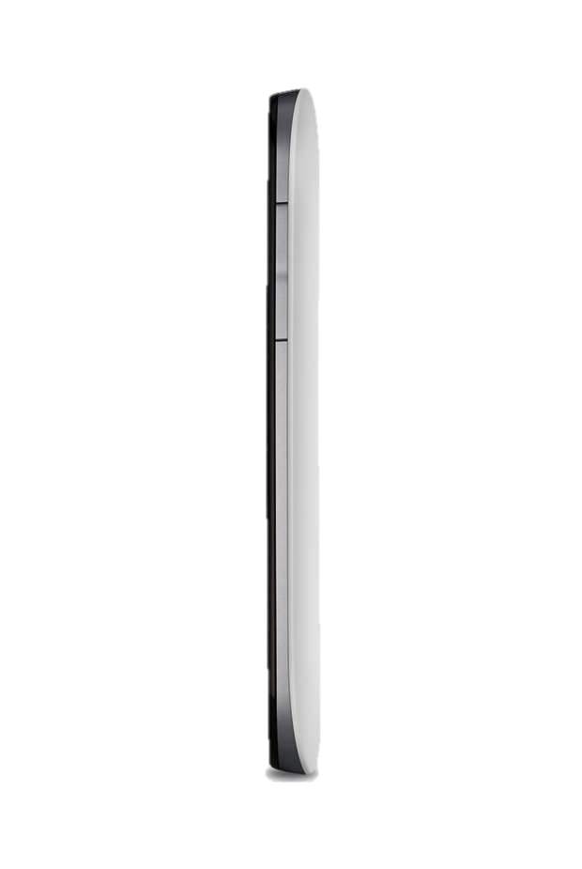

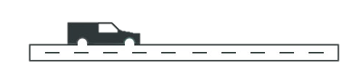
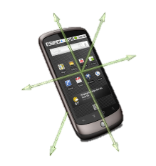
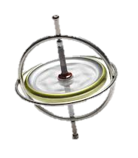
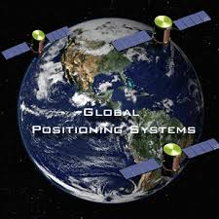
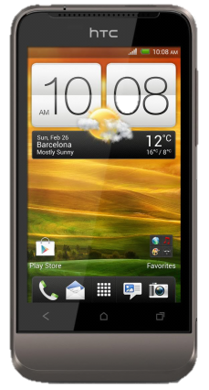
CarSafe
Dual-camera app
What are detected:
1) Face directions
2) Eye states
What are detected:
1) The following distances
2) Lane trajectory categories
What are detected:
1) Speed
2) Turns
3) Lane trajectory categories
GPS
Accelerometer
Gyroscope
Notes:
What are detected

Slide 8
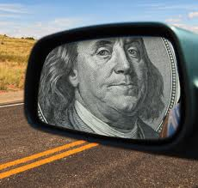
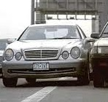
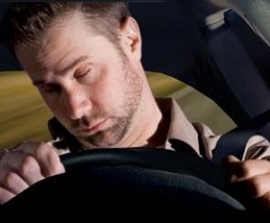
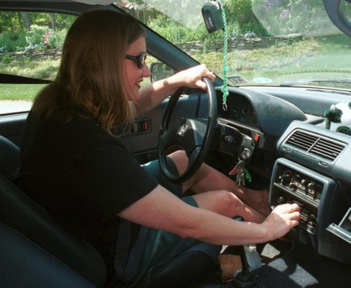
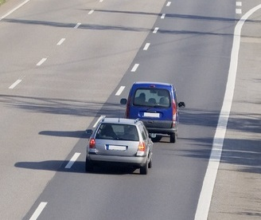
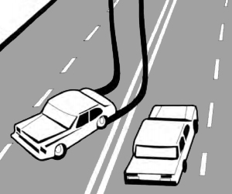
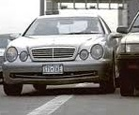
Dangerous driving events
Drowsy driving
  Inattentive driving
  Tailgating
  Lane weaving
  Careless lane change

Slide 9
Limited dual camera access
`
A blind spot in the front
`
Time
A blind spot in the back
Back camera
Switching delay
Front camera

Slide 10
Switching delay & frame processing time
About 500 ms ~ 3 seconds
About 50 ms ~ 2 seconds
Overhead Model | Switching delay (Front-Back (ms)) | Switching delay (Back-Front (ms)) | Frame processing time (Face detection (ms))
Nokia Lumia | 804 | 2856.3 | 2032.5
Samsung Galaxy S3 | 519 | 774 | 301.2
HTC One X | 1030 | 939 | 680.3
iPhone 4S | 446 | 503 | 70.92
iPhone 5 | 467 | 529 | 58.48

Slide 11
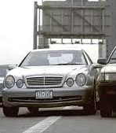
Challenges for real-time processing of dual camera video streams on smartphones
Limited dual-camera access
Events occurring in blind spots
Varying mobile environment
Real-time performance
Camera switching algorithm
Sensor fusion techniques to
provide blind spot hints
Adapt existing vision algorithms
Utilize multicore computation resources

Slide 12
Outline
Outline
Motivation
Approach
Design & implementation
Evaluation
Related work
Conclusion

Slide 13
The Overview of CarSafe
CarSafe Architecture
alerts
user interface
dangerous driving conditions
dangerous driving event engine
driver states
road conditions
car events
multicore computation planner
driver classification pipeline
road classification pipeline
car classification pipeline
front/rear images
lane proximity
blind spot hints
sensor readings
context-driven camera switching
front images
rear images
front-facing camera
rear-facing camera
GPS, accel, gyro & compass

Slide 14
The Overview of CarSafe
CarSafe architecture
Driver, road, & car classification pipelines
alerts
alerts
user interface
user interface
dangerous driving conditions
dangerous driving conditions
dangerous driving event engine
dangerous driving event engine
driver states
road conditions
car events
multicore computation planner
multicore computation planner
driver classification pipeline
road classification pipeline
car classification pipeline
front/back images
lane proximity
lane proximity
blind spot hints
blind spot hints
sensor readings
context-driven camera switching
context-driven camera switching
back images
front images
back images
front images
GPS, accel, gyro & compass
back-facing camera
GPS, accel, gyro & compass
front-facing camera
back-facing camera
front-facing camera

Slide 15
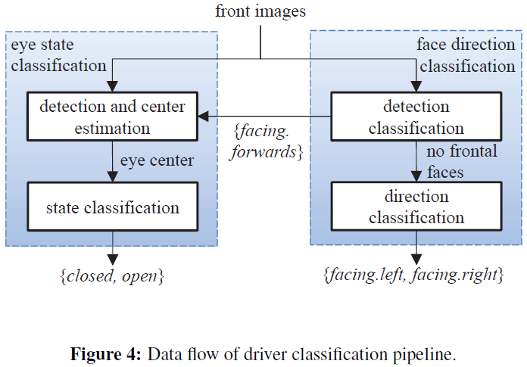
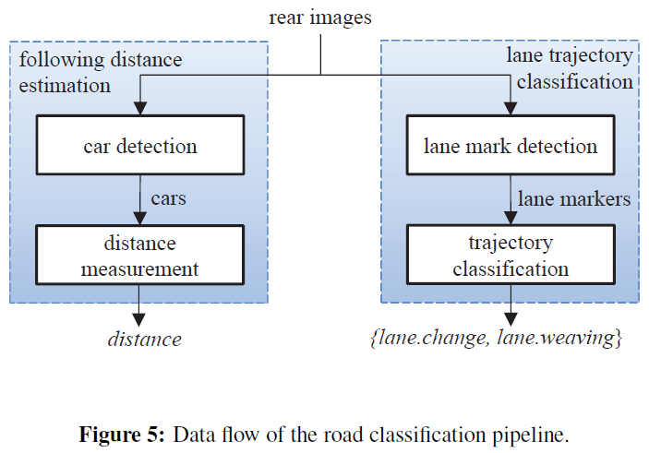
Driver classification pipeline
DATA FLOW

Slide 16
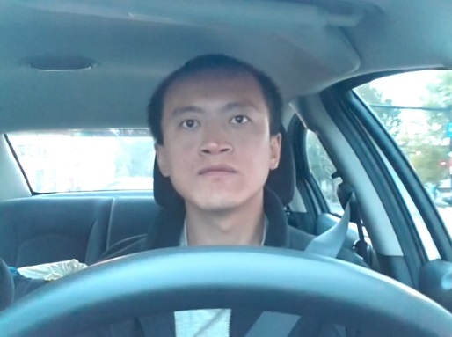


Driver Classification Pipeline
Driver classification pipeline
Eye state classification
{closed, open}
Eye center localization
Eye state classification
Frontal face detection
Eye region estimation
Eye center localization
Eye state classification
Frontal face detection
Eye region estimation
- Haar-like feature
- Adaboost classifier for frontal faces
- Active shape model
- Gradient-based approach
- SURF features
- SVM classifier

Slide 17
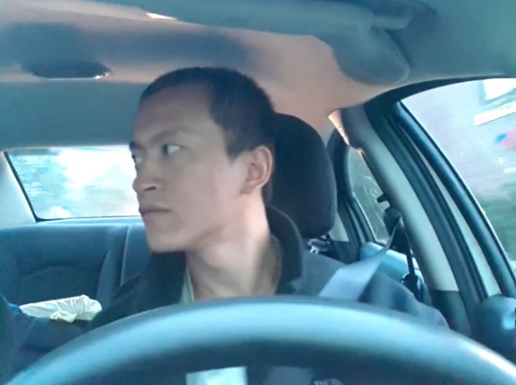
Driver Classification Pipeline
Driver classification pipeline
Face direction classification
facing.right
Frontal face detection
Side face detection
Frontal face detection
Side face detection
Face direction classification
- Haar-like feature
- Adaboost classifier for frontal faces
- Haar-like feature
- Adaboost classifier for side faces
- Left face → facing right
- Right face → facing left

Slide 18
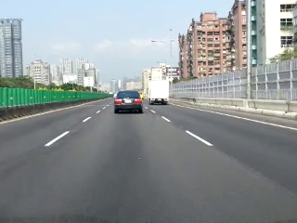
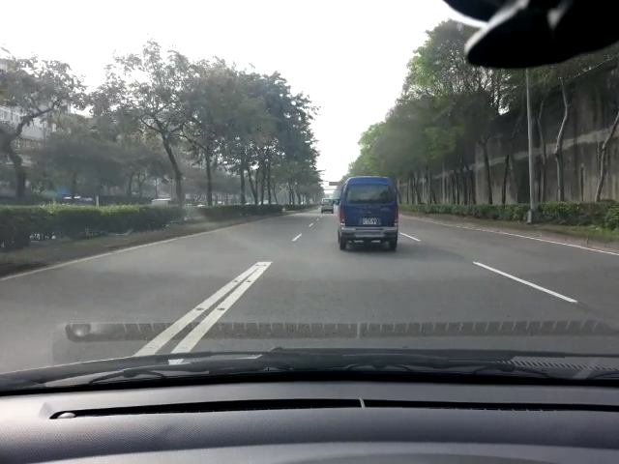
Road classification pipeline
Lane trajectory detection
Lane crossing events
Decision tree
Lane change
Lane weaving
Crossing
Lane marker detection
Lane crossing detection
Trajectory classification
Lane marker detection
Lane crossing detection

Slide 19
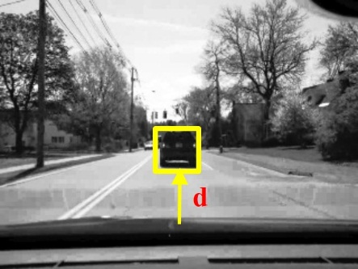
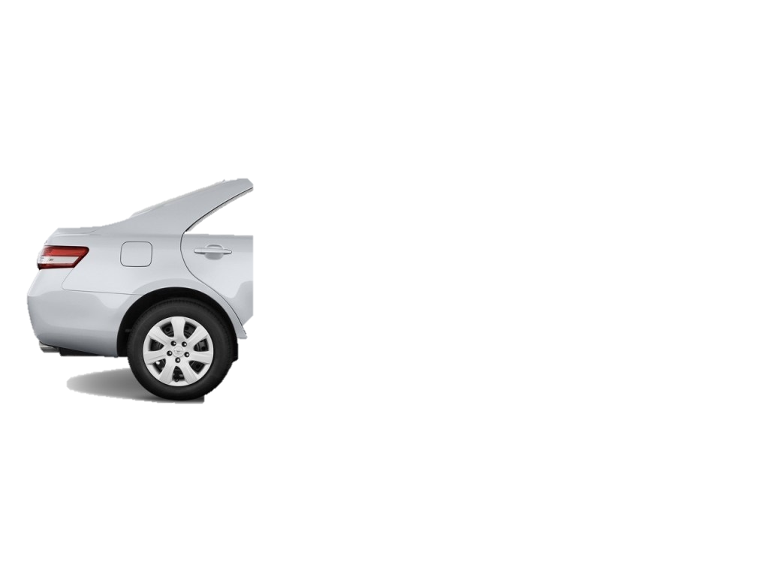
Road classification pipeline
Following distance estimation
Image plane
N
d1
M
M
d2
Focal point (F)
f
N
R
S
Road surface
Z2
Z1
Car recognition
Distance estimation
Car recognition
- Haar-like feature
- Adaboost classifier for cars
- Pin-hole camera projection

Slide 20
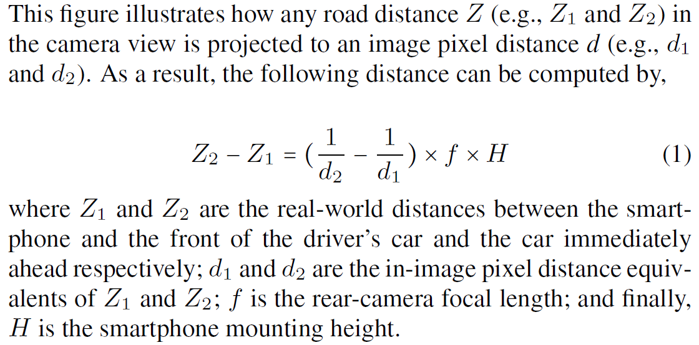
Road classification pipeline
Following distance estimation

Slide 21
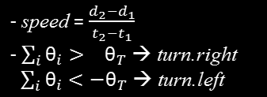
Road classification pipeline
Speed, turn, and trajectory inferences
GPS samples
θ2
Inertial sensor readings
d3
θ1
d2
Multi-variate Gaussian
d1
Lane change / weaving class
Other class
Speed estimation & turn detection
Speed estimation & Turn detection
Trajectory classification
Trajectory classification
- Provide as blind spot hints

Slide 22
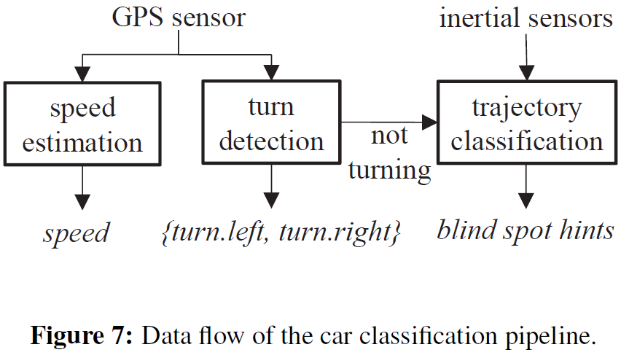
Car classification pipeline

Slide 23
The Overview of CarSafe
CarSafe architecture
Dangerous driving event engine
alerts
alerts
user interface
user interface
dangerous driving conditions
dangerous driving event engine
driver states
road conditions
car events
multicore computation planner
multicore computation planner
driver classification pipeline
driver classification pipeline
road classification pipeline
road classification pipeline
car classification pipeline
car classification pipeline
front/back images
lane proximity
blind spot hints
front/back images
lane proximity
blind spot hints
sensor readings
sensor readings
context-driven camera switching
context-driven camera switching
back images
front images
back images
front images
GPS, accel, gyro & compass
back-facing camera
GPS, accel, gyro & compass
front-facing camera
back-facing camera
front-facing camera

Slide 24
Dangerous Driving Event Engine
Dangerous driving event engine
Drowsy Driving
  Measuring alertness, PERcentage of CLOSure of the eyelid (PERCLOS), and declares the driver “drowsy” if PERCLOS exceeds a threshold
Inattentive Driving
  Not facing forward for longer than 3 seconds while the car is moving forward
Tailgating
  The safe following distance is not respected for a period longer than 3 seconds
Lane Weaving and Drifting
  The classifier infers lane weaving continuously for longer than 2 seconds
Careless Lane Change
  No head turn corresponding to a lane change event
Drowsy driving
  Inattentive driving
  Tailgating
  Lane weaving
  Careless lane change

Slide 25
The Overview of CarSafe
CarSafe Architecture
Context-driven camera switching
alerts
alerts
user interface
user interface
dangerous driving conditions
dangerous driving conditions
dangerous driving event engine
dangerous driving event engine
car events
driver states
car events
driver states
road conditions
road conditions
multicore computation planner
multicore computation planner
driver classification pipeline
driver classification pipeline
road classification pipeline
road classification pipeline
car classification pipeline
car classification pipeline
front/back images
lane proximity
blind spot hints
lane proximity
blind spot hints
sensor readings
sensor readings
context-driven camera switching
front images
back images
GPS, accel, gyro & compass
back-facing camera
GPS, accel, gyro & compass
front-facing camera
back-facing camera
front-facing camera

Slide 26



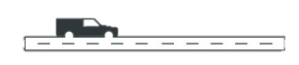
Context-driven camera switching
Scheduled switching
Predict when to switch based on current context (PERCLOS, speed or following distance)
Tb
Tf
Time
Tf
Front camera
Back camera
Switching delay
Tb

Slide 27
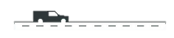
Context-driven camera switching
Pre-emptive switching
Pre-empted by blind spot hints or lane proximity information
Original switching point
Tf
Tf
Tb
Time
Pre-empted by a blind spot hint
Front camera
Back camera
Switching delay
Tb

Slide 28
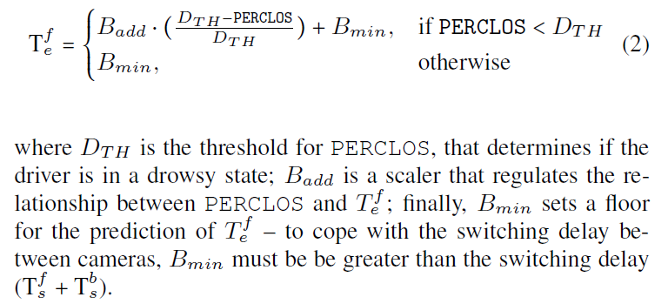
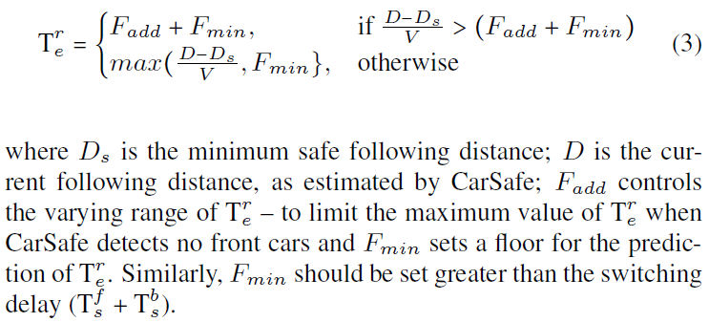

Slide 29
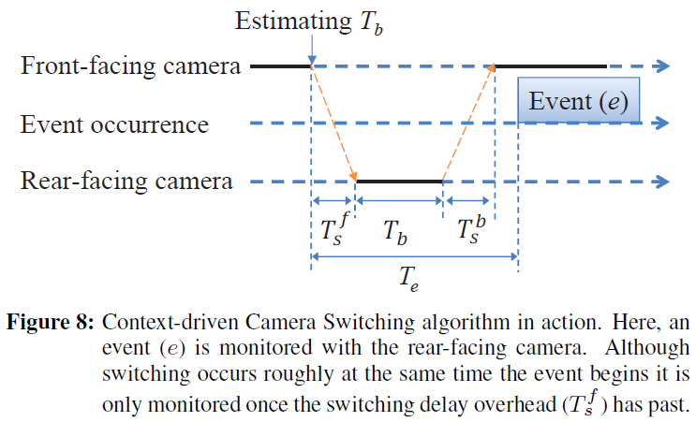

Slide 30
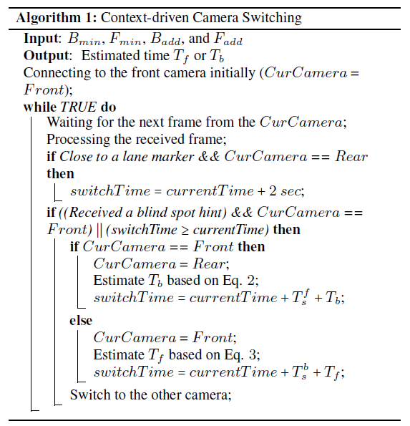

Slide 31
The Overview of CarSafe
CarSafe architecture
Multicore computation planner
alerts
alerts
user interface
user interface
dangerous driving conditions
dangerous driving conditions
dangerous driving event engine
dangerous driving event engine
car events
driver states
car events
driver states
road conditions
road conditions
multicore computation planner
multicore computation planner
driver classification pipeline
driver classification pipeline
road classification pipeline
road classification pipeline
car classification pipeline
car classification pipeline
front/back images
lane proximity
blind spot hints
front/back images
lane proximity
blind spot hints
sensor readings
context-driven camera switching
sensor readings
context-driven camera switching
front images
back images
front images
back images
GPS, accel, gyro & compass
back-facing camera
GPS, accel, gyro & compass
front-facing camera
back-facing camera
front-facing camera

Slide 32
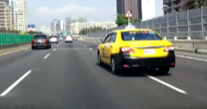
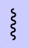
Multi-core Computation Planner
Multicore computation planner
Leverage the multicore architecture of new smartphones to perform classification
queue manager
dispatcher
drop outdated frames
demultiplexer
events

Slide 33
CarSafe architecture
User interface
alerts
user interface
dangerous driving conditions
dangerous driving event engine
dangerous driving event engine
car events
driver states
car events
driver states
road conditions
road conditions
multicore computation planner
multicore computation planner
driver classification pipeline
driver classification pipeline
road classification pipeline
road classification pipeline
car classification pipeline
car classification pipeline
front/back images
lane proximity
blind spot hints
front/back images
lane proximity
blind spot hints
sensor readings
sensor readings
context-driven camera switching
context-driven camera switching
front images
back images
front images
back images
GPS, accel, gyro & compass
back-facing camera
GPS, accel, gyro & compass
front-facing camera
back-facing camera
front-facing camera

Slide 34

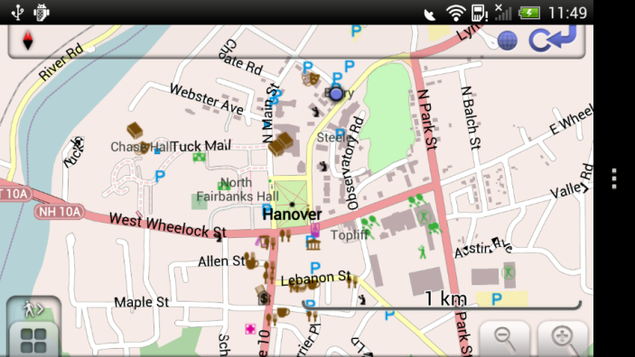

User Interface
User interface & implementation

Slide 35
Outline
Outline
Motivation
Approach
Design & implementation
Evaluation
Related work
Conclusion

Slide 36
Evaluation
Evaluation
Demonstrate CarSafe under real-world conditions where people use the application in the wild
  Overall accuracies of CarSafe & individual pipelines
  Effectiveness of the context-driven camera switching
  Performance improvement of the multicore computation planner

Slide 37
Data Collection
Data collection
Collecting datasets to adequately evaluate CarSafe is challenging
Two distinct experiments and datasets
  12 participants (11 males and 1 female)
    Controlled car maneuvers (6 males)
    Normal daily driving (5 males and 1 female)
Manually labeled dangerous driving events

Slide 38
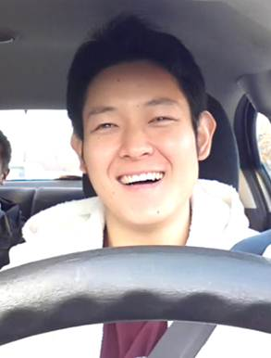
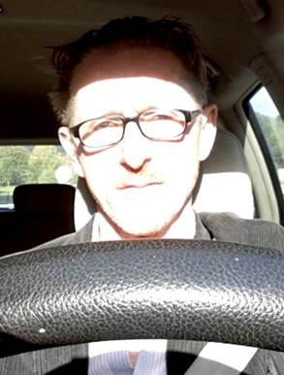
Overall CarSafe Accuracy
Overall CarSafe accuracy
Condition | # of true positives | # of false positives | # of ground truth | Precision | Recall
Drowsy driving | 18 | 12 | 25 | 0.6 | 0.72
Tailgating | 62 | 8 | 78 | 0.89 | 0.79
Careless lane change | 12 | 2 | 14 | 0.86 | 0.86
Lane weaving | 16 | 0 | 22 | 1.00 | 0.72
Inattentive driving | 16 | 4 | 25 | 0.8 | 0.64
Overall | - | - | 164 | 0.83 | 0.75
0.75
smiling
squinting

Slide 39
Overall accuracy for detecting low-level events
Event | # of true positives | # of false positives | # of ground truth | Precision | Recall
Part 1: events detected from the driver classifier
facing.right | 21 | 10 | 31 | 0.68 | 0.68
facing.left | 23 | 6 | 26 | 0.79 | 0.88
Part 2: events detected from the road classifier
lane.change | 21 | 1 | 24 | 0.95 | 0.88
lane.weaving | 16 | 2 | 22 | 1.00 | 0.73
Part 3: events detected from the car classifier
turn.right | 31 | 0 | 35 | 1.00 | 0.89
turn.left | 22 | 2 | 25 | 0.92 | 0.88
Overall | - | - | - | 0.89 | 0.82

Slide 40
Overall accuracy for classifying lane trajectory events
Mean precision and recall are 84% and 76% respectively
# of data segments |  | Detected
 |  | Lane change / weaving | Other
Real | Lane change / weaving | 190 | 30
 | Other | 109 | 1127

Slide 41
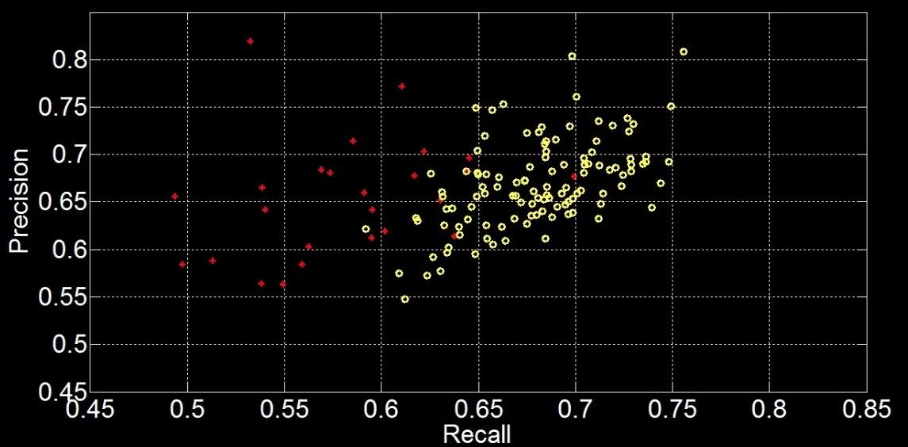
Effectiveness of the context-driven camera switching
Compare carsafe to a static strategy (baseline)
carsafe outperforms baseline
The optimal parameter setting
baseline
carsafe

Slide 42
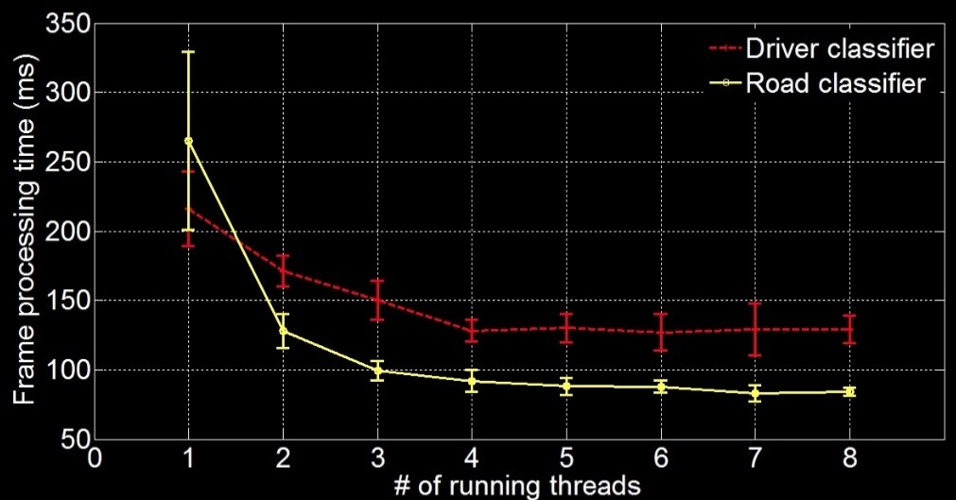
Multi-core Computation Planner
Multicore computation planner benchmarks
Front fps: 5 → 10
Back fps: 4 → 11

Slide 43
Outline
Outline
Motivation
Approach
Design & implementation
Evaluation
Related work
Conclusion

Slide 44
Related Work
Related work
 | Cost | Device | Detected event
Fixed vehicle-mounted devices | $$ | Fixed cameras | Driver drowsiness, Lane departure, or following distance
Top-end cars | $$$$ | Cameras, radar, and ultrasonic sensors | Collision avoidance, night vision, and pedestrian detection
Existing phone-based systems | $ | Smartphones | Collision & off-road warnings
CarSafe | $ | Dual-camera Smartphones | Drowsy driving, inattentive driving, tailgating, lane weaving, and careless lane change

Slide 45
Outline
Outline
Motivation
Approach
Design & implementation
Evaluation
Related work
Conclusion

Slide 46
Conclusion
Conclusion
Propose the design and implementation of CarSafe and evaluate CarSafe in a small field trial
Explore how to design computation-intensive mobile apps
  Where are the performance bottlenecks?
Apply and tune vision algorithms for mobile sensing apps
  How well existing vision algorithms can achieve under varying mobile settings?
Our future plans
  Improve the current prototype
  Test CarSafe on other phone models or platforms
Stimulate dual camera app interest
  Encourage major platform vendors to solve this dual camera problem

Slide 47
Drive Safe.
Be Safe.
Think CarSafe.
0
Notes:
Hi,

