Slide 1
MAUI: Making Smartphones Last Longer With Code Offload
Eduardo Cuervo - Duke
Aruna Balasubramanian - U Mass Amherst
Dae-ki Cho - UCLA
Alec Wolman, Stefan Saroiu, Ranveer Chandra, Paramvir Bahl – Microsoft Research

Slide 2
Battery is a scarce resource
CPU performance during same period: 246X
A solution to the battery problem seems unlikely
Just 2X in 15 years

Slide 3
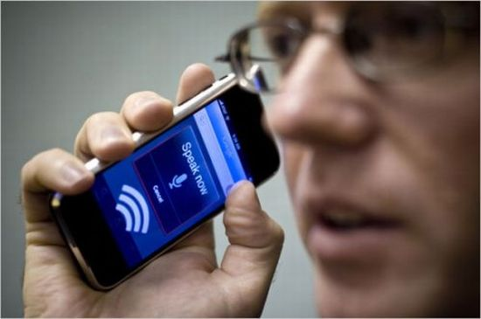
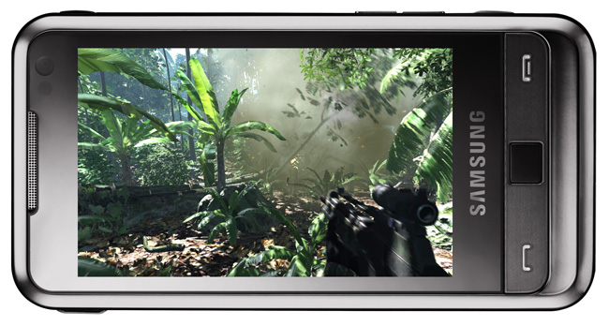
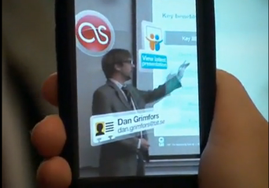
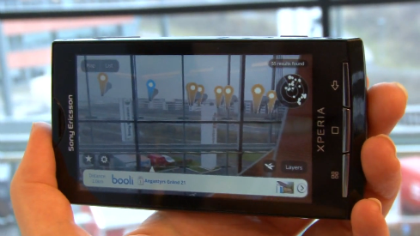
Mobile apps can’t reach their full potential
Slow, Limited or Inaccurate
Not on par with desktop counterparts
Power Intensive
Speech Recognition and Synthesis
Interactive Games
Too CPU intensive
Limited
Augmented Reality

Slide 4
One Solution: Remote Execution
Remote execution can reduce energy consumption
Challenges:
  What should be offloaded?
  How to dynamically decide when to offload?
  How to minimize the required programmer effort?

Slide 5
MAUI: Mobile Assistance Using Infrastructure
MAUI Contributions:
Combine extensive profiling with an ILP solver
  Makes dynamic offload decisions
  Optimize for energy reduction
  Profile: device, network, application
Leverage modern language runtime (.NET CLR)
  To simplify program partitioning
  Reflection, serialization, strong typing

Slide 6
Roadmap
Motivation
MAUI system design
  MAUI proxy
  MAUI profiler
  MAUI solver
Evaluation
Conclusion

Slide 7
MAUI Architecture
Application
Application
Maui Runtime
Maui Runtime
Client Proxy
Server Proxy
RPC
Profiler
Profiler
RPC
Solver
Solver
Maui Controller
Smartphone
Maui server

Slide 8
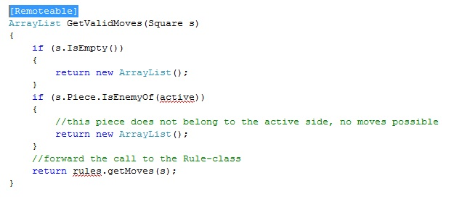
How Does a Programmer Use MAUI?
Goal: make it dead-simple to MAUI-ify apps
  Build app as a standalone phone app
  Add .NET attributes to indicate “remoteable”
  Follow a simple set of rules

Slide 9
Language Run-Time Support For Partitioning
Portability:
  Mobile (ARM) vs Server (x86)
  .NET Framework Common Intermediate Language
Type-Safety and Serialization:
  Automate state extraction
Reflection:
  Identifies methods with [Remoteable] tag
  Automates generation of RPC stubs

Slide 10
MAUI Proxy
Application
Application
Maui Runtime
Maui Runtime
Handles Errors
Client Proxy
Server Proxy
Provides runtime information
RPC
Intercepts Application Calls
Synchronizes State
Profiler
Profiler
RPC
Solver
Solver
Chooses local or remote
Maui Controller
Smartphone
Maui server

Slide 11
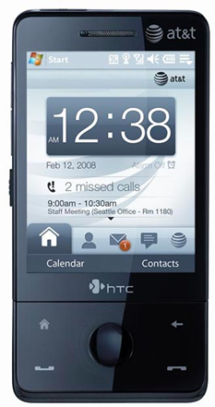
MAUI Profiler
CPU Cycles
State size
Device Profile
Execution Time
Network Latency
Profiler
Callgraph
Network Bandwidth
Computational Power Cost
Computational Delay
Annotated Callgraph
Network Power Cost
Network Delay
Computational Delay

Slide 12
MAUI Solver
A sample callgraph
C
5000 mJ
3000 ms
10000 mJ
A
1000mJ
B
900 mJ
15ms
Energy and delay for state transfer
Computation energy and delay for execution
25000 mJ
D
15000 mJ
12000 ms

Slide 13
Is Global Program Analysis Needed?
Yes! – This simple example from Face Recognition app shows why local analysis fails.
InitializeFace
Recognizer
5000 mJ
10000 mJ
User
Interface
1000mJ
FindMatch
900 mJ
Cheaper to do local
25000 mJ
DetectAndExtract Faces
15000 mJ

Slide 14
Is Global Program Analysis Needed?
Yes! – This simple example from Face Recognition app shows why local analysis fails.
InitializeFace
Recognizer
5000 mJ
10000 mJ
Cheaper to do local
User
Interface
1000mJ
FindMatch
900 mJ
25000 mJ
DetectAndExtract Faces
15000 mJ
Cheaper to do local

Slide 15
Is Global Program Analysis Needed?
InitializeFace
Recognizer
User
Interface
1000mJ
FindMatch
25900mJ
Cheaper to offload
DetectAndExtract Faces

Slide 16
Can MAUI Adapt to Changing Conditions?
Adapt to:
  Network Bandwidth/Latency Changes
  Variability on method’s computational requirements
Experiment:
  Modified off the shelf arcade game application
  Physics Modeling (homing missiles)
  Evaluated under different latency settings

Slide 17
Can MAUI Adapt to Changing Conditions?
HandleEnemies
11KB + missiles
11KB + missiles
DoFrame
DoLevel
HandleBonuses
11KB + missiles
missiles
Required state is smaller
HandleMissiles
Complexity increases with # of missiles
*Missiles take around 60 bytes each

Slide 18
Case 1
HandleEnemies
Zero Missiles
Low latency (RTT < 10ms)
DoFrame
DoLevel
HandleBonuses
Offload starting at DoLevel
HandleMissiles
Computation cost is close to zero
*Missiles take around 60 bytes each

Slide 19
Case 2
HandleEnemies
5 Missiles
Some latency (RTT = 50ms)
DoFrame
DoLevel
HandleBonuses
Very expensive to offload everything
Little state to offload
HandleMissiles
Only offload Handle Missiles
Most of the computation cost
*Missiles take around 60 bytes each

Slide 20
Roadmap
Motivation
MAUI system design
  MAUI proxy
  MAUI profiler
  MAUI solver
Evaluation
Conclusion

Slide 21
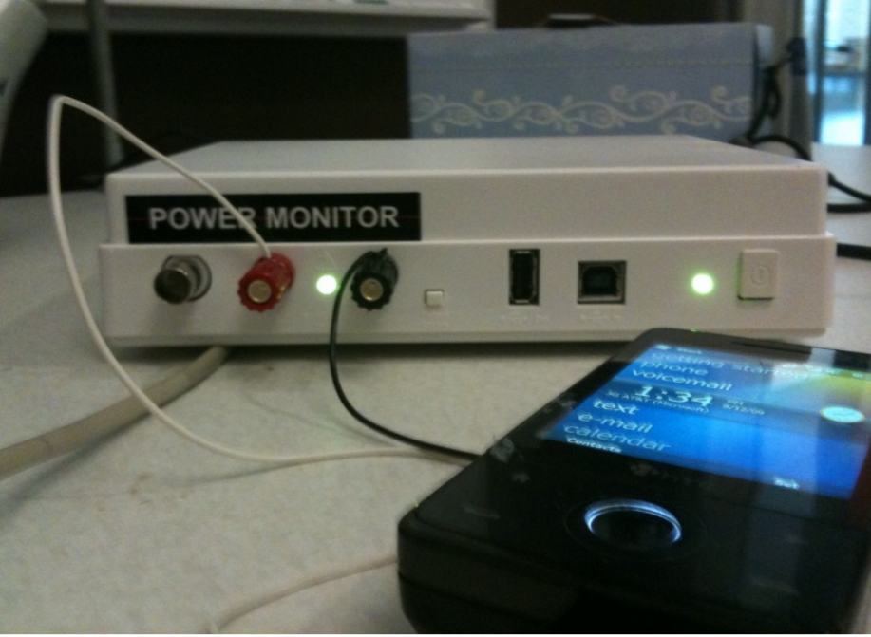
MAUI Implementation
Platform
  Windows Mobile 6.5
  .NET Framework 3.5
  HTC Fuze Smartphone
  Monsoon power monitor
Applications
  Chess
  Face Recognition
  Arcade Game
  Voice-based translator

Slide 22
Questions
How much can MAUI reduce energy consumption?
How much can MAUI improve performance?
Can MAUI Run Resource-Intensive Applications?

Slide 23
How much can MAUI reduce energy consumption?
Face Recognizer
An order of magnitude improvement on Wi-Fi
Big savings even on 3G

Slide 24
How much can MAUI improve performance?
Face Recognizer
Improvement of around an order of magnitude

Slide 25
Latency to server impacts the opportunities for fine-grained offload
Solver would decide not to offload
Arcade Game
Up to 40% energy savings on Wi-Fi

Slide 26
Can MAUI Run Resource-Intensive Applications?
Translator
Can be run on the phone with MAUI
CPU Intensive even on a Core 2 Duo PC

Slide 27
Roadmap
Motivation
MAUI system design
  MAUI proxy
  MAUI profiler
  MAUI solver
Evaluation
Conclusion

Slide 28
Conclusions
MAUI enables developers to:
  Bypass the resource limitations of handheld devices
  Low barrier entry: simple program annotations
For a resource-intensive application
  MAUI reduced energy consumed by an order of magnitude
  MAUI improved application performance similarly
MAUI adapts to:
  Changing network conditions
  Changing applications CPU demands

Slide 29
Questions?
http://research.microsoft.com/en-us/projects/maui/
ecuervo@cs.duke.edu

